Slide 1

Procrastination
WCU Success Coaching

Slide 2

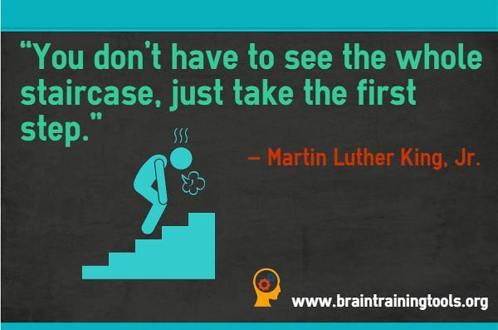
What is Procrastination?
Why we keep putting things off, despite the consequences? Don't worry; we all do it
1. Procrastination is the act of delaying or putting off tasks until the last minute or past their deadline. It's not just a time management problem. Researchers suggest that it's a failure in self-regulation that leads us to act irrationally
2.Passive Procrastinators: Delay the task because they have trouble making decisions and acting on them
3.Active procrastinators: Delay the task purposefully because working under pressure allows them to "feel challenged and motivated”.
(K. Cherry, 2024)

Slide 3
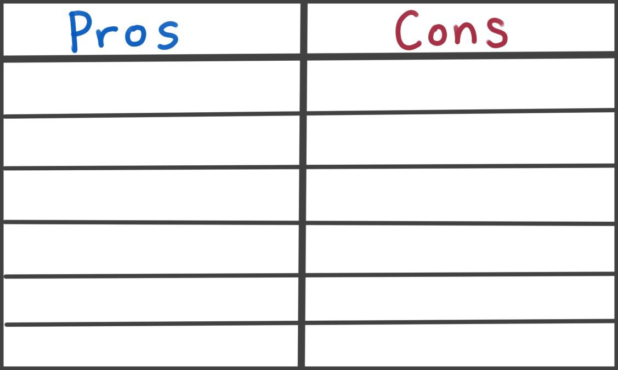
Why Do we Procrastinate?
1. Not knowing what needs to be done
2.Not knowing how to do something
3.Not wanting to do something
4.Not caring if it gets done or not
5. Not caring when something gets done
6. Not feeling in the mood to do it
7. Being in the habit of waiting until the last minute
8. Believing that you work better under pressure
9. Thinking that you can ﬁnish it at the last minute
10. Lacking the initiative to get started
11. Forgetting
12. Blaming sickness or poor health
13. Waiting for the right moment
14. Needing time to think about the task
15. Delaying one task in favor of working on another
(K. Cherry, 2024)
Notes:
Thumbs up if you have, thumbs down if you have never.

Slide 4


How Common Is Procrastination?
While some people are better at motivating themselves to tackle unpleasant tasks,
procrastination is a highly prevalent problem. Among college students, nearly all admitted
to procrastinating sometimes, while 75% described themselves as habitual procrastinators.
(K. Cherry, 2024)

Slide 5

What’s Next?
We often assume that projects won't take as long to ﬁnish as they really will -leads to a false sense of security - believing that we still have plenty of time to complete these tasks
Biggest factor contributing to procrastination is the notion that we have to feel inspired or
motivated to work on a task at a particular moment
Waiting for motivation isn't the only problem that contributes to procrastination:
Academics, Present Bias, Depression, OCD, ADHD are also contributing factors
Procrastination can have a serious impact on many life areas, including a person's mental
and social health, professional, and ﬁnancial well-being
(K. Cherry, 2024)

Slide 6

Advice on Completing Tasks- Hosted by therapist Amy Morin, LCSW, this episode of The Verywell Mind Podcast. Click Link!
https://megaphone.link/MERE2827488043
Make a to-do list: To help keep you on track, consider placing a due date next to each item.
Take baby steps: Break down the items on your list into small, manageable steps so that your tasks
don’t seem so overwhelming.
Recognize the warning signs: Pay attention to any thoughts of procrastination and do your best to
resist the urge. If you begin to think about procrastinating, force yourself to spend a few minutes
working on your task.
Eliminate distraction: Ask yourself what pulls your attention away the most—whether it's
Instagram, Facebook updates, or the local news—and turn off those sources of distraction.
Pat yourself on the back: When you ﬁnish an item on your to-do list on time, congratulate yourself
and reward yourself by indulging in something you ﬁnd fun.
MEET WITH A SUCCESS COACH!
(K. Cherry, 2024)

Slide 7
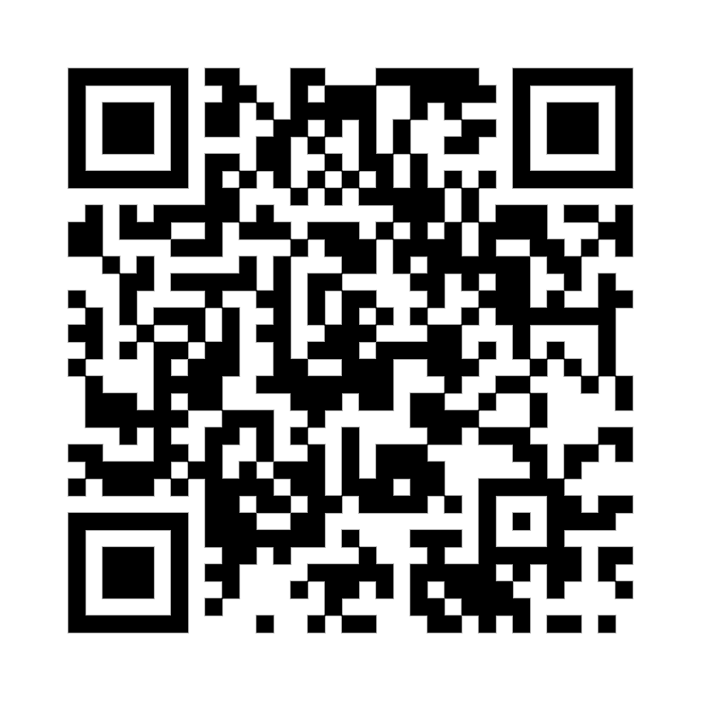

Thank You!
To receive more assistance on ways to avoid Procrastination,
Schedule with a Success Coach!
220 Lawrence Center
Phone: (610) 436-1067
Email: successcoaching@wcupa.edu

Slide 8
Reference:
Cherry, K. (2024, July 7). What is procrastination?. Verywell Mind. https://www.verywellmind.com/the-psychology-of-procrastination-2795944

