Slide 1



Modern
DIGITAL LEARNING
Success Coaching

Slide 2

Introduction to D2L
Where to find D2L?
https://d2l.wcupa.edu/d2l/home
What is D2l?
Brightspace by D2L is the Learning Management System used by the university to support education and offers a highly personal learning experience that connects faculty and students to collaborative learning tools, activities, resources and content. We refer to Brightspace as D2L. D2L is the company that created our Learning Management System.
Need Technical Support?
The Instructional Technology Support and Systems team supports students, faculty, and staff in the use of Instructional Technology tools such as D2L, Zoom, Panopto, Qualtrics, and external tool integrations.
Phone: 610-436-3350
Hours: Monday - Friday, 8:00am - 4:30pm

Slide 3
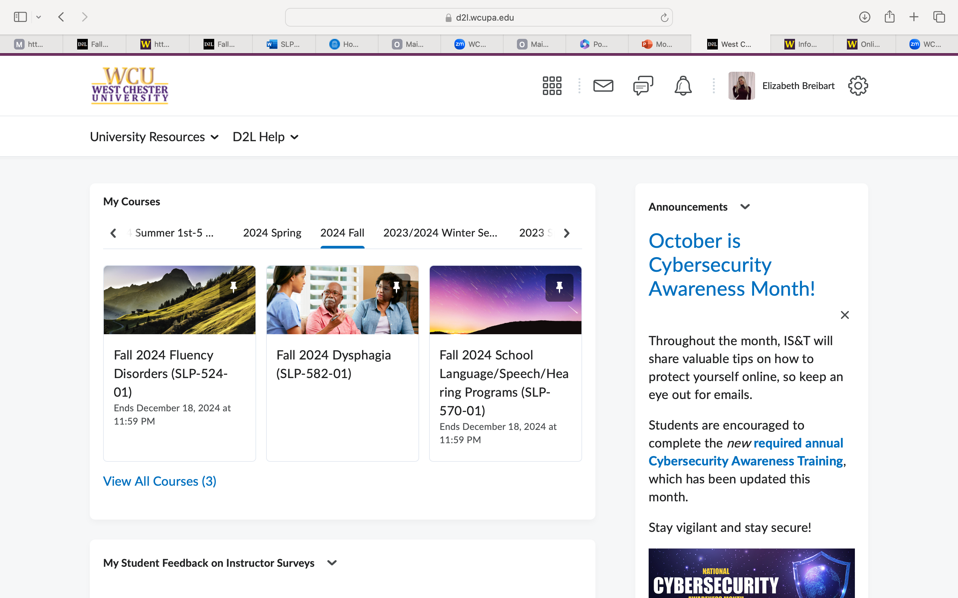
D2L homepage https://d2l.wcupa.edu/d2l/home

Slide 4
D2L HOMEPAGE broken down
SEARCH
FOR
COURSE
MESSAGE CONVERSATION UPDATE
ALERTS ALERTS ALERTS
YOUR PROFILE
​YOUR CURRENT COURSES

Slide 5
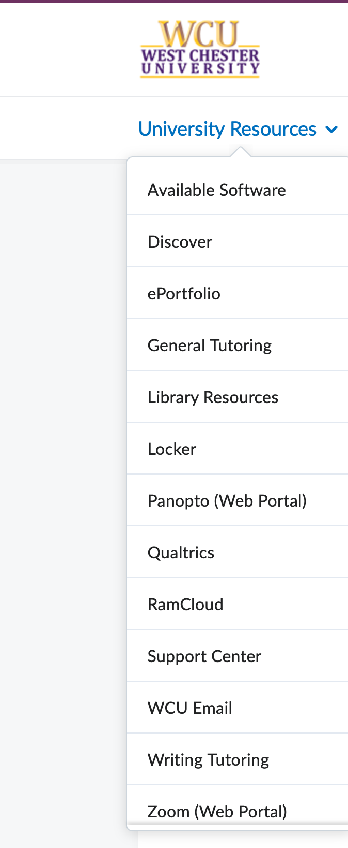
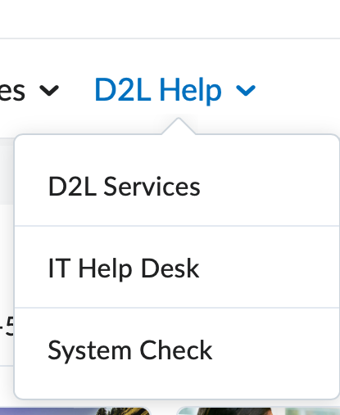
MAKE THE MOST OF YOUR RESOURCES!

Slide 6
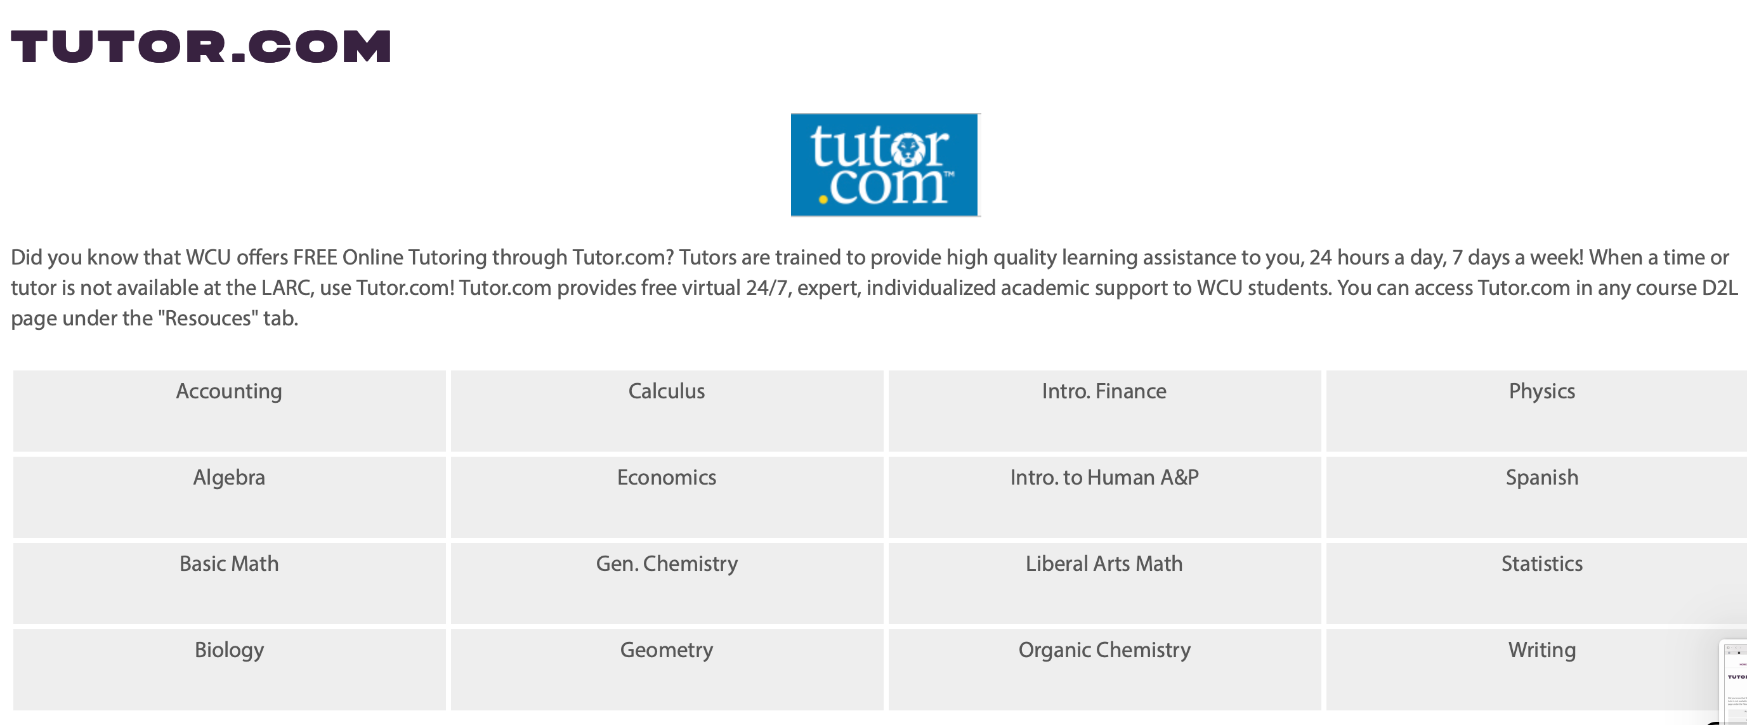
MAKE THE MOST OF YOUR RESOURCES!
Did you know that WCU offers FREE Online Tutoring through Tutor.com? Tutors are trained to provide high quality learning assistance to you, 24 hours a day, 7 days a week!
When a time or tutor is not available at the LARC, use Tutor.com! Tutor.com provides free virtual 24/7, expert, individualized academic support to WCU students. You can access Tutor.com in any course D2L page under the "Resources" tab.

Slide 7

Introduction to Digital Learning
What is Digital Learning?
The use of technology and internet-based resources for education.
Examples: Online classes, eBooks, mobile learning apps, and virtual tutoring.
Why is it important?
Flexibility in learning anytime, anywhere.
Access to a wide range of resources and tools.
Opportunities for personalized learning and global collaboration.

Slide 8

Getting Started with Digital Learning
Choosing the Right Platform:
University learning management systems (EX: D2L).
Setting Up a Productive Learning Space:
Quiet, well-lit area.
Stable internet connection.
Comfortable seating and a tidy desk setup.
Digital Learning Essentials:
Laptop or tablet.
Headphones for concentration.
Notetaking app (OneNote, Notion) or traditional notebook.

Slide 9

Digital Learning Techniques
1. Time Management in a Digital Space:
Create a study schedule with clear time blocks for online lectures, assignments, and self-study.
Use productivity apps (EX: Google Calendar) to track deadlines and tasks.
2. Maximizing Online Classes:
Engage actively: Participate in discussions, ask questions, and interact with peers.
Turn on your camera to stay engaged and alert.
3. Note-taking and Organization:
Use apps like Evernote or Notion to organize notes by subject, topic, and date.
Consider recording lectures (with permission) and reviewing key points.

Slide 10
Using Digital Resources
eBooks & Online Articles:
Access digital libraries and databases (EX: Google Scholar, JSTOR).
Video-Based Learning:
YouTube educational channels, TED Talks, or Khan Academy for visual learning.
Interactive Tools:
Quizlet for digital flashcards.
Kahoot! for interactive quizzes.
Virtual Study Groups:
Organize Zoom or Microsoft Teams study sessions with classmates.
Use collaborative tools like Google Docs for group assignments.

Slide 11
Overcoming Challenges in Digital Learning
Dealing with Distractions:
Turn off notifications and use "Do Not Disturb" mode.
Use tools like timers to stay focused.
Staying Motivated:
Set small, achievable goals for each study session.
Take regular breaks to prevent burnout (e.g., the 25-5 Pomodoro method).

Slide 12
Maximizing Digital Learning for Your Success
Tips for Effective Learning:
  Review lecture materials before and after class.
  Utilize professor office hours and virtual tutoring services for additional help.
Health & Wellness:
  Maintain a healthy work-life balance by scheduling time for physical activity and relaxation.
  Use apps like Headspace or Calm for mindfulness and stress management.

Slide 13
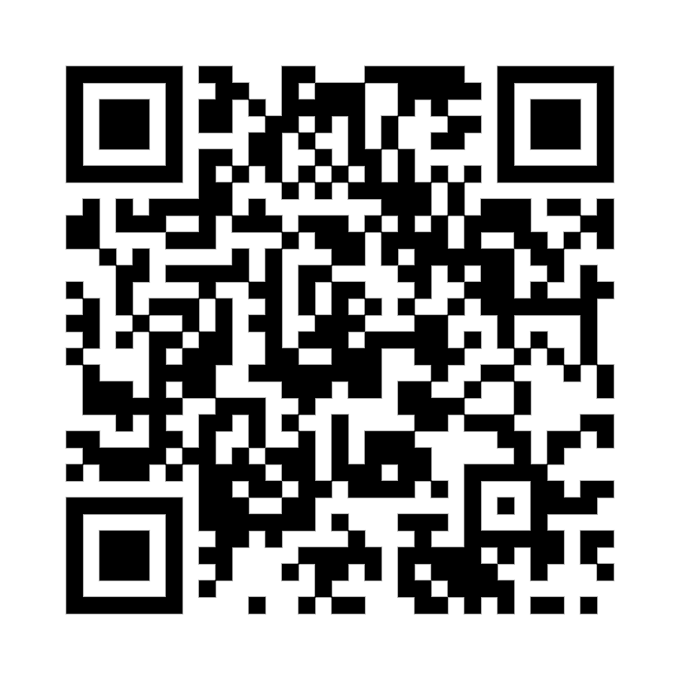
Lawrence Center- 220
Phone: (610) 436-1067
Email: successcoaching@wcupa.edu
thank you!
To receive assistance with Digital Learning, Schedule with a Success Coach!

