Slide 1
Goal Setting
The Success Coaching Team Lawrence Building 220

Slide 2
Goals: Why are they Important for Success?
❏ Goals are an important part for success in a student’s academics, social life, ﬁtness goals, and extracurriculars.
❏ What are some goals you may have?
❏ Some examples of goals:
❏ Academic: I will raise my Chemistry grade from a C to a B within the next 2 months by studying 2 nights a week.
❏ Social: I will try to talk to one new peer in each of my classes every day for the ﬁrst month of the semester.
❏ Fitness: I will decrease my mile time from 9 minutes to 8 minutes in the next 2 months by running at least 4 times a week.
❏ Extracurriculars: I will become Vice President of the Chess Club next year by showing up to all meetings and taking the time to know each member.

Slide 3

Motivation to Achieve your Goals
❏ Being motivated to achieve your goal will make it more likely you can achieve said goal.
❏ When trying to ﬁnd motivation to achieve your goals, be sure to avoid distractions such as too much screen time, socializing, etc.
❏ What are some things that can positively motivate you to achieve goals?
Examples of motivators:
❏ Family
❏ Friends
❏ School
❏ Community

Slide 4
SMART Goals
❏ What is a SMART Goal? A SMART goal is an acronym that explains what should be included when ﬁrst creating a goal you want to achieve in the future.
❏ S: Speciﬁc. A goal should be speciﬁc enough that you know exactly what it is you
wish to achieve.
❏ M: Measurable. A goal should be able to be measured in some way.
❏ A: Achievable. Make sure when setting goals, they are not out of reach. Being sure to understand what you can realistically achieve and applying that to your goal can increase motivation and make it more likely you will achieve this goal.
❏ R: Relevant. Make sure your goal is relevant to something you would like to
change in your life. If you are taking the time to achieve something, you must make sure it is worth it.
❏ T: Time Bound. SMART goals should have some sort of time limit.

Slide 5
Examples of SMART Goals
❏ Speciﬁc: “I will become vice president of the Chess Club…..”
❏ By being speciﬁc, this person would know exactly what position they wanted to be elected for and of what club.
❏ Measurable: “I will raise my chemistry grade from a C to a B…”
❏ This person has measured in letter grades how much they would like to improve their score.
❏ Achievable: “I will decrease my mile time from 9 minutes to 8 minutes in 2 months….”
❏ This person is making sure their goal is achievable within the amount of time they have given themselves to achieve it. For example, if the person wanted to decrease their time from 9 minutes to 5 minutes in 2 month, that is likely not realistic.
❏ Relevant: I will raise my Statistics grade this semester because if not, I will fail the class”
❏ This person is choosing to make a goal for something that is relevant to their academic success. If they did not focus their goal on a class they are struggling in, it may be detrimental for their success.
❏ Time Bound: “I will study for 2 hours a night for the next week to prepare for my exam.”
❏ This person has given themselves a timeline to achieve their goal.

Slide 6
After Creating Your Goal
❏ After creating your SMART goal, it is important to
❏ Implement the goal you have created
❏ Find a way to keep yourself accountable
❏ Track your success
❏ Are you on track with the timeline you gave yourself to achieve the goal?
❏ Is the goal still relevant or does it need to be altered?
❏ Make sure your motivation is still high
❏ Reward yourself for your achievements!

Slide 7
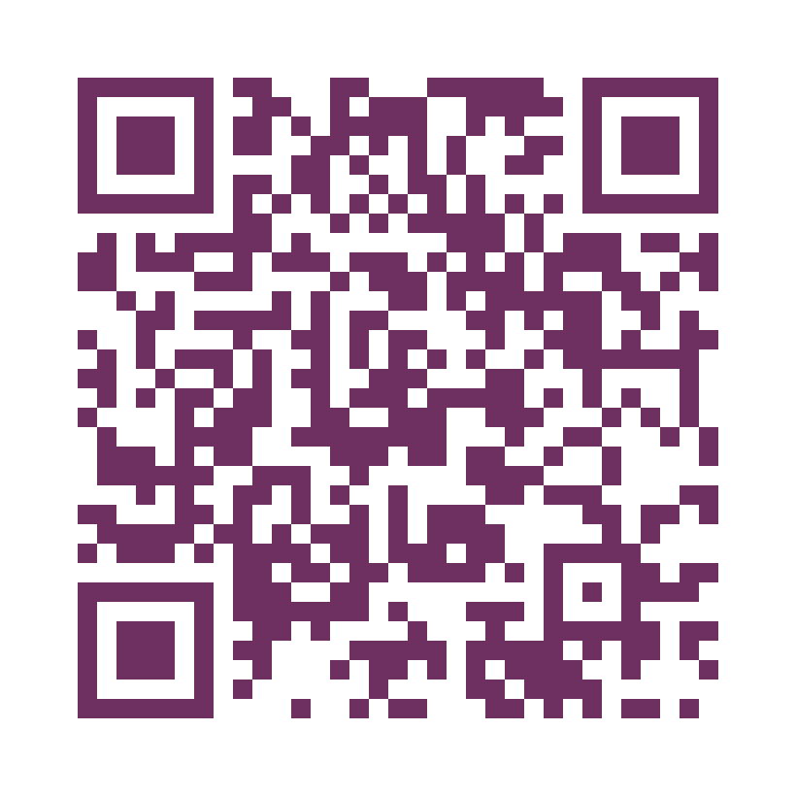
Summary
❏ Goal setting should not be a scary thing, be conﬁdent in yourself and create a goal that works best for you.
❏ As Success Coaches, we are here to help. Feel free to make an appointment with us at any time. We’re happy to help!
Click here to Schedule an Appointment
Email: successcoaching@wcupa.edu
Phone: 610-436-1067

