Slide 1
My Brain Hurts…
Lauren Weaver

Slide 2
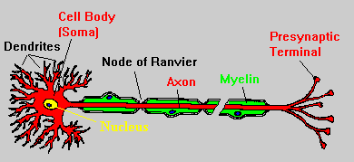
Neurons have three main structures
  Cell Body
  Dendrites
    Receive information from other cells
  Axon
    Carries information from the cell body to other neurons

Slide 3
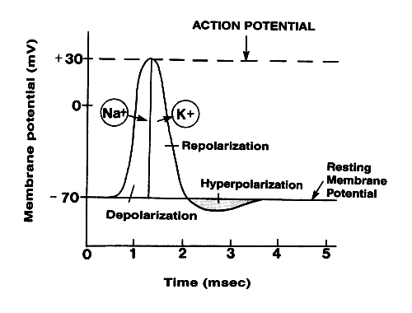
Information is transmitted via action potentials
Action potentials cause a massive change in the membrane potential of the cell

Slide 4
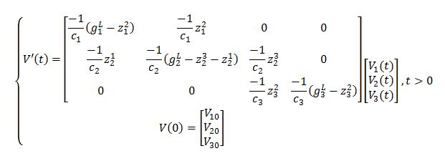
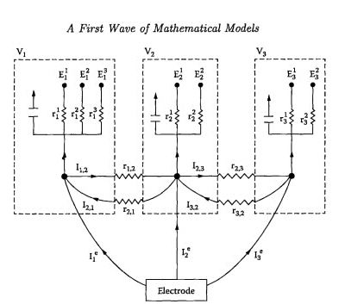
Mulit-Compartmental Membrane Potential Model

Slide 5
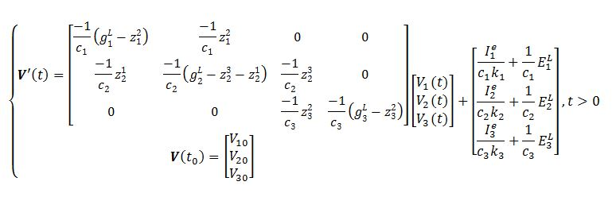
Non-Homogeneous MCMP

Slide 6
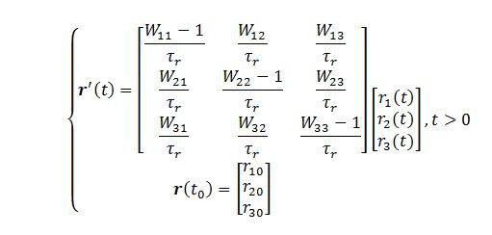
Recurrent Network Firing-Rate Model

Slide 7
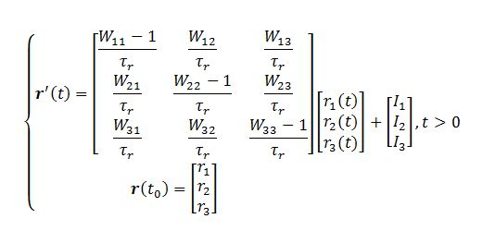
Non-Homogeneous RNFR Model

Slide 8
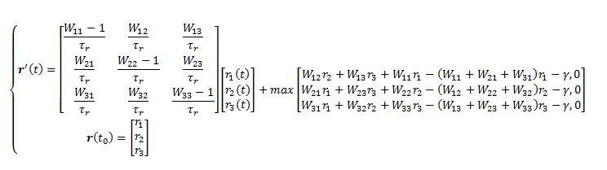
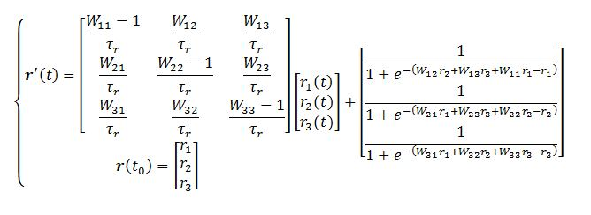
Semi-Linear RNFR Models

