Slide 1
Building the Foundation of Earthquakes
Presented by
Paul Johnson

Slide 2
Why study earthquake engineering?
Earthquakes are a devastating natural disaster:
Average of 10,000 people perish annually [2]
Severe economic and infrastructure loss
Extensive recovery timeframe
Sociological impact

Slide 3
What causes earthquakes?
Rapid release of elastic energy from rock [8]
  Volcanic eruptions [2]
  Collapse of underground infrastructure [2]
  Aftershocks/tremors
  Crust dislocations : Plate Tectonic Theory [2]
    Normal fault : divergent boundary
    Reverse fault : convergent boundary
    Strike-slip fault : transform boundary

Slide 4
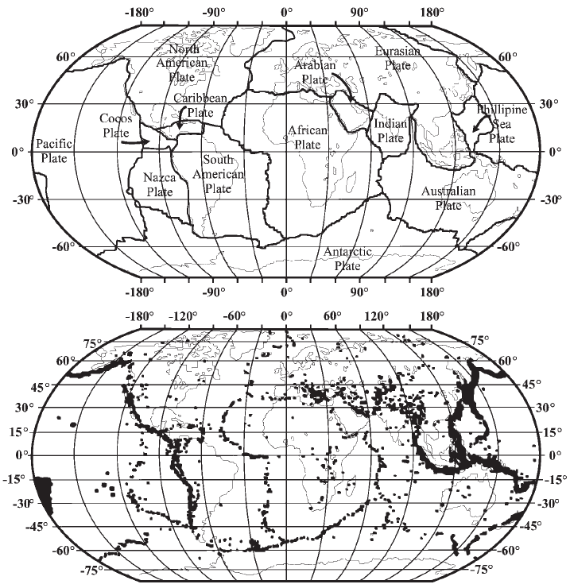
Top: The 15 tectonic plates; Bottom: Plot of earthquake epicenters [2]

Slide 5
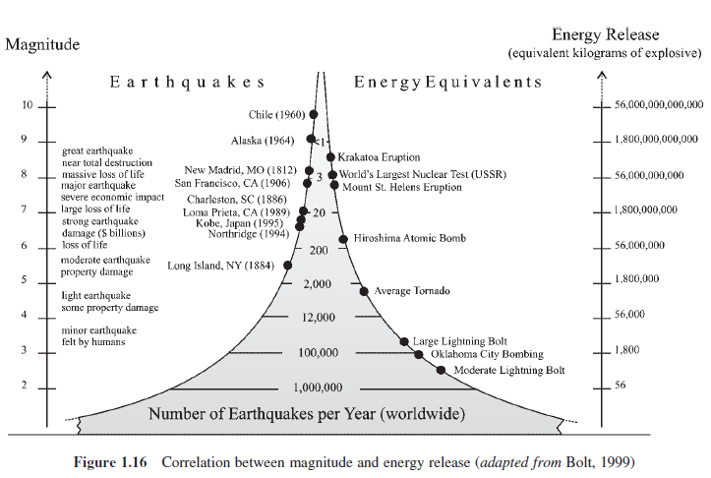
[2]
Moment Magnitude scale: 32x per level

Slide 6
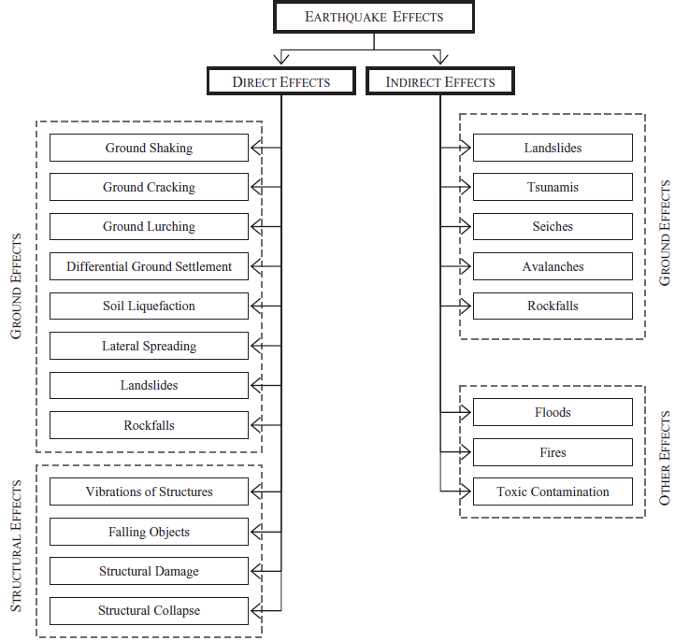
Direct and indirect effects of earthquakes [2]

Slide 7
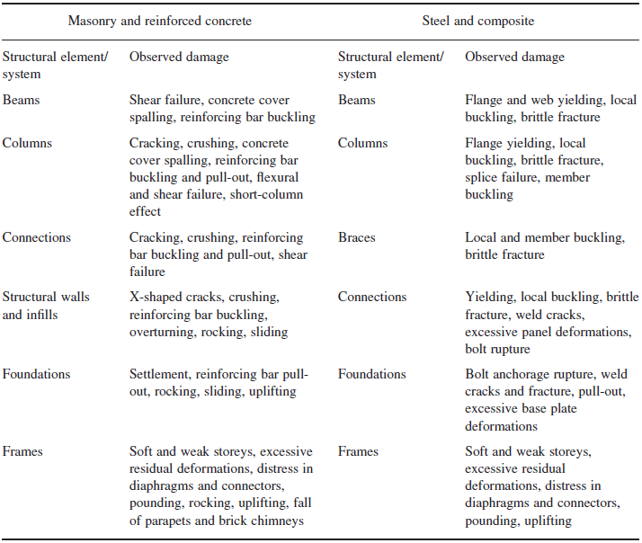
Types of damage to structures [2]

Slide 8
Structural response characteristics
Stiffness: resistance of deformations, rigidity
Strength: level of reversible (elastic) deformation
Yield Strength: point of exceeding elasticity
Ultimate Strength: point of total yielding
Ductility: durability beyond elastic deformation (plasticity)

Slide 9
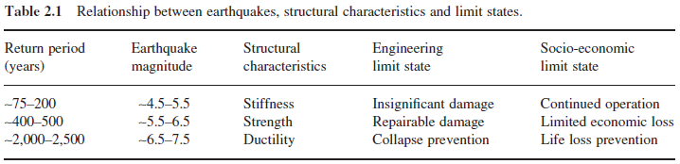
Structural response contributions
[2]
Stiffness: non-structural damage
Strength: repairable structural damage
Ductility: preventing total yielding

Slide 10
Structural Analysis
  Equivalent lateral-force procedure: Discretization of masses [3]
Modal analysis procedure [7]
  N modes for N-degree freedom
  Natural frequencies of modes
  System response as linear combination
Push-over (static) Analysis: stiffness, strength, ductility [2]
Inelastic Response: adaptive/dynamic push-over

Slide 11
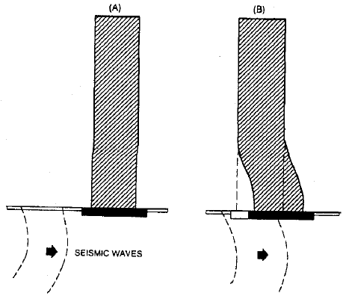
Floor Displacement Model
[3]
Horizontal Spring Mass System
With and without dampening

Slide 12

Higher Order substitutions
$$y_{1}^{′}(t)=x_{1}^{′}(t)=y_{2}\left(t\right),y_{2}^{′}(t)=x_{1}^{′′}\left(t\right),…,y_{9}′\left(t\right)=x_{5}′\left(t\right)=y_{8}(t),y_{10}′\left(t\right)=x_{5}^{′′}\left(t\right)$$
$$My^{′′}\left(t\right)+Cy^{′}\left(t\right)+Ky\left(t\right)=f\left(t\right)$$
$$A=−\left(M^{−1}K+M^{−1}C\right)$$
$$y^{′′}\left(t\right)=Ay\left(t\right)+f\left(t\right)$$
$${y\left(0\right)=y}_{0}$$

Slide 13
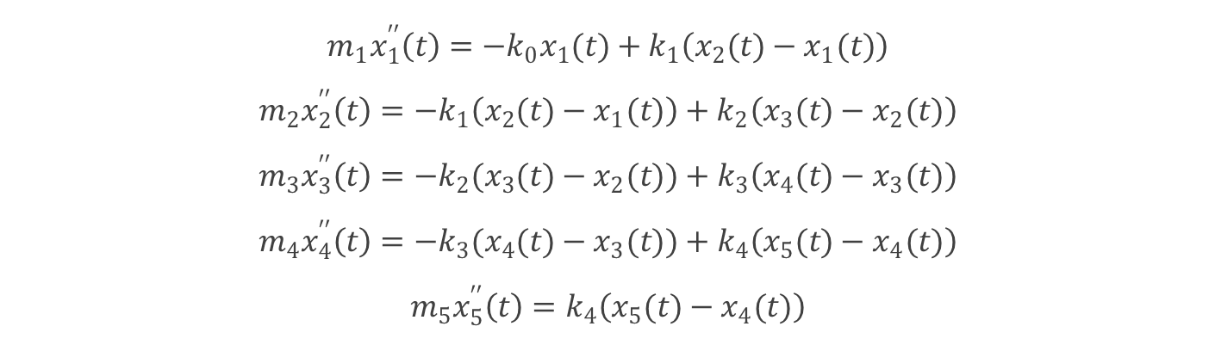
HCP undamped: Relative positions
$$m_{1}x_{1}^{′′}\left(t\right)=−k_{0}x_{1}(t)+k_{1}\left(x_{2}(t)−x_{1}(t)\right)$$
$$m_{2}x_{2}^{′′}\left(t\right)=−k_{1}\left(x_{2}(t)−x_{1}(t)\right)+k_{2}\left(x_{3}(t)−x_{2}(t)\right)$$
$$m_{3}x_{3}^{′′}\left(t\right)=−k_{2}(x_{3}(t)−x_{2}(t))+k_{3}\left(x_{4}(t)−x_{3}(t)\right)$$
$$m_{4}x_{4}^{′′}\left(t\right)=−k_{3}(x_{4}(t)−x_{3}(t))+k_{4}\left(x_{5}(t)−x_{4}(t)\right)$$
$$m_{5}x_{5}^{′′}\left(t\right)=k_{4}\left(x_{5}(t)−x_{4}(t)\right)$$
X(t) relates the displacement from the equilibrium position. K is the spring/stiffness/restoring force. M is the mass.

Slide 14
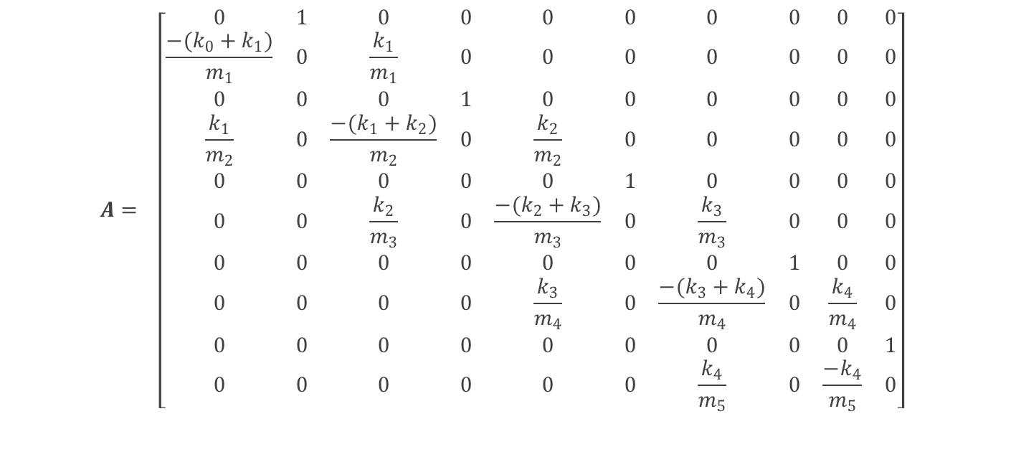
Coefficient Matrix
$$A= \left[\begin{matrix}0 & 1 & 0 & 0 & 0 & 0 & 0 & 0 & 0 & 0 \\ \frac{−(k_{0}+k_{1})}{m_{1}} & 0 & \frac{k_{1}}{m_{1}} & 0 & 0 & 0 & 0 & 0 & 0 & 0 \\ 0 & 0 & 0 & 1 & 0 & 0 & 0 & 0 & 0 & 0 \\ \frac{k_{1}}{m_{2}} & 0 & \frac{−(k_{1}+k_{2})}{m_{2}} & 0 & \frac{k_{2}}{m_{2}} & 0 & 0 & 0 & 0 & 0 \\ 0 & 0 & 0 & 0 & 0 & 1 & 0 & 0 & 0 & 0 \\ 0 & 0 & \frac{k_{2}}{m_{3}} & 0 & \frac{−(k_{2}+k_{3})}{m_{3}} & 0 & \frac{k_{3}}{m_{3}} & 0 & 0 & 0 \\ 0 & 0 & 0 & 0 & 0 & 0 & 0 & 1 & 0 & 0 \\ 0 & 0 & 0 & 0 & \frac{k_{3}}{m_{4}} & 0 & \frac{−(k_{3}+k_{4})}{m_{4}} & 0 & \frac{k_{4}}{m_{4}} & 0 \\ 0 & 0 & 0 & 0 & 0 & 0 & 0 & 0 & 0 & 1 \\ 0 & 0 & 0 & 0 & 0 & 0 & \frac{k_{4}}{m_{5}} & 0 & \frac{−k_{4}}{m_{5}} & 0\end{matrix}\right]$$

Slide 15
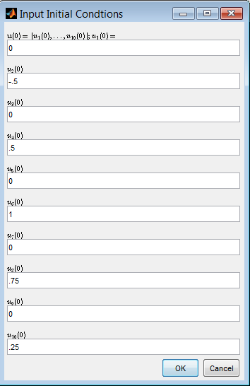
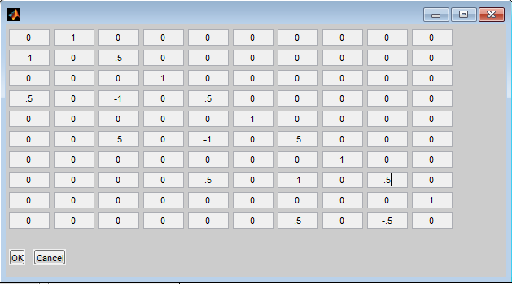
APC Solver
  Every m=10000 kg
  Every k=5000 kg/s²
  Displaced initial positions

Slide 16
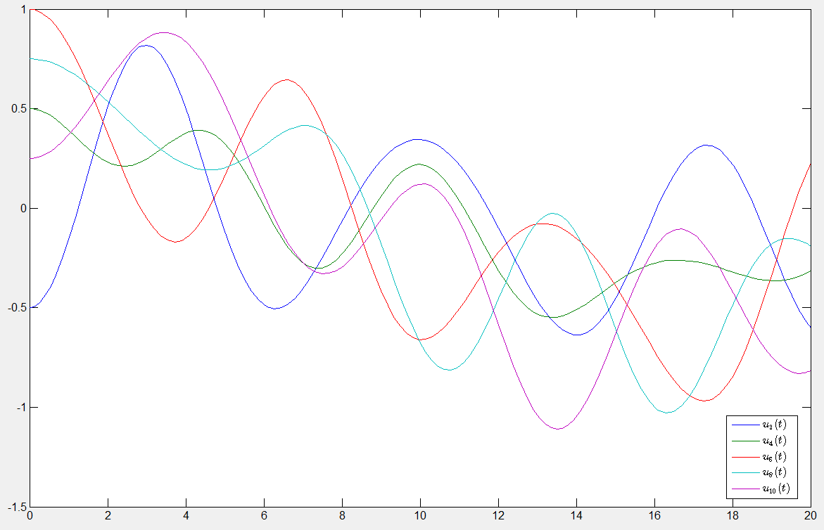
T=20

Slide 17
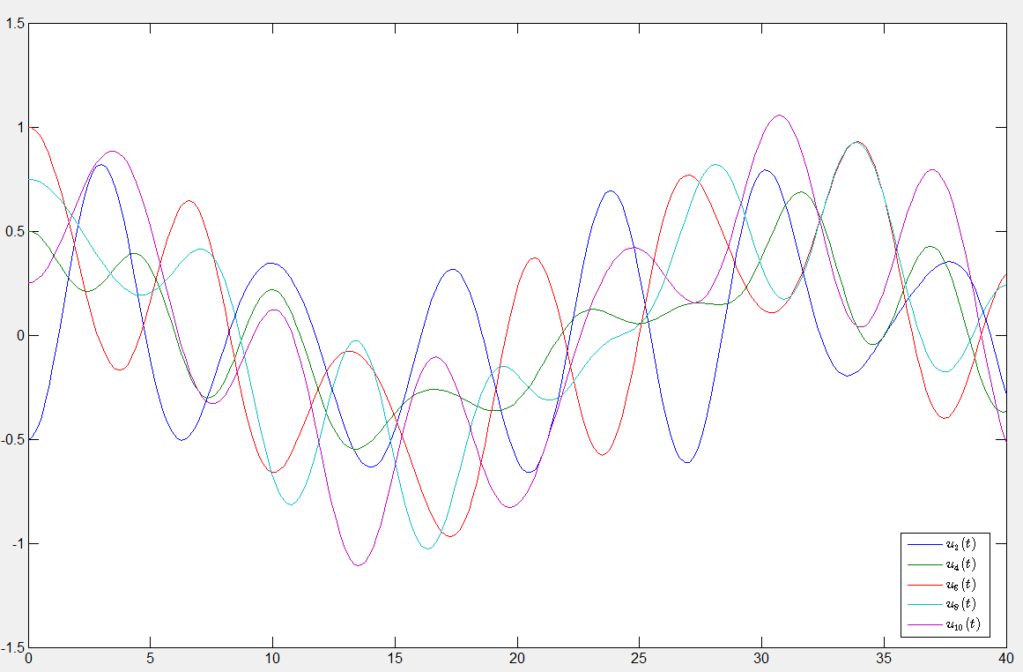
T=40

Slide 18
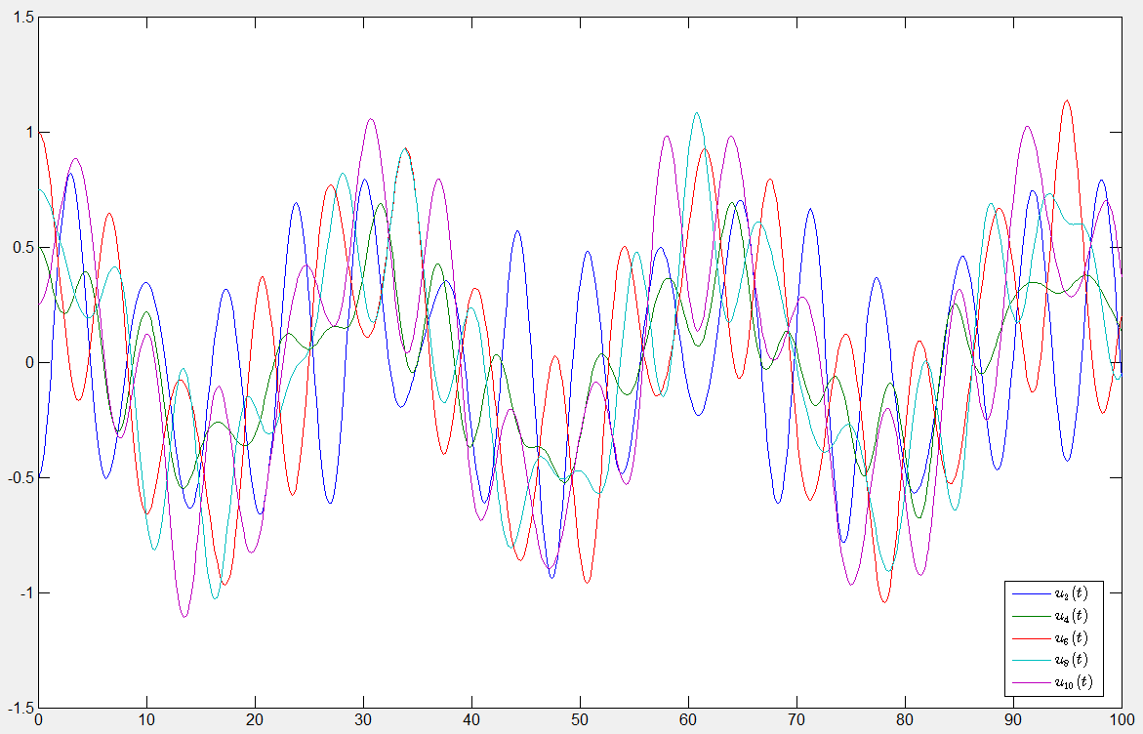
T=100

Slide 19
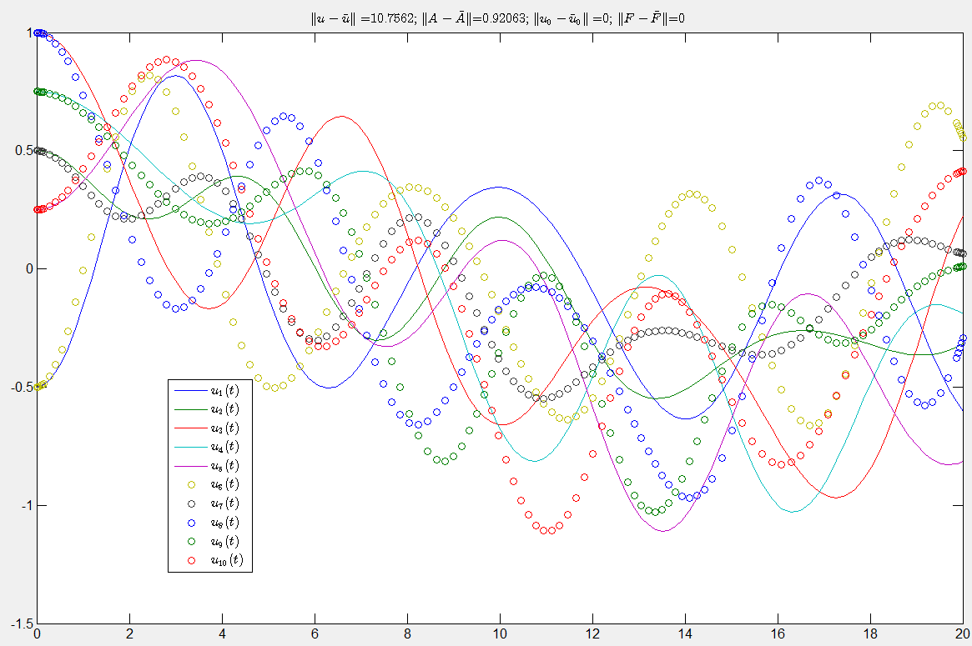
Uniformly increasing restoring force 50% decreases period (*converse for mass*)

Slide 20
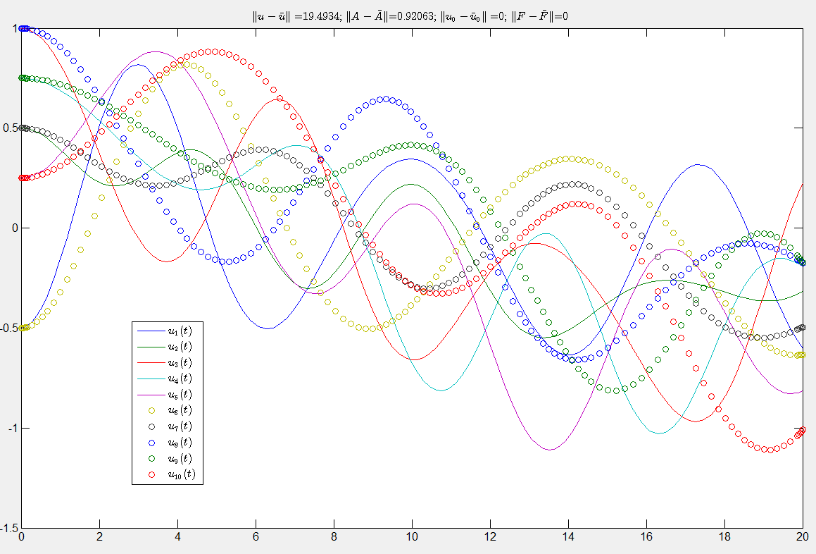
Uniformly decreasing restoring force 50% increases period (*converse for mass*)

Slide 21
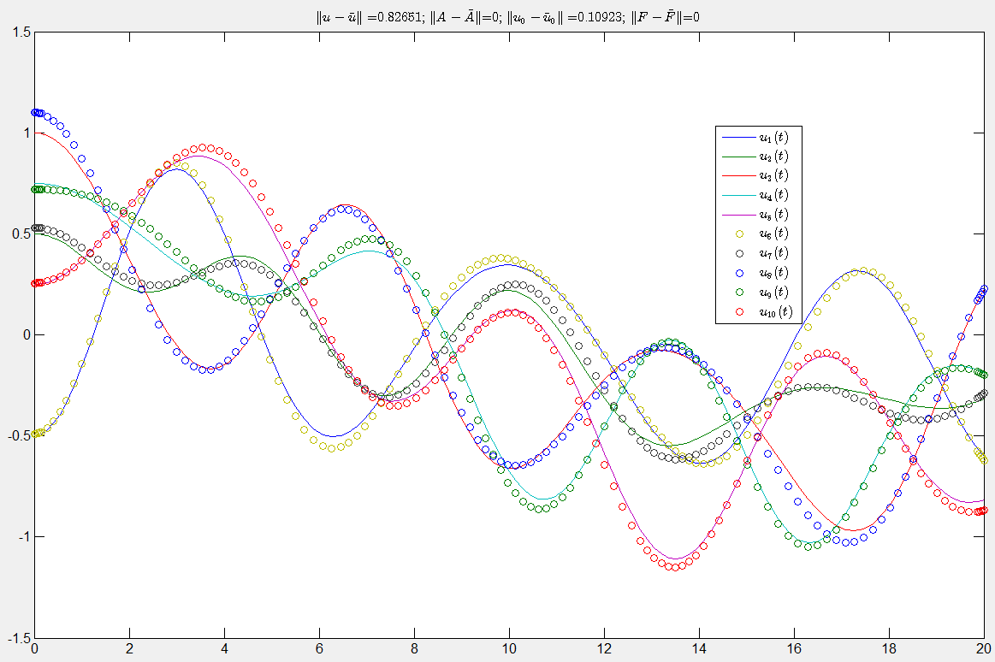
Perturbed Position

Slide 22
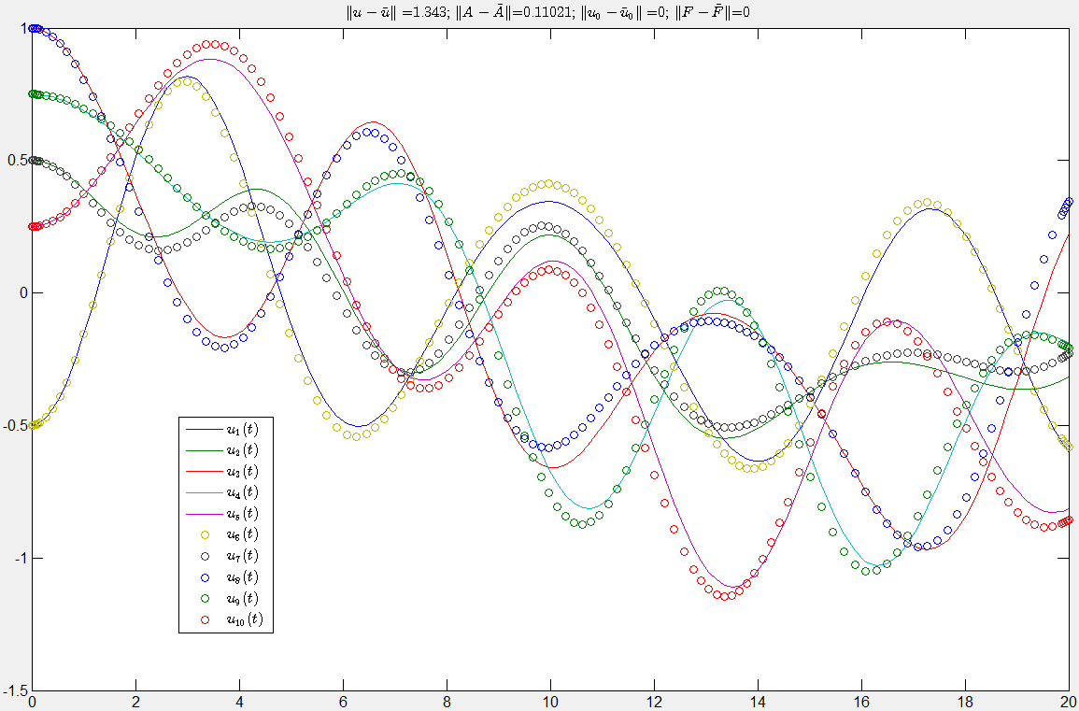
Perturbed stiffness/mass

Slide 23
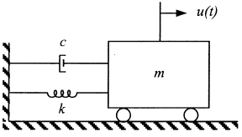
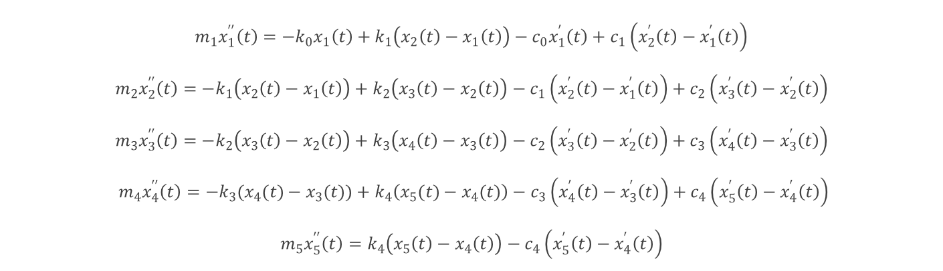
HCP damped: Relative velocities
(proportional to speed)
$$m_{1}x_{1}^{′′}\left(t\right)=−k_{0}x_{1}\left(t\right)+k_{1}\left(x_{2}\left(t\right)−x_{1}\left(t\right)\right)−c_{0}x_{1}^{′}\left(t\right)+c_{1}\left(x_{2}^{′}\left(t\right)−x_{1}^{′}\left(t\right)\right)$$
$$m_{2}x_{2}^{′′}\left(t\right)=−k_{1}\left(x_{2}\left(t\right)−x_{1}\left(t\right)\right)+k_{2}\left(x_{3}\left(t\right)−x_{2}\left(t\right)\right)−c_{1}\left(x_{2}^{′}\left(t\right)−x_{1}^{′}\left(t\right)\right)+c_{2}\left(x_{3}^{′}\left(t\right)−x_{2}^{′}\left(t\right)\right)$$
$$m_{3}x_{3}^{′′}\left(t\right)=−k_{2}\left(x_{3}\left(t\right)−x_{2}\left(t\right)\right)+k_{3}\left(x_{4}\left(t\right)−x_{3}\left(t\right)\right)−c_{2}\left(x_{3}^{′}\left(t\right)−x_{2}^{′}\left(t\right)\right)+c_{3}\left(x_{4}^{′}\left(t\right)−x_{3}^{′}\left(t\right)\right)$$
$${ m}_{4}x_{4}^{′′}\left(t\right)=−k_{3}(x_{4}(t)−x_{3}(t))+k_{4}\left(x_{5}(t)−x_{4}(t)\right)−c_{3}\left(x_{4}^{′}\left(t\right)−x_{3}^{′}\left(t\right)\right)+c_{4}\left(x_{5}^{′}\left(t\right)−x_{4}^{′}\left(t\right)\right)$$
$$m_{5}x_{5}^{′′}\left(t\right)=k_{4}\left(x_{5}\left(t\right)−x_{4}\left(t\right)\right)−c_{4}\left(x_{5}^{′}\left(t\right)−x_{4}^{′}\left(t\right)\right)$$
Horizontal damped spring-mass visualization [5]

Slide 24

Coefficient Matrix
$$A= \left[\begin{matrix}0 & 1 & 0 & 0 & 0 & 0 & 0 & 0 & 0 & 0 \\ \frac{−(k_{0}+k_{1})}{m_{1}} & \frac{−(c_{0}+c_{1})}{m_{1}} & \frac{k_{1}}{m_{1}} & \frac{c_{1}}{m_{1}} & 0 & 0 & 0 & 0 & 0 & 0 \\ 0 & 0 & 0 & 1 & 0 & 0 & 0 & 0 & 0 & 0 \\ \frac{k_{1}}{m_{2}} & \frac{c_{1}}{m_{2}} & \frac{−(k_{1}+k_{2})}{m_{2}} & \frac{−(c_{1}+c_{2})}{m_{2}} & \frac{k_{2}}{m_{2}} & \frac{c_{2}}{m_{2}} & 0 & 0 & 0 & 0 \\ 0 & 0 & 0 & 0 & 0 & 1 & 0 & 0 & 0 & 0 \\ 0 & 0 & \frac{k_{2}}{m_{3}} & \frac{c_{2}}{m_{3}} & \frac{−(k_{2}+k_{3})}{m_{3}} & \frac{−(c_{2}+c_{3})}{m_{3}} & \frac{k_{3}}{m_{3}} & \frac{c_{3}}{m_{3}} & 0 & 0 \\ 0 & 0 & 0 & 0 & 0 & 0 & 0 & 1 & 0 & 0 \\ 0 & 0 & 0 & 0 & \frac{k_{3}}{m_{4}} & 0 & \frac{−(k_{3}+k_{4})}{m_{4}} & \frac{−(c_{3}+c_{4})}{m_{4}} & \frac{k_{4}}{m_{4}} & \frac{c_{4}}{m_{4}} \\ 0 & 0 & 0 & 0 & 0 & 0 & 0 & 0 & 0 & 1 \\ 0 & 0 & 0 & 0 & 0 & 0 & \frac{k_{4}}{m_{5}} & \frac{c_{4}}{m_{5}} & \frac{−k_{4}}{m_{5}} & \frac{−c_{4}}{m_{5}}\end{matrix}\right]$$

Slide 25
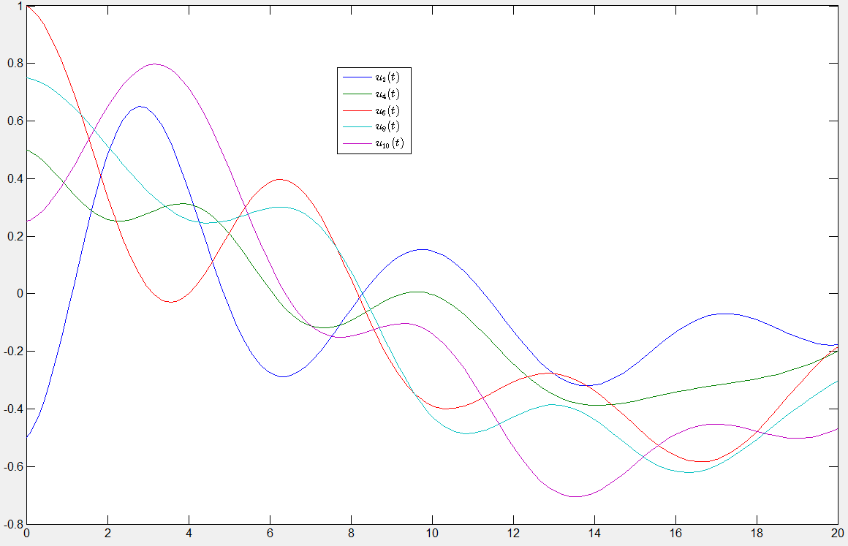
Previous example damped T=20

Slide 26
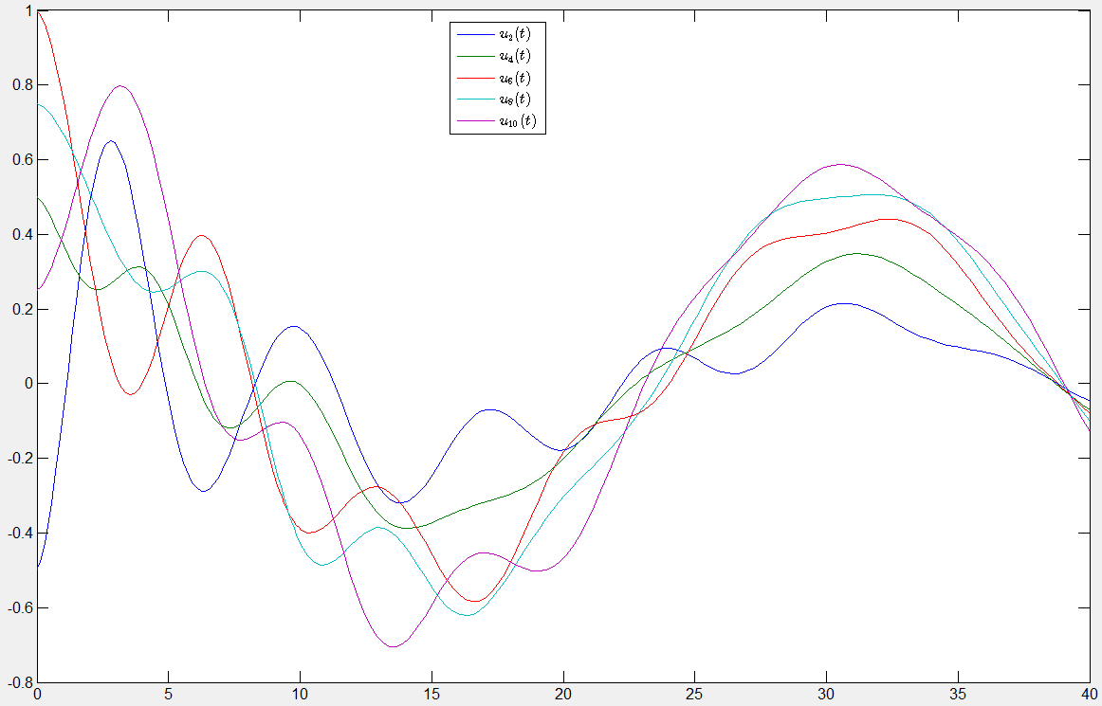
T=40

Slide 27
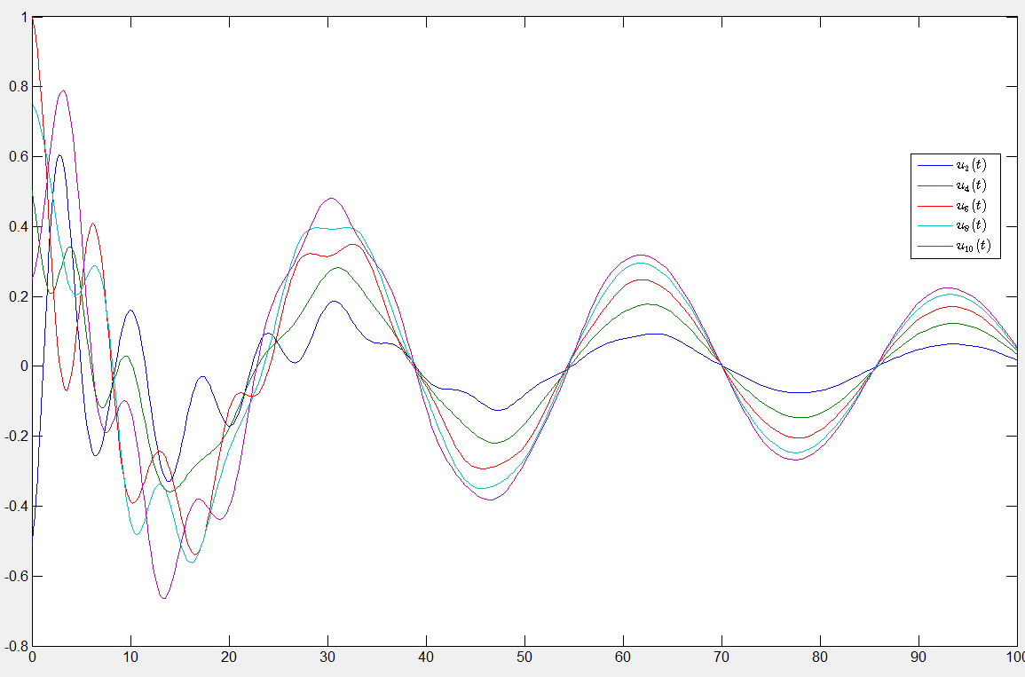
T=100

Slide 28
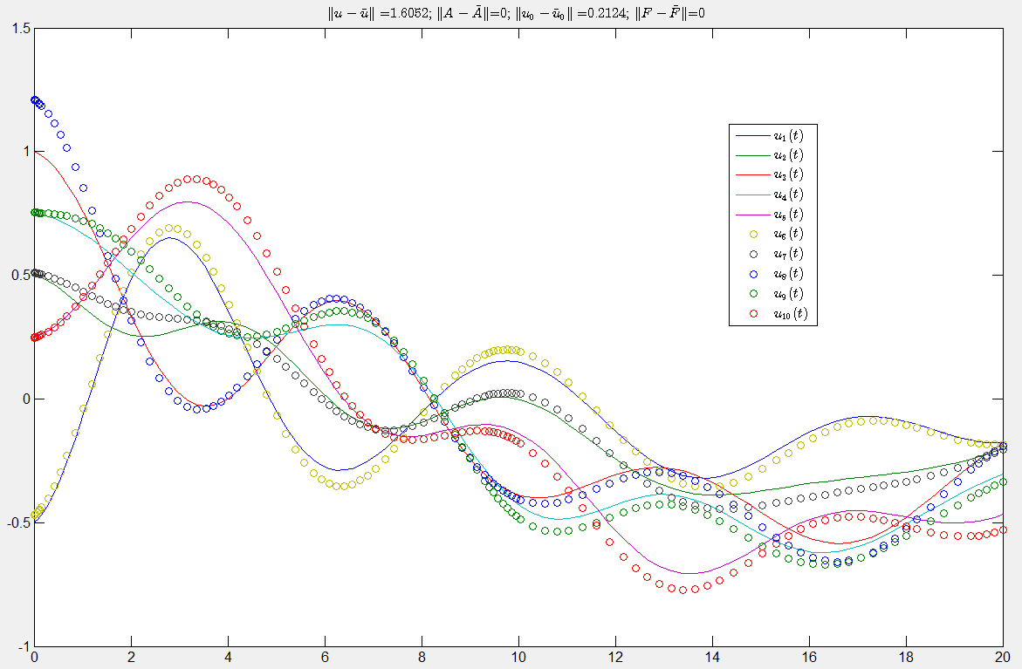
Perturbed T=20

Slide 29
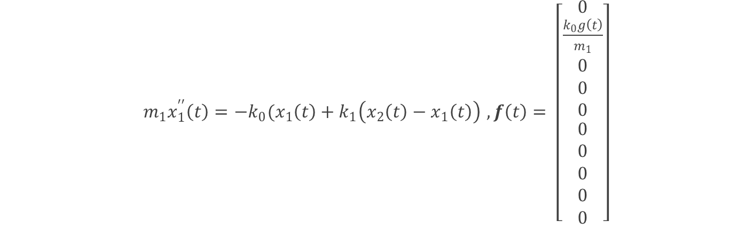
NON-CP: Now with ground movement
$m_{1}x_{1}^{′′}\left(t\right)=−k_{0}(x_{1}\left(t\right)+k_{1}\left(x_{2}\left(t\right)−x_{1}\left(t\right)\right)$ $,f\left(t\right)= \left[\begin{aligned}0 \\ \frac{k_{0}g\left(t\right)}{m_{1}} \\ 0 \\ 0 \\ 0 \\ \begin{aligned}0 \\ 0 \\ 0 \\ 0 \\ 0\end{aligned}\end{aligned}\right]$
Only the first floor has changed
Vector of forcing terms added

Slide 30
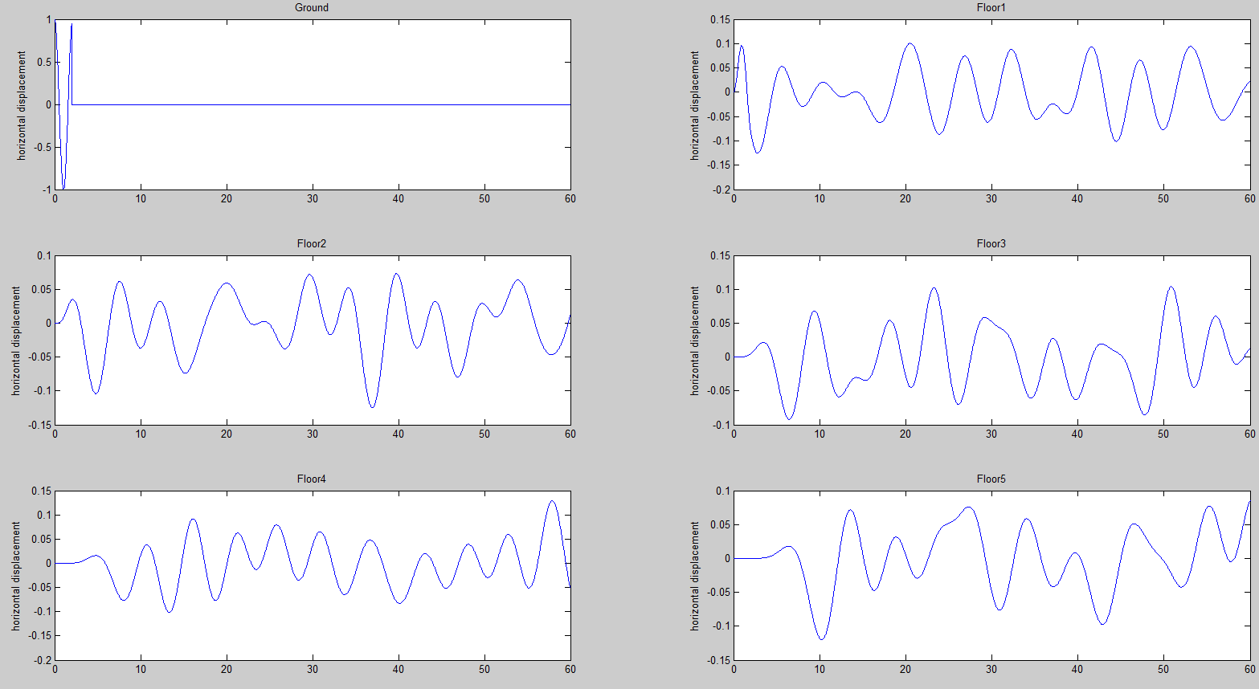
Floor Displacement

Slide 31
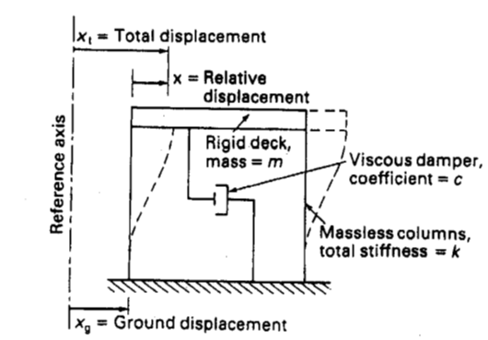
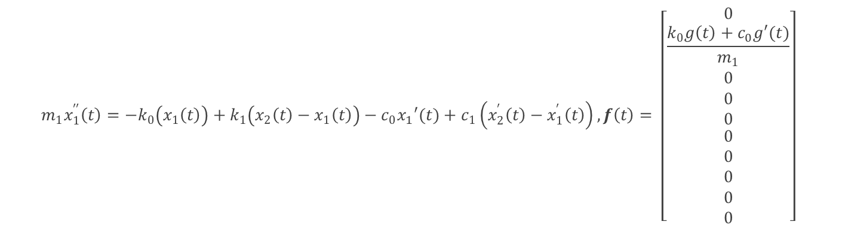
NON-CP damped: now with ground movement
$$m_{1}x_{1}^{′′}\left(t\right)=−k_{0}\left(x_{1}\left(t\right)\right)+k_{1}\left(x_{2}\left(t\right)−x_{1}\left(t\right)\right)−c_{0}x_{1}′(t)+c_{1}\left(x_{2}^{′}\left(t\right)−x_{1}^{′}\left(t\right)\right),f\left(t\right)= \left[\begin{aligned}0 \\ \frac{k_{0}g\left(t\right)+c_{0}g′(t)}{m_{1}} \\ 0 \\ 0 \\ 0 \\ \begin{aligned}0 \\ 0 \\ 0 \\ 0 \\ 0\end{aligned}\end{aligned}\right]$$
Visualization of building shear and variable representation [3]

Slide 32
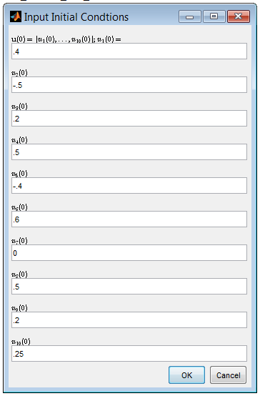
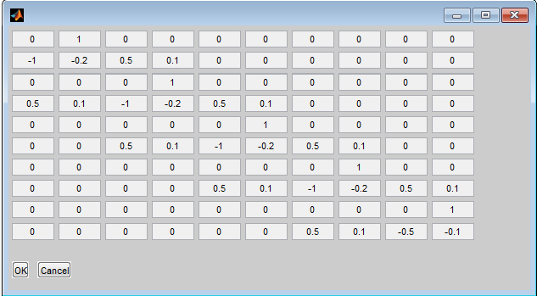
APC Solver
  Every m=10000 kg
  Every k=5000 kg/s²
  Displaced initial positions & velocities
  Damped

Slide 33
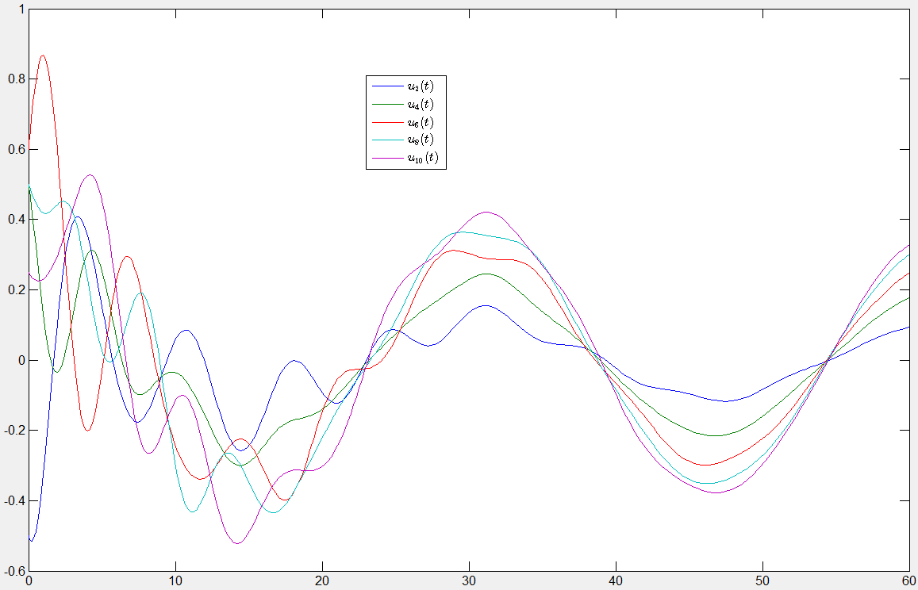
T=60

Slide 34
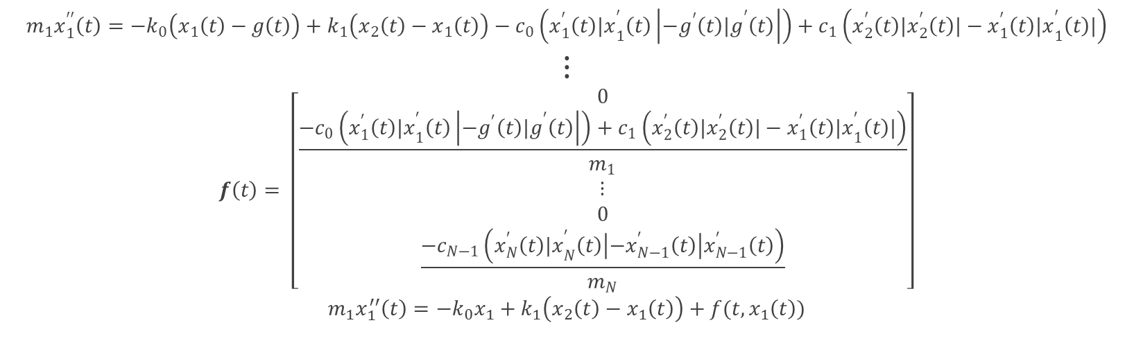
Semi-CP: Relative velocities²
$$m_{1}x_{1}^{′′}\left(t\right)=−k_{0}\left(x_{1}\left(t\right)−g\left(t\right)\right)+k_{1}\left(x_{2}\left(t\right)−x_{1}\left(t\right)\right)−c_{0}\left(x_{1}^{′}\left(t\right){|x}_{1}^{′}\left(t\right)\left|−g^{′}\left(t\right){|g}^{′}\left(t\right)\right|\right)+c_{1}\left(x_{2}^{′}\left(t\right)|x_{2}^{′}\left(t\right)|−x_{1}^{′}\left(t\right){|x}_{1}^{′}\left(t\right)|\right)$$
$$⋮$$
$$f\left(t\right)= \left[\begin{aligned}0 \\ \frac{−c_{0}\left(x_{1}^{′}\left(t\right){|x}_{1}^{′}\left(t\right)\left|−g^{′}\left(t\right){|g}^{′}\left(t\right)\right|\right)+c_{1}\left(x_{2}^{′}\left(t\right)|x_{2}^{′}\left(t\right)|−x_{1}^{′}\left(t\right){|x}_{1}^{′}\left(t\right)|\right)}{m_{1}} \\ ⋮ \\ 0 \\ \frac{{−c}_{N−1}\left(x_{N}^{′}\left(t\right){|x}_{N}^{′}\left(t\right)\left|−x_{N−1}^{′}\left(t\right)\right|x_{N−1}^{′}\left(t\right)\right)}{m_{N}}\end{aligned}\right]$$
$$m_{1}x_{1}^{′′}\left(t\right)=−k_{0}x_{1}+k_{1}\left(x_{2}\left(t\right)−x_{1}\left(t\right)\right)+f(t,x_{1}\left(t\right))$$

Slide 35
References
[1] Chopra, A. K., (2009), Dynamics of Stuctures (3rd ed.), New Delhi, India: Pearson
[2] Elnashai, A. S., Sarno, L. D., (2008), Fundamentals of Earthquake Engineering, West Sussex, United Kingdom: Wiley.
[3] Ghosh, S. K., (2003), Seismic Design Using Structural Dynamics (2000 IBC), Country Club Hills, IL: International Code Council.
[4] Kalny, O., (2013), Modal Analysis, available at: https://wiki.csiamerica.com/display/kb/Modal+analysis.
[5] Marchand, R., McDevitt, T. J., (1999), “Learning Differential Equations by Exploring Earthquake Induced Structural Vibrations: A Case Study,” International Journal of Continuing Engineering Education and Life-Long Learning, 6, 477-485.
[6] McKibben, A. M., and Webster, M. D., (2015) Differential Equations with MATLAB, New York: CRC Press.
[7] MIT OpenCourseWare, (2013), “Modal Analysis Orthogonality, Mass Stiffness, Damping Matrix,” available at: https://www.youtube.com/watch?v=OxcCPTc_bXw.
[8] Tarbuck, E. J., (2011), Earth an Introduction to Physical Geology (10th ed.), Upper Saddle River, NJ: Pearson Education.

