Slide 1
Boom! Chemical Kinetics
Anthony Doria
MAT 493
5/6/2015

Slide 2
Outline
Introduction
Homogeneous Case
Non-Homogeneous Case
Semi-Linear Case

Slide 3
Introduction

Slide 4

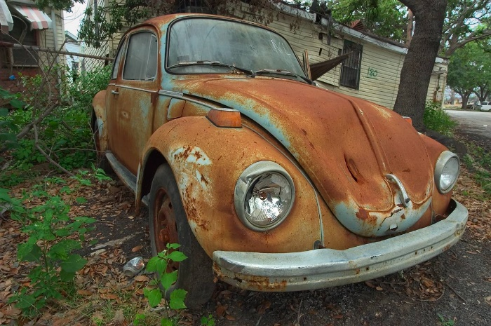
What is a Chemical Reaction?
A process that transforms one or more substances into another.
Examples:
  Photosynthesis
  Lighting a match
  Rusting

Slide 5
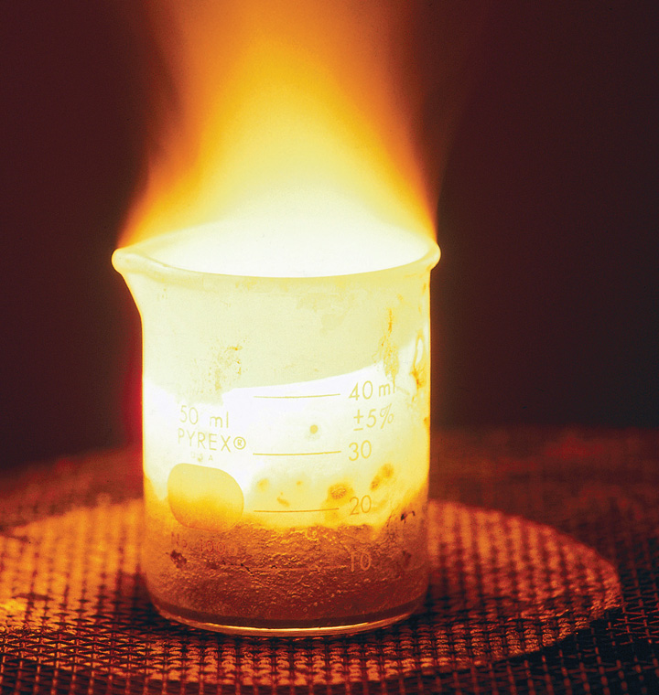
Source: catalog.flatworldknoledge.com

Slide 6
Chemical Kinetics
Chemical kinetics is the study of the rates of chemical reactions.
Analyze how factors of interest influence the reaction rates

Slide 7
Factors of Interest
Concentration
Temperature
Pressure
Surface Area
Catalysts
Inhibitors

Slide 8
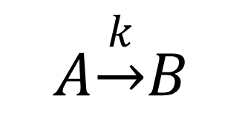
A Basic Reaction
A – the reactant
B – the product
k – the rate of reaction (comes from the Law of Mass Action)
$$A\underset{→}{k}B$$

Slide 9
Law of Mass Action
Formulated by Guldberg and Waage
“The rate of any chemical reaction is proportional to the product of the masses of the reacting substances, with each mass raised to a power equal to the coefficient that occurs in the chemical reaction “ (“Law of Mass Action”).

Slide 10
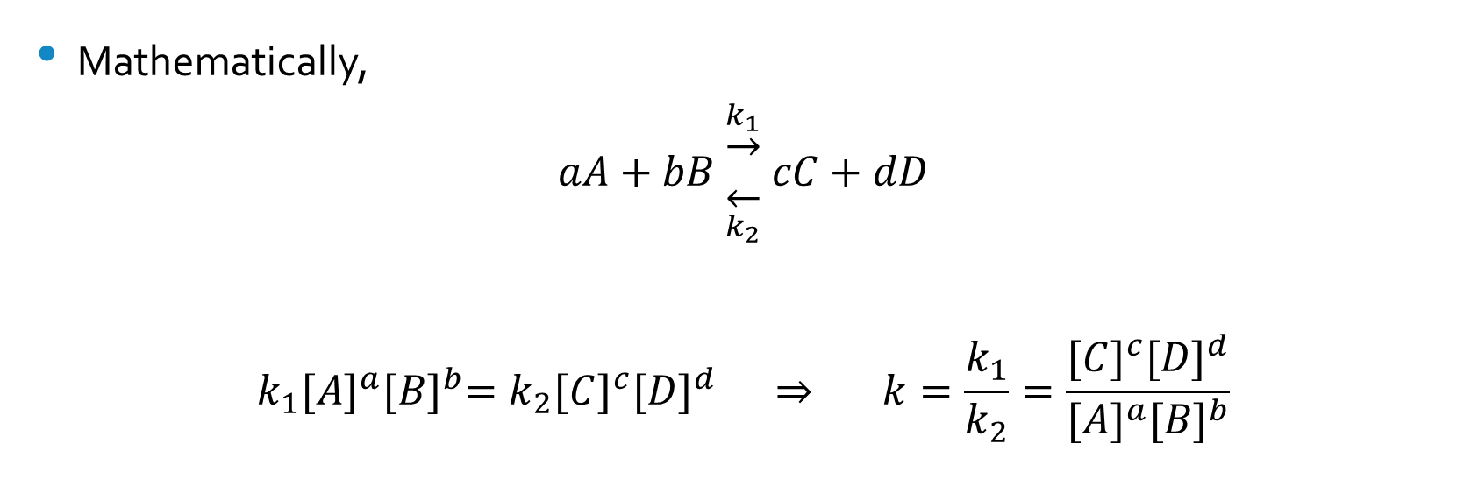
Law of Mass Action
Mathematically,
$$aA+bB \begin{matrix}\underset{→}{k_{1}} \\ \overset{←}{k_{2}}\end{matrix} cC+dD$$
$$k_{1}{[A]}^{a}{[B]}^{b}=k_{2}{[C]}^{c}{[D]}^{d} ⇒ k=\frac{k_{1}}{k_{2}}=\frac{{[C]}^{c}{[D]}^{d}}{{[A]}^{a}{[B]}^{b}}$$

Slide 11
Homogeneous Case

Slide 12
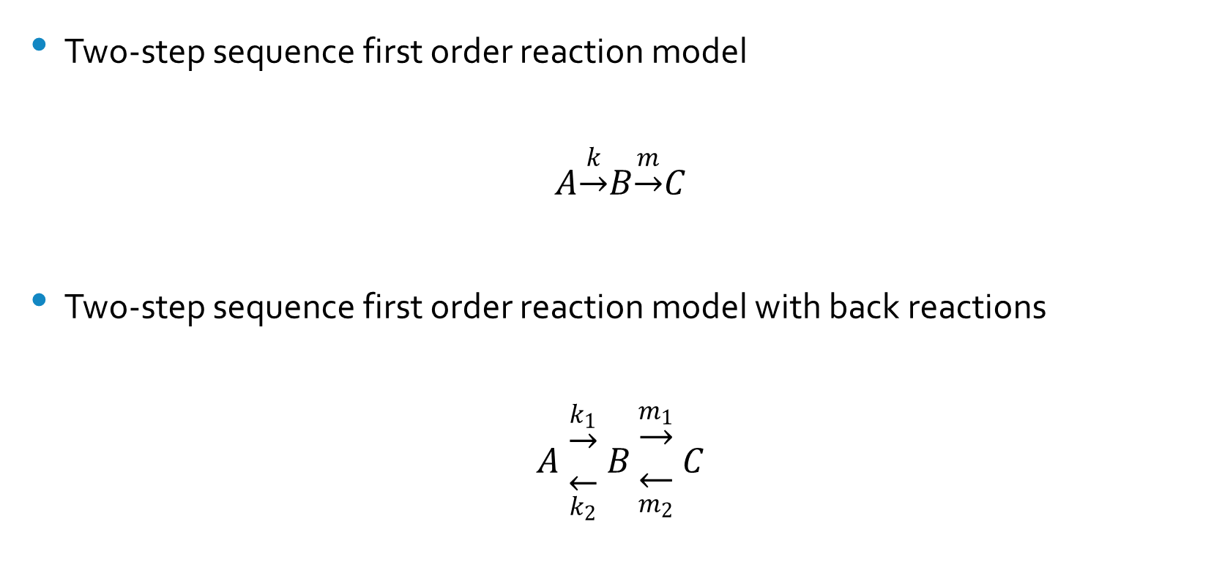
Two Reaction Models
Two-step sequence first order reaction model
$$A\underset{→}{k}B\underset{→}{m}C$$
Two-step sequence first order reaction model with back reactions
$$A \begin{matrix}\underset{→}{k_{1}} \\ \overset{←}{k_{2}}\end{matrix} B \begin{matrix}\underset{→}{m_{1}} \\ \overset{←}{m_{2}}\end{matrix} C$$

Slide 13
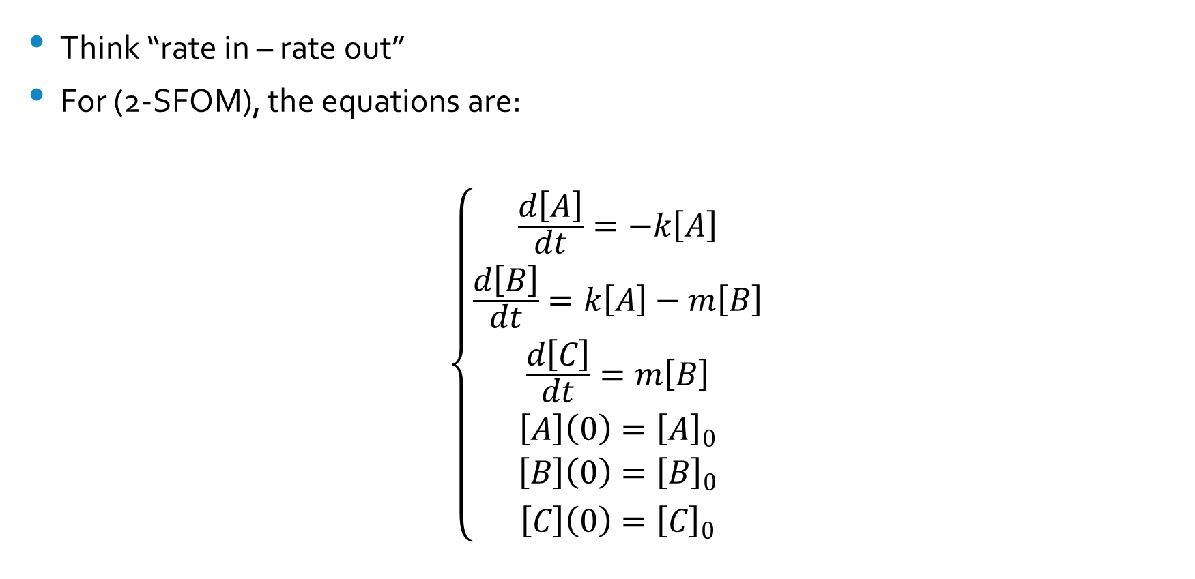
Deriving the Equations
Think “rate in – rate out”
For (2-SFOM), the equations are:
$$\left\{\begin{aligned}{\frac{d\left[A\right]}{dt}=−k\left[A\right] \atop \frac{d\left[B\right]}{dt}=k\left[A\right]−m\left[B\right]} \\ {\frac{d\left[C\right]}{dt}=m\left[B\right] \atop \left[A\right]\left(0\right)={\left[A\right]}_{0}} \\ {\left[B\right]\left(0\right)={\left[B\right]}_{0} \atop \left[C\right]\left(0\right)={\left[C\right]}_{0}}\end{aligned}\right.$$

Slide 14
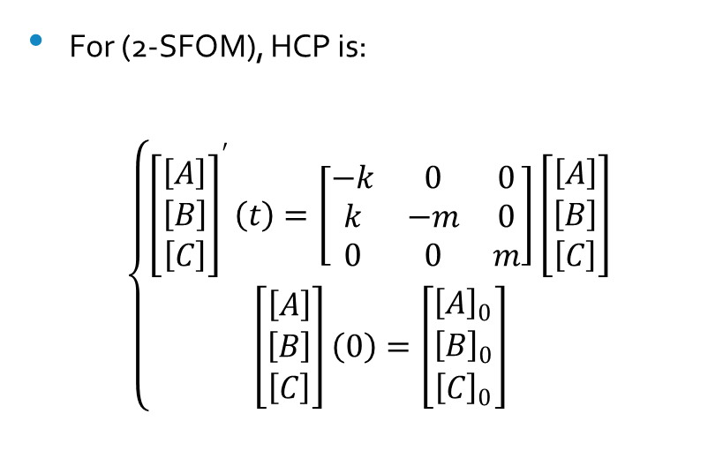
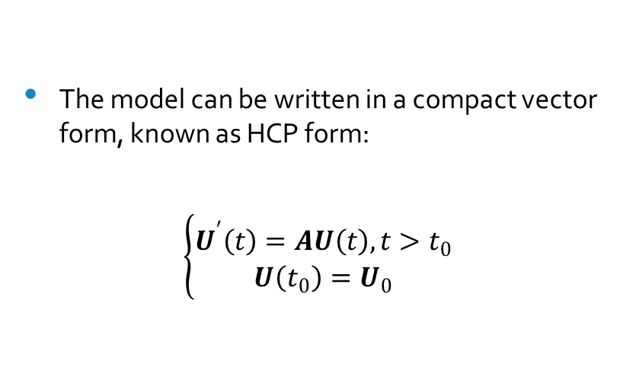
HCP
The model can be written in a compact vector form, known as HCP form:
$$\left\{\begin{aligned}U^{′}\left(t\right)=AU\left(t\right), t>t_{0} \\ U\left(t_{0}\right)=U_{0}\end{aligned}\right.$$
For (2-SFOM), HCP is:
$$\left\{\begin{aligned}{\left[\begin{matrix}\left[A\right] \\ \left[B\right] \\ \left[C\right]\end{matrix}\right]}^{′}\left(t\right)=\left[\begin{matrix}−k & 0 & 0 \\ k & −m & 0 \\ 0 & 0 & m\end{matrix}\right]\left[\begin{matrix}\left[A\right] \\ \left[B\right] \\ \left[C\right]\end{matrix}\right] \\ \left[\begin{matrix}\left[A\right] \\ \left[B\right] \\ \left[C\right]\end{matrix}\right]\left(0\right)=\left[\begin{matrix}{\left[A\right]}_{0} \\ {\left[B\right]}_{0} \\ {\left[C\right]}_{0}\end{matrix}\right]\end{aligned}\right.$$

Slide 15

Solution and Continuous Dependence
By EXPLORE! (118-120), as long as the errors are small, the perturbed version of (2-SFOM) will behave like the original.
Theorem 4.6.1: HCP has a unique solution given by:
$$\overset{⃑}{U}\left(t\right)=e^{A(t−t_{0})}{\overset{⃑}{U}}_{0}$$

Slide 16
Non-Homogenous Case

Slide 17
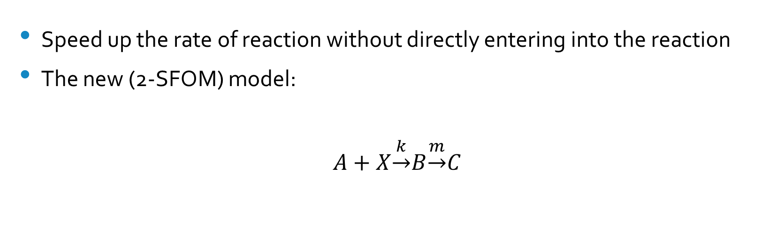
Catalysts
Speed up the rate of reaction without directly entering into the reaction
The new (2-SFOM) model:
$$A+X\underset{→}{k}B\underset{→}{m}C$$

Slide 18

Non-CP
Non-CP form:
$$\left\{\begin{aligned}U^{′}\left(t\right)=AU\left(t\right)+f(t), t>t_{0} \\ U\left(t_{0}\right)=U_{0}\end{aligned}\right.$$
The new models can be written in this form.
Theorem 5.3.1 is applied, so each model has a unique solution.
EXPLORE! (145-147) results are applied, as long as the errors are small, the perturbed version will behave like the original.

Slide 19
Semi-Linear Case

Slide 20
Enzymes
Chemical reactions occur in all living things.
  But, most of these reactions take too long to occur
Enzymes are proteins that speed up chemical reactions within the cell

Slide 21
How Enzymes Work
The enzyme and the substrate combine
  This forms an enzyme-substrate complex.
The complex forms the product
  When the product is released, the enzyme remains unaltered and repeats this process.
Modeled by Michaelis and Menten

Slide 22

Michaelis-Menten Enzyme Kinetics Model
$$E+S \begin{matrix}\underset{→}{k_{1}} \\ \overset{←}{k_{−1}}\end{matrix} ES$$
$$ES\underset{→}{k_{2}}E+Z$$
$$E+Z \begin{matrix}\underset{→}{k_{3}} \\ \overset{←}{k_{−3}}\end{matrix} EZ$$
$$EZ\underset{→}{k_{4}}E+P$$

Slide 23
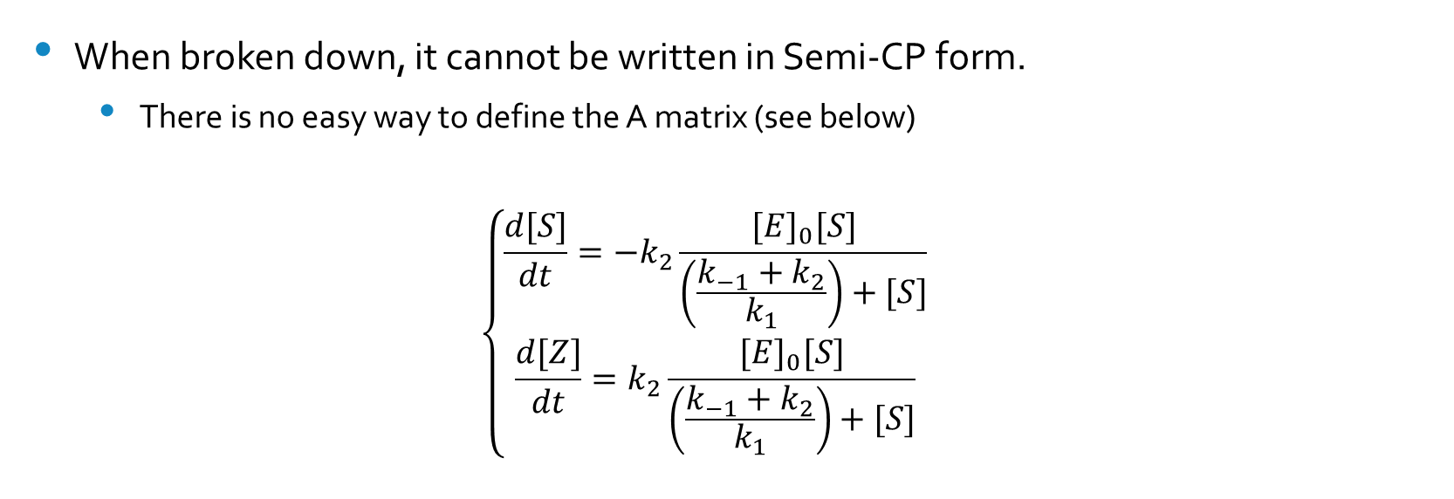
Michaelis-Menten Enzyme Kinetics Model
When broken down, it cannot be written in Semi-CP form.
  There is no easy way to define the A matrix (see below)
  $$\left\{\begin{matrix}\frac{d[S]}{dt}=−k_{2}\frac{{[E]}_{0}[S]}{\left(\frac{k_{−1}+k_{2}}{k_{1}}\right)+[S]} \\ \frac{d[Z]}{dt}=k_{2}\frac{{[E]}_{0}[S]}{\left(\frac{k_{−1}+k_{2}}{k_{1}}\right)+[S]}\end{matrix}\right.$$

Slide 24
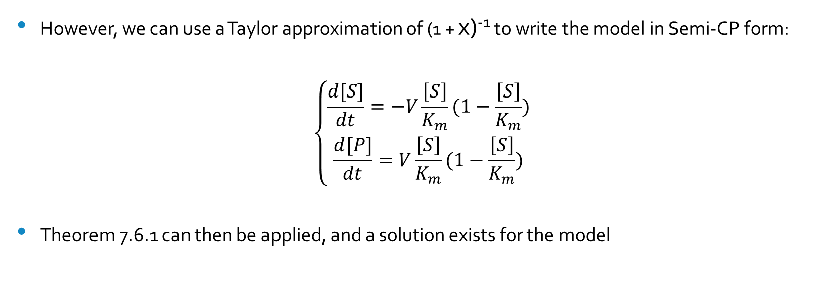
Taylor to the Rescue!
However, we can use a Taylor approximation of (1 + x)⁻¹ to write the model in Semi-CP form:
$$\left\{\begin{matrix}\frac{d[S]}{dt}=−V\frac{\left[S\right]}{K_{m}}(1−\frac{\left[S\right]}{K_{m}}) \\ \frac{d[P]}{dt}=V\frac{\left[S\right]}{K_{m}}(1−\frac{\left[S\right]}{K_{m}})\end{matrix}\right.$$
Theorem 7.6.1 can then be applied, and a solution exists for the model

Slide 25
Some Extra Information
All the models presented here were of first order. Reactions can be as high as 2nd, 3rd or even 4th order.
The models here generally consisted of only one reactant transforming into one product.
  Some reactions need multiple reactants to occur
  They might also create more than one product

Slide 26
References
"Law of Mass Action." Encyclopedia Britannica Online. Encyclopedia Britannica, n.d. Web. 15 Mar. 2015.

