Slide 1
Animated Case-based Studies in Teaching Trauma Informed Practices
Vicki McGinley, PhD
Thomas Haughey, PhD
Michelle Fisher, MS
West Chester University
Notes:
Introductions - ALL

Slide 2
Project Objectives
Develop three trauma related video case-based animations.
Provide students an experiential approach to apply what they will do in real classroom situations related to trauma.
Develop learning activities (e.g., problem-based questions, teaching of a concept, etc.).
Involve theatre students in the process in learning to create a character using their voice and in the process of learning how to create digital animation.
Create a resource (inhouse, open access content) for faculty and staff around Trauma Informed Practices.
Notes:
Vicki – objectives, overview of project and grant

Slide 3
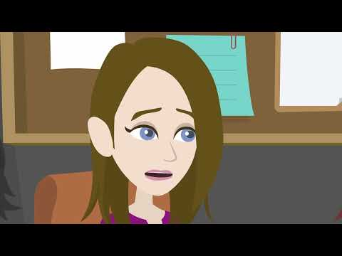
Animated Cases: Andy
Notes:
Vicki – introduct andy case....

Slide 4
Trauma-informed education is now mandatory at all Pennsylvania public schools
Schools are requiring educators to become trauma sensitive and informed, and to incorporate research-based practices within their classrooms that address Adverse Childhood Experiences (Felitti, et al., 1995) it is critical that educators gain those skills and knowledge.
Schools must now be able to recognize the signs and symptoms of trauma and integrate that knowledge into education-based policies, learning procedures and practices. During the budget process, legislators combined the bills and incorporated them into Senate Bill 144.
Notes:
Vicki – Teacher Certification explanation

Slide 5
Senate Bill 144
The new bill recognizes that Adverse Childhood Experiences (ACEs) tailored to the entire school community.
The mandatory training required includes:
A minimum of one hour of training on trauma-informed approaches for both newly elected and reelected school board directors.
A minimum of one hour of professional development training on trauma-informed approaches.
The Pennsylvania Department of Education’s PA Leadership Standards must include information on trauma-informed approaches.
Notes:
VICKI
The new bill recognizes that Adverse Childhood Experiences (ACEs) – which include factors such as abuse, neglect and other traumatic experiences – have a potentially long-lasting effect on children’s cognitive functioning and physical, social, emotional, mental and spiritual well-being. The bill requires schools to implement mandatory training of administrators, staff and school board members to identify the signs and symptoms of trauma. That would lead to the school community using a multi-tiered support system for students and families who have experienced trauma, preventing its reoccurrence and promoting resiliency tailored to the entire school community.
The mandatory training required includes:
A minimum of one hour of training on trauma-informed approaches for both newly elected and reelected school board directors. Similar requirements apply to charter school trustees.
A minimum of one hour of professional development training on trauma-informed approaches.
The Pennsylvania Department of Education’s PA Leadership Standards must include information on trauma-informed approaches.

Slide 6
Research on Case Based Learning
Case based learning allows preservice teachers to:
Develop critical inquiry and analytical skills.
(Gunn and Williams, 2015 and Cho et al., 2015)
Apply theory-based knowledge to real world situations prior to in person field experiences or student teaching. (Gravett et al, 2017)
Gain access to hard-to-reach populations that they may not have exposure to during field experiences or student teaching. (Billingsly and Scheuermann, 2014)
Notes:
Michelle:
Case-based instruction has been used for over a century in law schools, medical schools, and schools of education to provide real-world context to content and allow students to demonstrate and apply classroom and textbook knowledge before they practice their chosen profession (Arrastia-Chisholm et al., 2021). Gunn and Williams (2015) and Cho et al. (2015) focus on the ability of cases to allow students to develop critical inquiry and analytical skills. Gravett et al. (2017) identify case-based instruction as a pedagogical approach to bring theory-based knowledge in education closer to practice-based knowledge of teaching education for preservice teachers. According to Mostert (2007), research in the field of teacher education supports the use of case-based instruction to bring real-world content to preservice teachers due to the complicated nature and detailed interactions that take place in a classroom between teachers and students.
The use of case-based instruction can help provide access to field placement that are not physically accessible. As noted by Billingsly and Scheuermann (2014), in-person field placement is the best option, but due to the COVID-19 pandemic, field students all over the country in the spring of 2020 and into 2021 were suddenly displaced from their in-person field experiences and shifted to virtual placements which are similar to case-based instruction. As a result of this shift, research has shown that virtual field experiences can provide an equal academic benefit to preservice teachers. Vu and Fisher (2021) conducted research on the impact of virtual field experiences on preservice teachers due to the COVID-19 pandemic and found no statistically significant difference between the academic skills of students who had completed their field experiences in person (pre-COVID) and those that were forced in an emergency situation to complete their field component virtually.

Slide 7
Animated Case Based Learning
Can help provide students access to hard-to-reach populations where video cases are not available. (Herbst and Kosko, 2014)
Allows faculty members to design the scenario ensuring students are exposed to situations that allow them to apply theory and knowledge (Herbst and Kosko, 2014)
Can be as effective as video cases (Moreno et al., 2008)
Notes:
Michelle:
The use of animated case-based instruction could solve a problem in certain fields of teacher education where it is difficult to find contextually appropriate existing video-based cases for virtual observation, or opportunities for in-person placements for students. There is little current research on the use of animated case-based instruction (Aaron & Herbst, 2015; Herbst & Kosko, 2014; Moreno et al., 2008). Animation may be a helpful tool in preparing preservice teachers to work with hard-to-reach populations. Herbst and Kosko (2014) discuss the ability to control the content and scenario through written and animated presentations as a rationale for exploring the differences between video and animated classroom scenarios. Their data showed no significant difference between the proportion of comments made by teachers when viewing video scenarios compared to animated scenarios. The data showed an increase in the frequency of appropriate comments made by preservice teachers while watching animated classroom scenarios compared to those made while watching recorded videos. The authors note a trend towards more polite professional comments when viewing videos compared to comments made while watching animations. They suggest that preservice teachers may feel uncomfortable criticizing professional teachers but not animated characters.
The use of animation allows the designer of the case-based instruction to control the details of the case. In another study, Aaron and Herbst (2015) looked at teachers’ perceptions of students' work on the students’ ability to use conjecture in problem-solving. This study used nondescript characters (large blue circles as heads) which is unique in current research as animated case studies typically aim for a level of authenticity. Their data showed that teachers' perceptions focused on the resources students used rather than the students’ process of conjecture.
Animated case-based instruction may be as beneficial to learners as video case-based instruction. Moreno et al. (2008) investigated the difference in the effectiveness of three different formats of K12 classroom case studies for preservice teacher education students. The researchers looked at how well preservice teachers were able to apply what they learned in case studies to new classroom experiences and if the format of the case study itself impacted students’ perceptions of their learning experience. The results showed when students watched video and animated-based cases, students were able to identify more model applications in their own teaching than those who read the case study or were not exposed to any cases. Video and animation group assessment scores were also higher on the application test with the animation group scoring the highest.

Slide 8
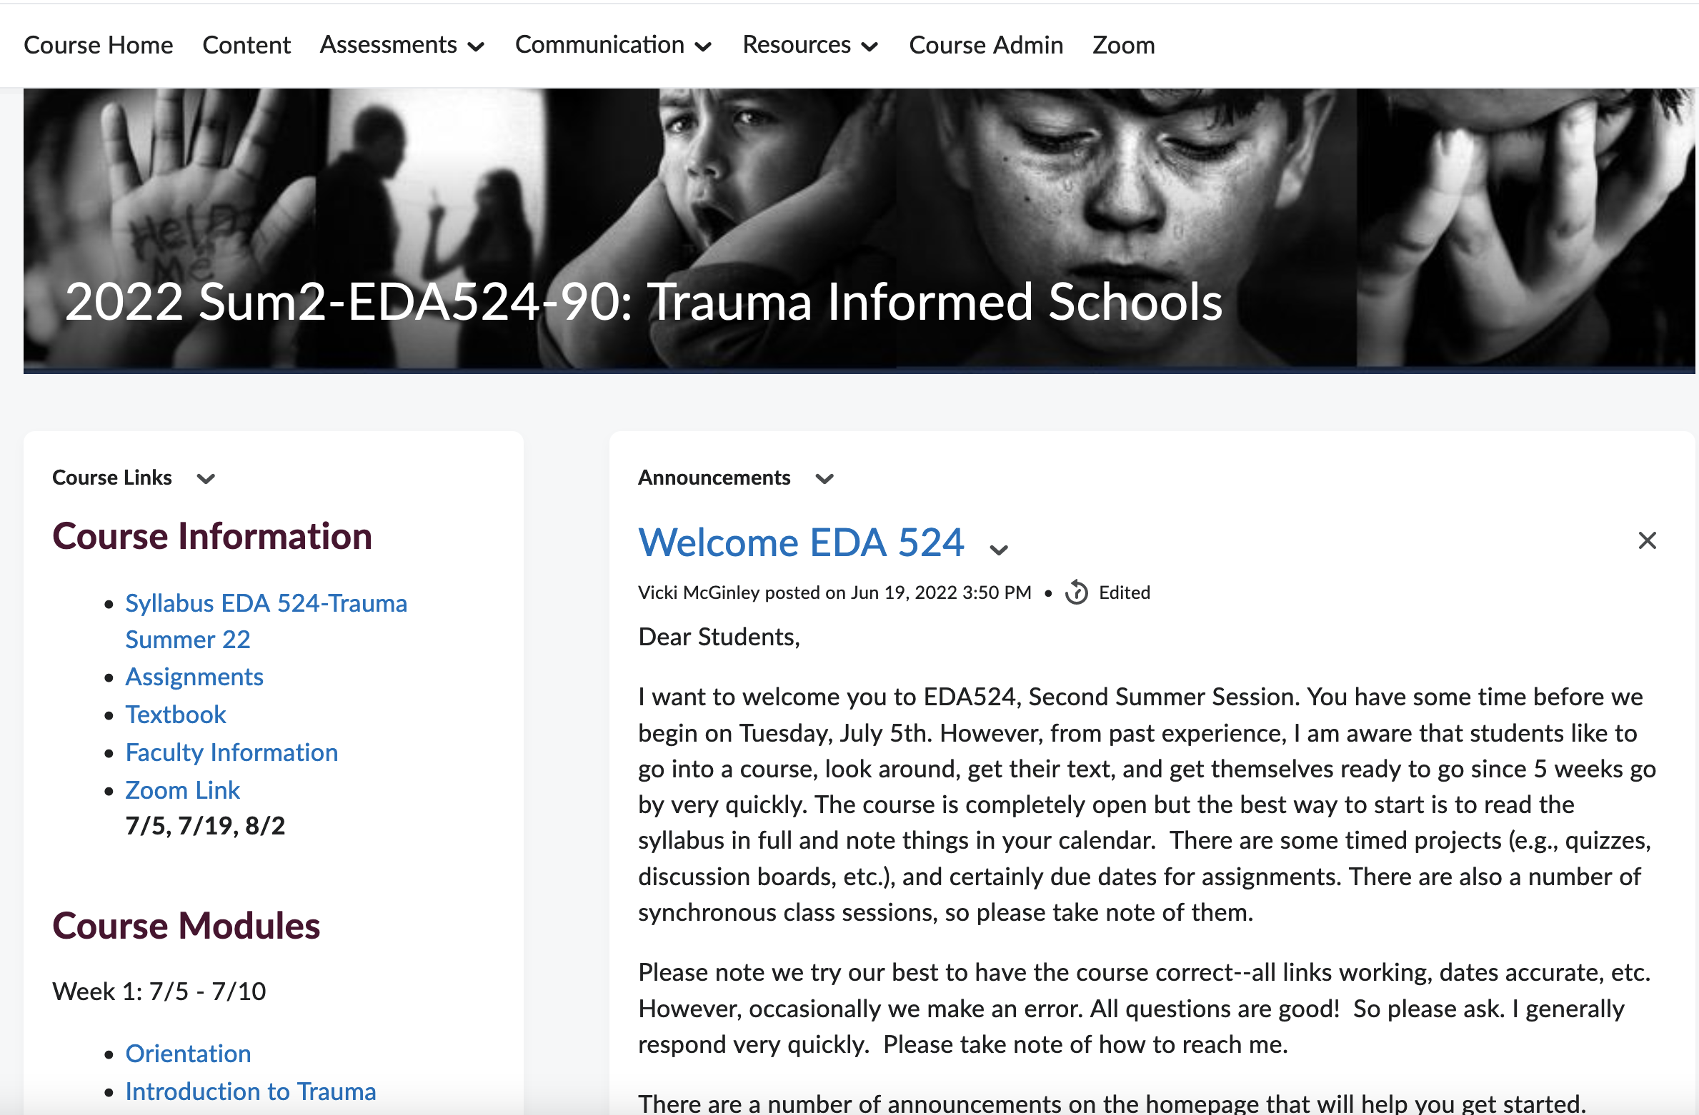
EDA324 and EDA524:
Trauma Informed Schools and Classrooms
Link to 524
Notes:
Vicki -

Slide 9
Project Methods
Develop or adapt cases
Re-write as dialog-based scripts
Develop storyboards to break up case into scenes
Recruit and hire actors
Develop draft animation using text to speech audio
Screen draft/alpha animation with content experts for authenticity
Edit script as needed
Record audio and connect to animation
Notes:
Vicki, Michelle and Tom
Three cases were developed and/or adapted from existing narrative-based cases.
Each case was rewritten into a dialogue-based format that will include scripting and characterization. Scripting includes blocking (stage and movement direction), detailed character profiles, and setting descriptions.
Scripts were then duplicated and broken down by roles of characters for student voice over actors.
Using a guided protocol within Qualtrics, three context experts reviewed the alpha animation (the first version of the animation which contains computer generated text-to-speech animation).
Questions addressed during this review were : is the case depicted accurately? more specifically, is it realistic? and is there any information that is missing that will help our students to make sound decisions?
Voice over actors (theatre students) from our theatre were auditioned.
In conjunction with the graduate assistant (GA), while students voice over actors are being screened, text-to-speech audio will be used to create animation.
The animation process included the selection of the animated characters (avatars) which are pulled from the character description (e.g., a principal, a teacher, parent, social worker, etc.).
The review of the animation will occur by the grant’s faculty and staff. This will allow us to see how the dialogue flows, howthe characters move on the screen, making sure everything is moving in the way we want before final audio is recorded, thus, saving time and money.
Student voice over actors will then record the character roles. The recording sessions and other specific sound cues are added to the animations, replacing text-to-speech audio with the real voice audio.
The team will review the final animations and place them into Kaltura, into YouTube, as well as a faculty’s D2L Manage Media Account developed specifically for this project for publication.
The animations will also be embedded into a separate D2L site to be embedded for anyone who makes a request for use.

Slide 10
Methods: Scripting and Actors
Break
Break scripts down by role
Recruit and select
Recruit and select actors
Record
Record each actor
Capture character and emotion
Narrators were critical
Vocal performances of challenging characters
Each line must be saved individually.
Notes:
Tom – theatre and acting part of it all

Slide 11

Animated Cases: Kalil
Notes:
Vicki – introduce, race-based bullying. Possible trigger warning.

Slide 12

Animated Cases: Kate

Slide 13
References
Arrastia-Chisholm, M., Tackett, S., & Torres, K. M. (2021). Case-based instruction in educational psychology: Comparing collaborative and independent approaches. Journal of Research in Education, 30(2), 1–16.
Billingsley, G. M., & Scheuermann, B. K. (2014). Using virtual technology to enhance field experiences for preservice special education teachers. Teacher Education and Special Education, 37(3), 255–272.
Felitti, V . J. et al., (1998). Relationship of childhood abuse and household dysfunction to many of the leading causes ofdeath in adults: The adverse childhood experiences (ACE) study. American Journal of Preventive Medicine, 14(4), 245-258.
Gravett, S., de Beer, J., Odendaal-Kroon, R., & Merseth, K. K. (2017). The affordances of case-based teaching for the professional learning of student-teachers. Journal of Curriculum Studies, 49(3), 369–390.
Gunn A.A., & Williams, N. (2015). Using teaching cases to foster a culturally responsive literacy pedagogy. Teacher Education & Practice, 28(1), 45–59.
Herbst, P., & Kosko, K. (2014). Using representations of practice to elicit mathematics teachers’ tacit knowledge of practice: A comparison of responses to animations and videos. Journal of Mathematics Teacher Education, 17(6), 515–537. https://search.ebscohost.com/login.aspx?direct=true&AuthType=sso&db=eue&AN=99372401&site=eds-live&scope=site&custid=s3916018
Pynoos, R. et al., (2008). The National Traumatic Stress Network: Collaborating to improve the standard of care.Professional Psychology: Research and Practice. 39(4), 389-395.
Robbins, S. H., Gilbert, K., Chummy, F., & Green, K. B. (2019). The Effects of Immersive Simulation on Targeted Collaboration Skills among Undergraduates in Special Education. Teaching & Learning Inquiry, 7(2), 168–185. https://doi.org/10.20343/teachlearninqu.7.2.11
Shonkoff, J P. et al., (2012). The lifelong effects of early childhood adversity and toxic stress. Retrieved from http:pediatrics.aapublications.org/content/129/1/e232

