Slide 1


Slide 2
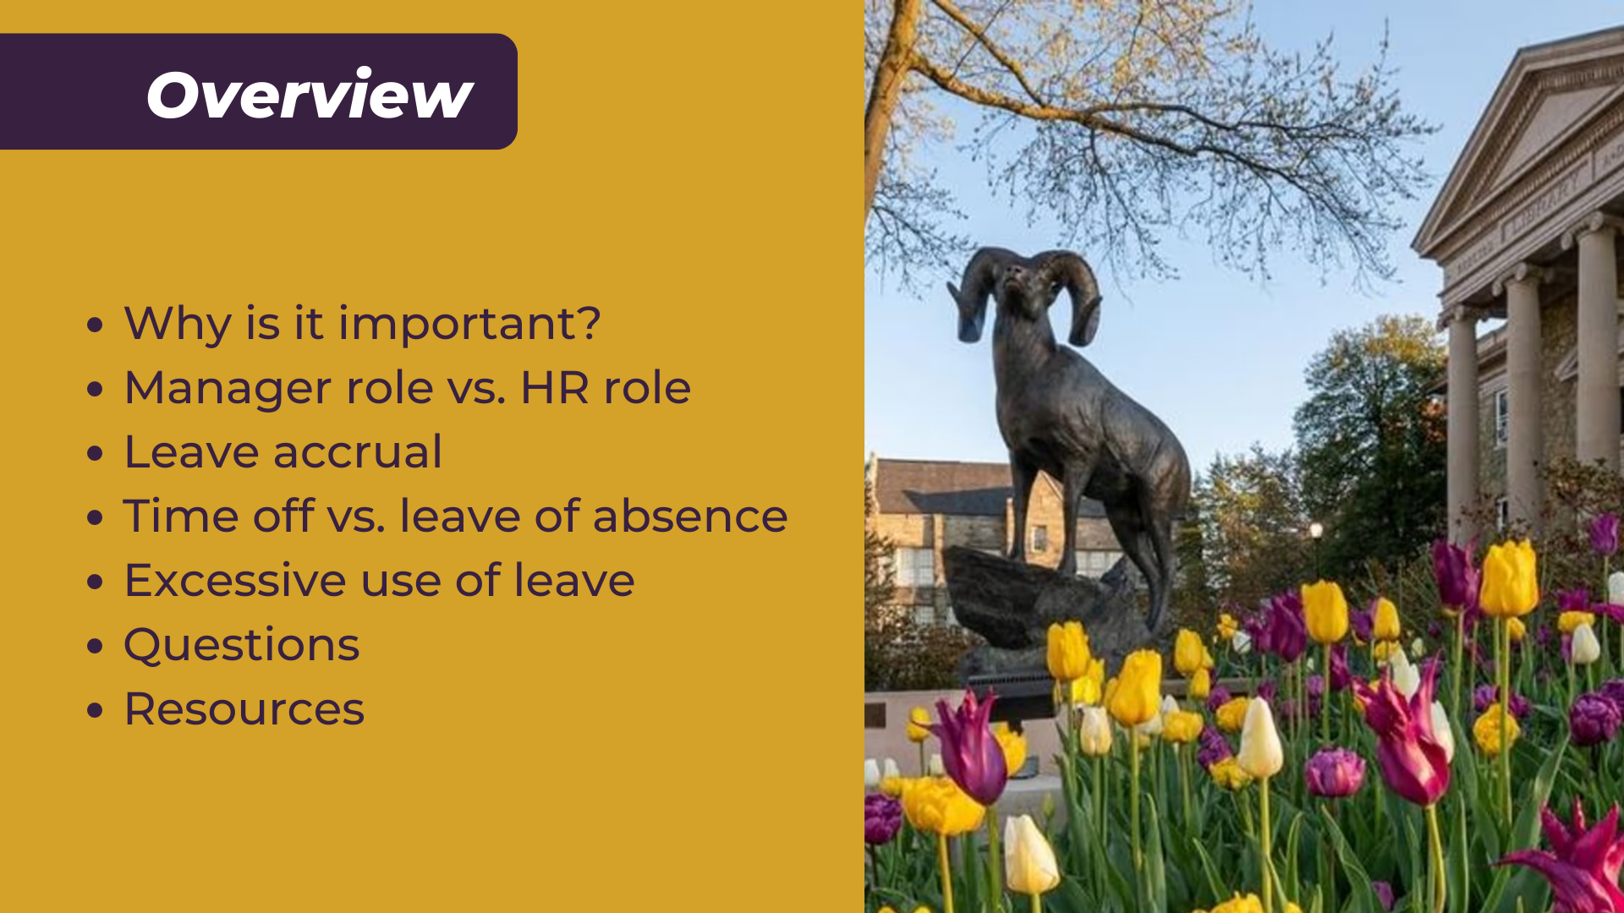

Slide 3
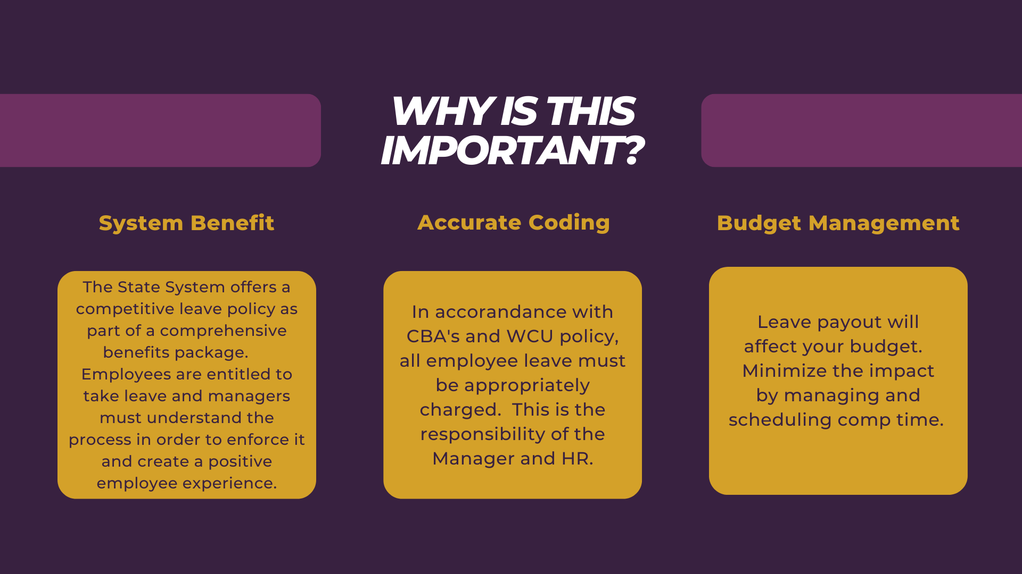

Slide 4
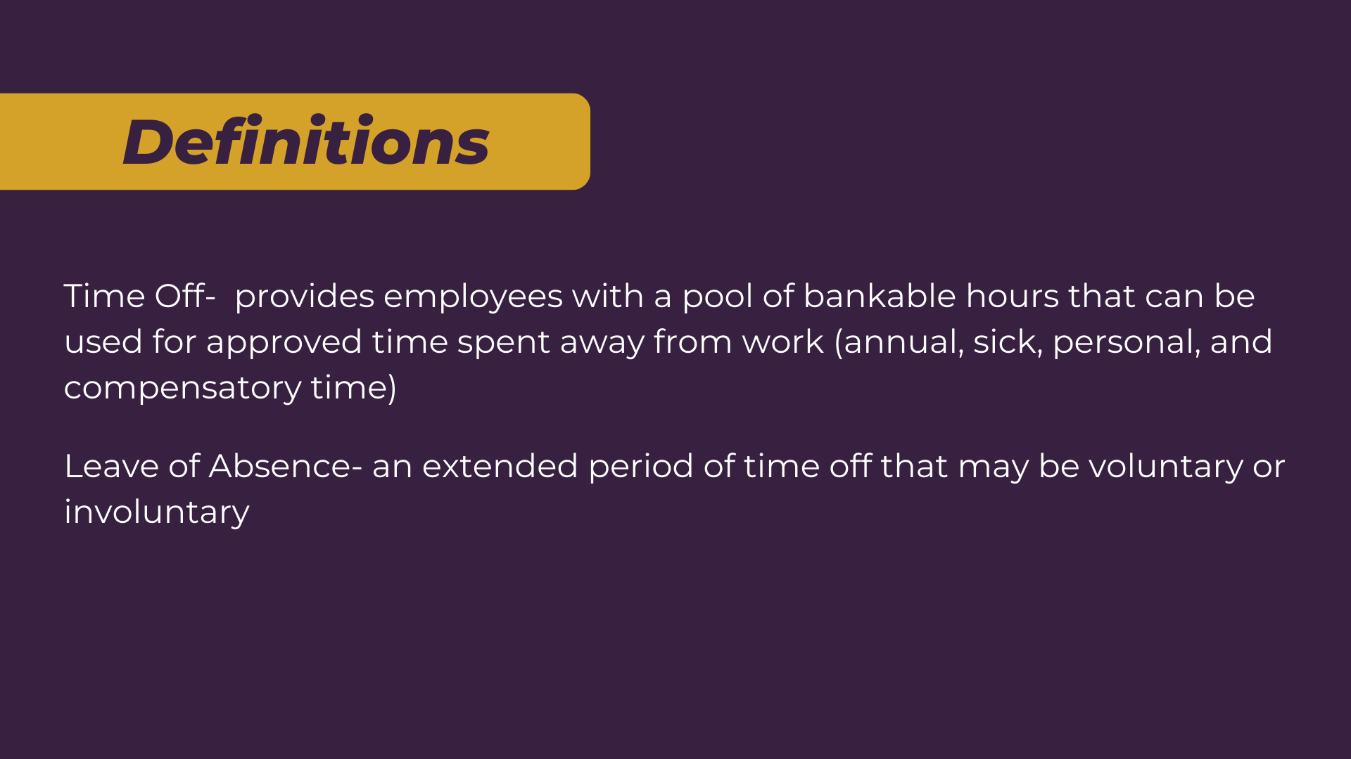

Slide 5


Slide 6
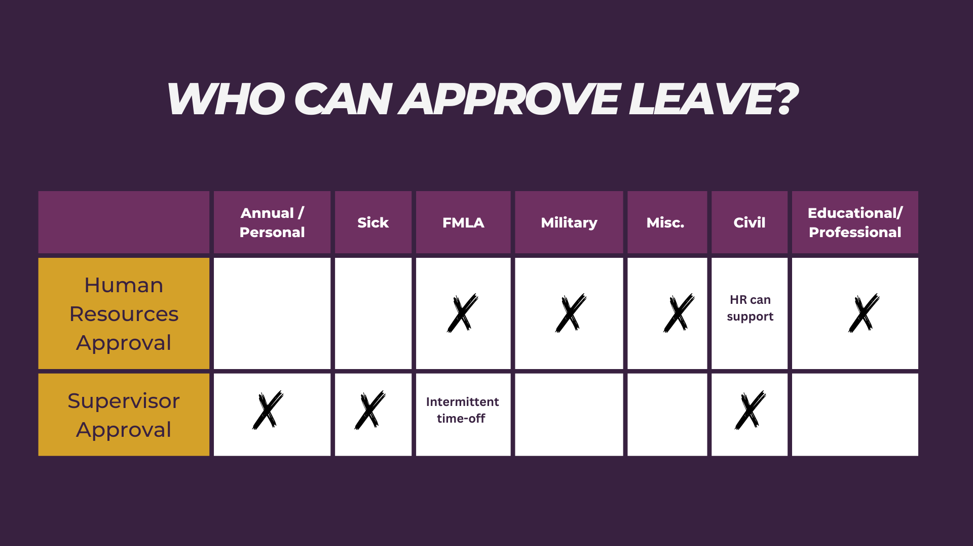

Slide 7
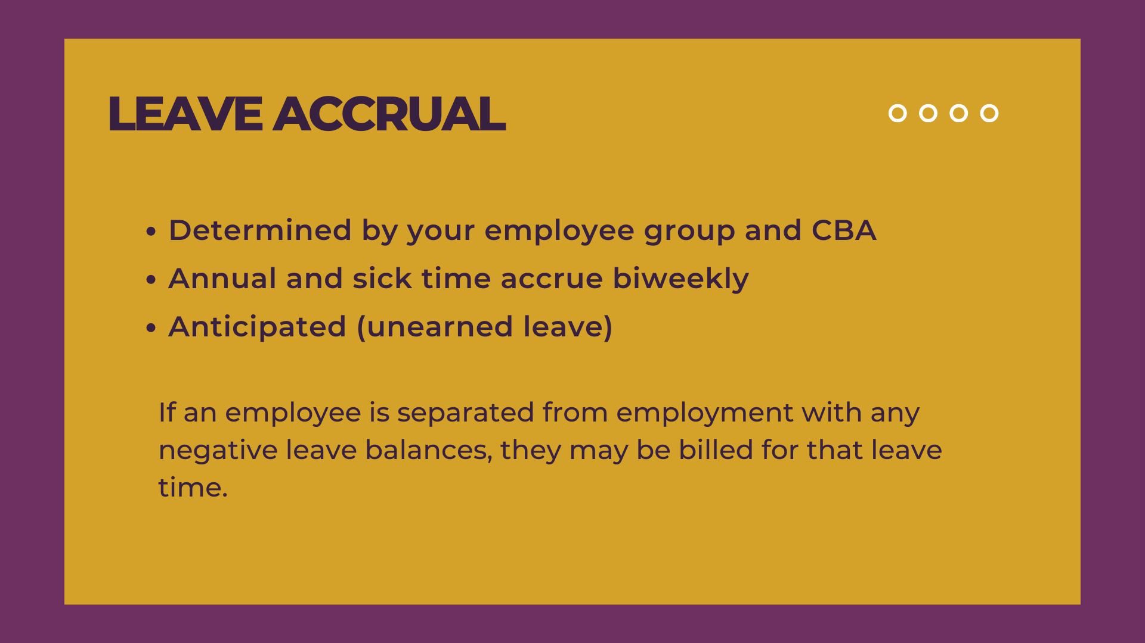

Slide 8
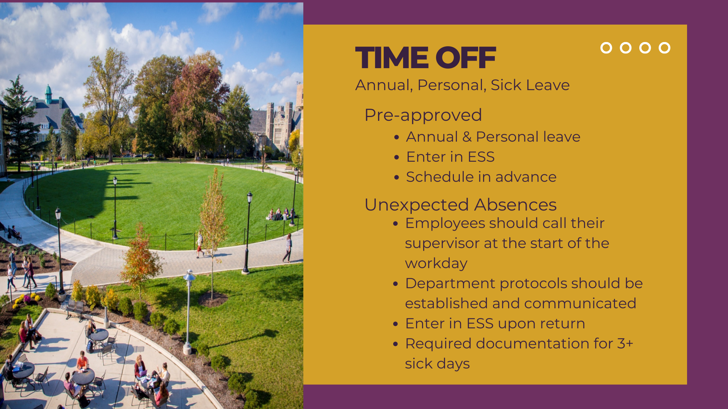

Slide 9


Slide 10
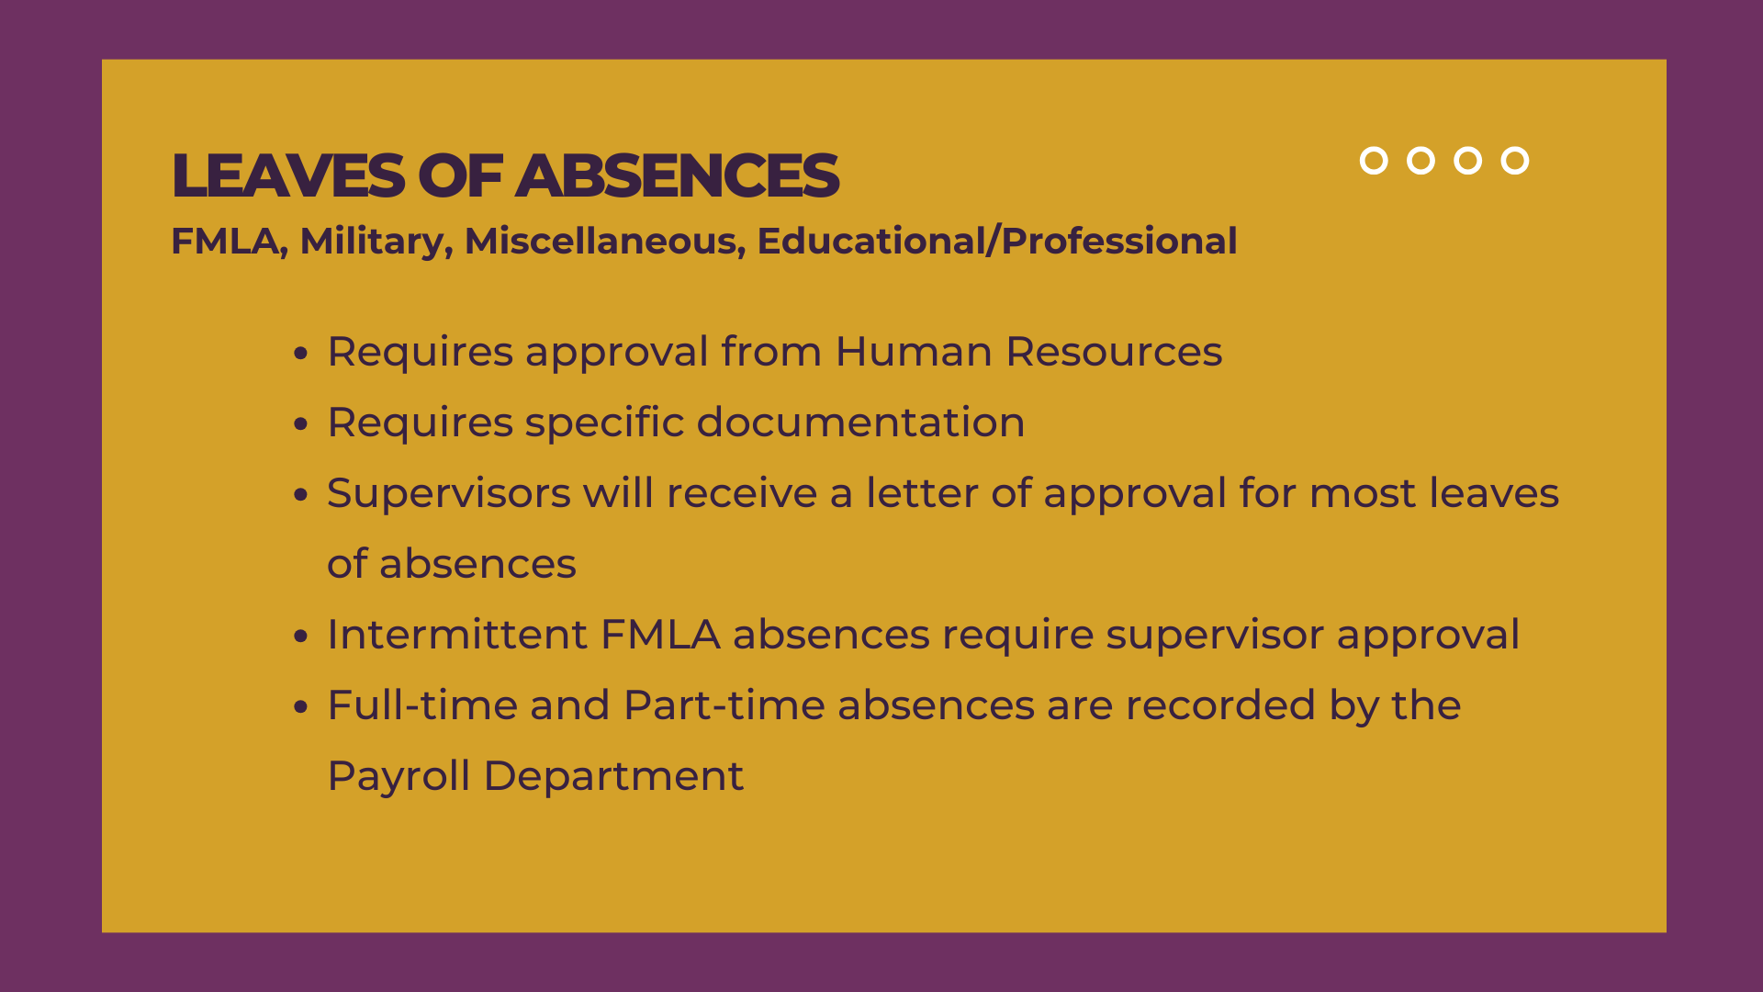

Slide 11
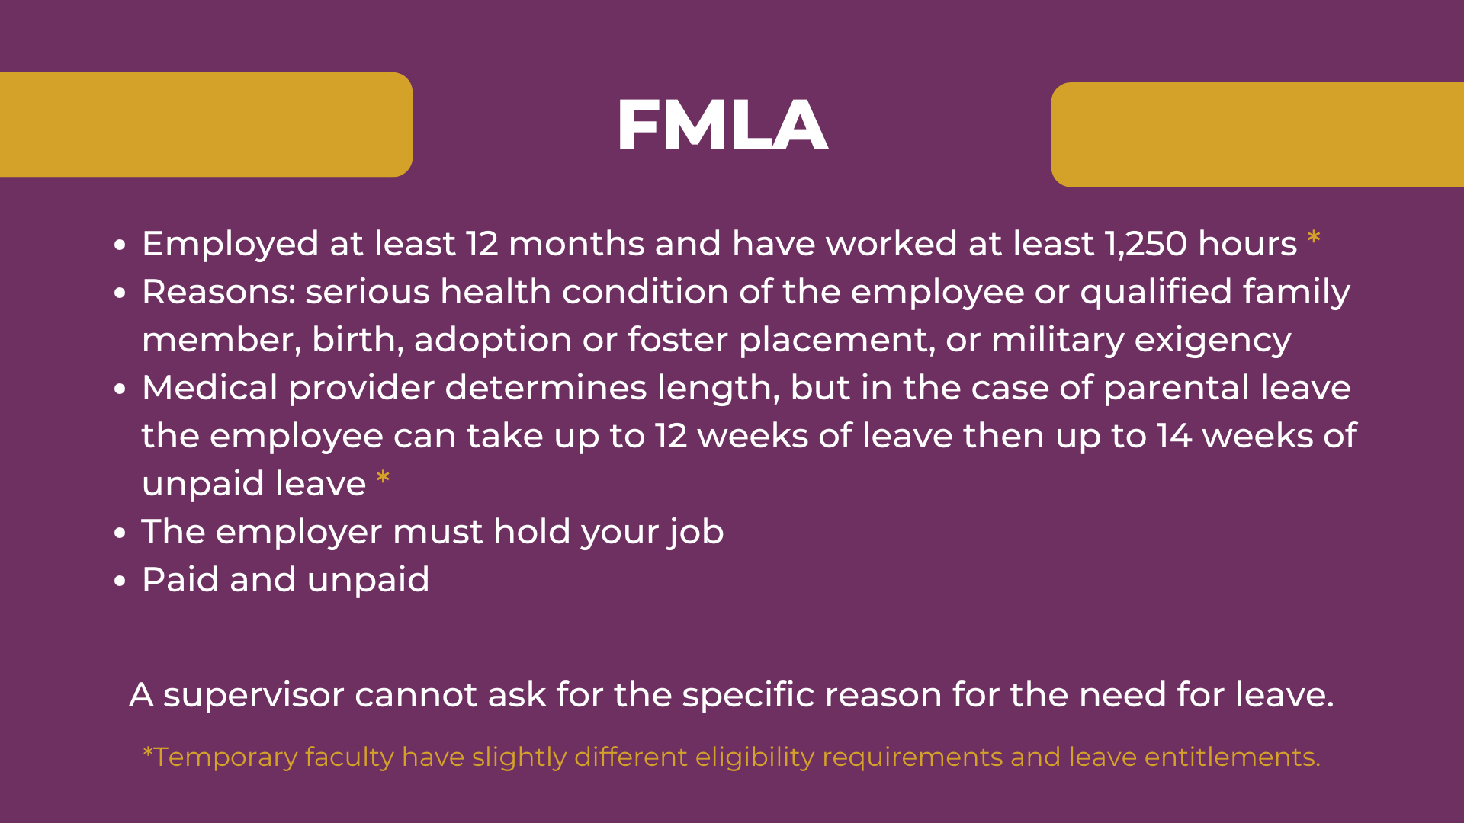

Slide 12
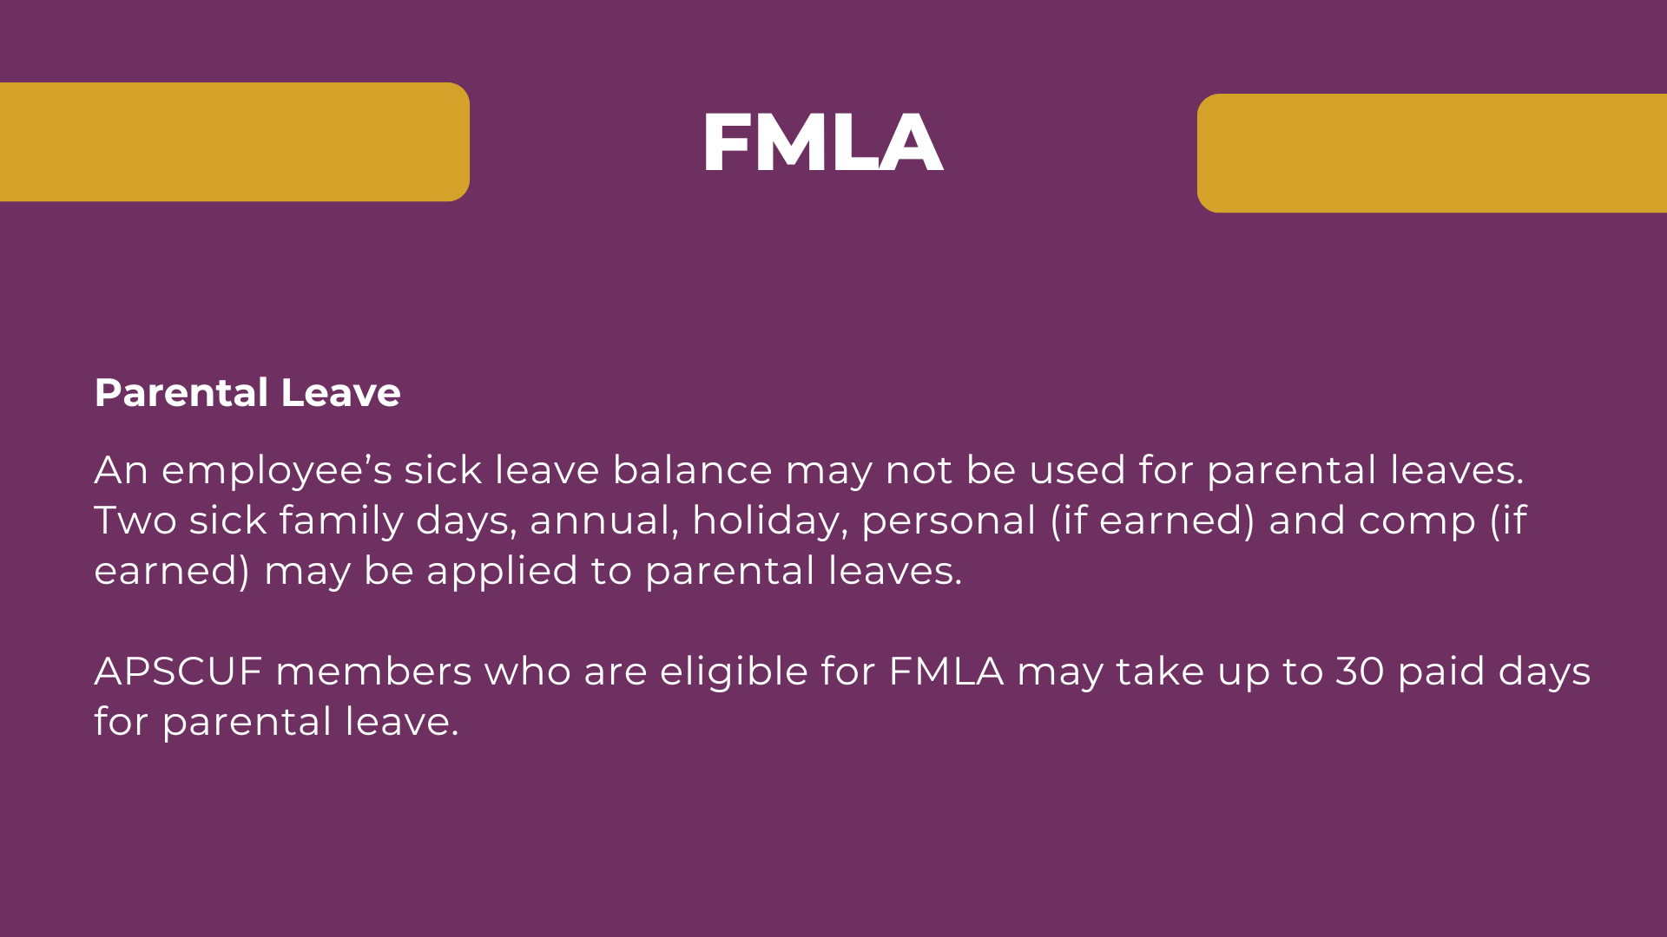

Slide 13
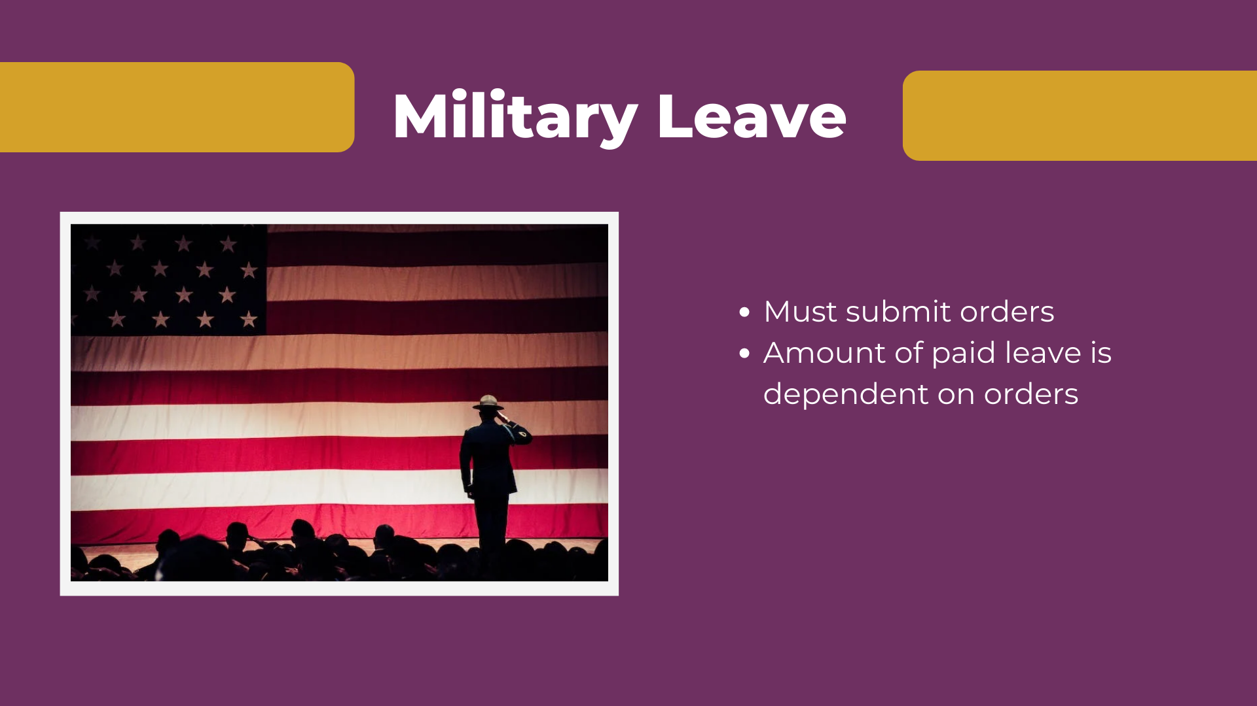

Slide 14


Slide 15


Slide 16
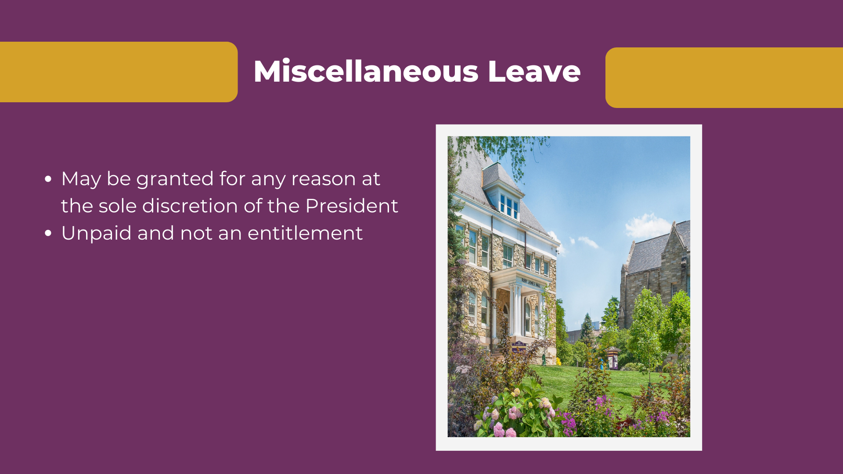

Slide 17
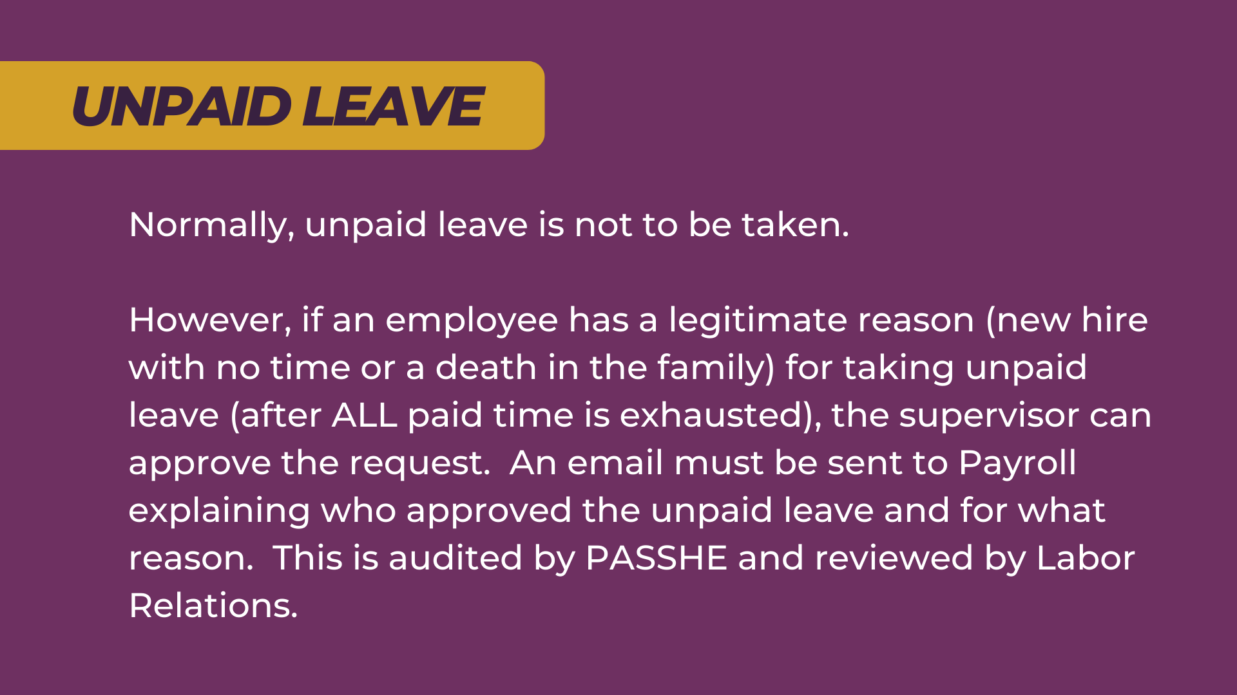

Slide 18
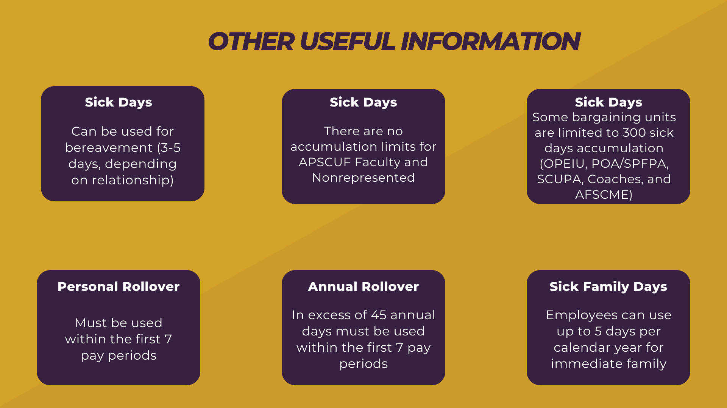

Slide 19


Slide 20


Slide 21


RESOURCES
Human Resources Contact
Leave Manager- Sue Robb x3117
Collective Bargaining Agreements
CLICK for 2025 Holiday Schedule
General Leave Accrual and Time Off

Slide 22


