Slide 1



Student Feedback on Instructor

Slide 2

What
Student Feedback on Instructor
Surveys are confidential – I don’t see your survey and I don’t know if you complete the survey or not
I receive a report of summarized survey data
I don’t receive the report until after grades have been submitted

Slide 3

Why
I value your input
I use your input to improve the class
Student ratings are used to make decisions regarding faculty tenure and promotion

Slide 4
Did you know that instructors who are perceived as attractive get more positive feedback on average than instructors who are not? Did you know that non-white instructors receive less positive feedback on average? Instructors who do not conform to the cultural expectations of what a stereotypical professor should be often receive less positive feedback. Biases like these affect the way we perceive others and impact the feedback we give.
Please keep this in mind as you provide feedback on this and other courses.

Slide 5
Such biases may include but are not limited to race, ethnicity, sexual orientation, gender identity or expression, national origin, religion, language, disability, and health related characteristics of your instructor
Students should also strive to avoid bias against their instructor due to course materials challenging their beliefs
Faculty have similarly committed themselves to avoiding cultural and social biases when evaluating student work and when there is disagreement with challenging course materials

Slide 6

How
You will receive an email from
SFI@wcupa.edu
with a link to your surveys

Slide 7
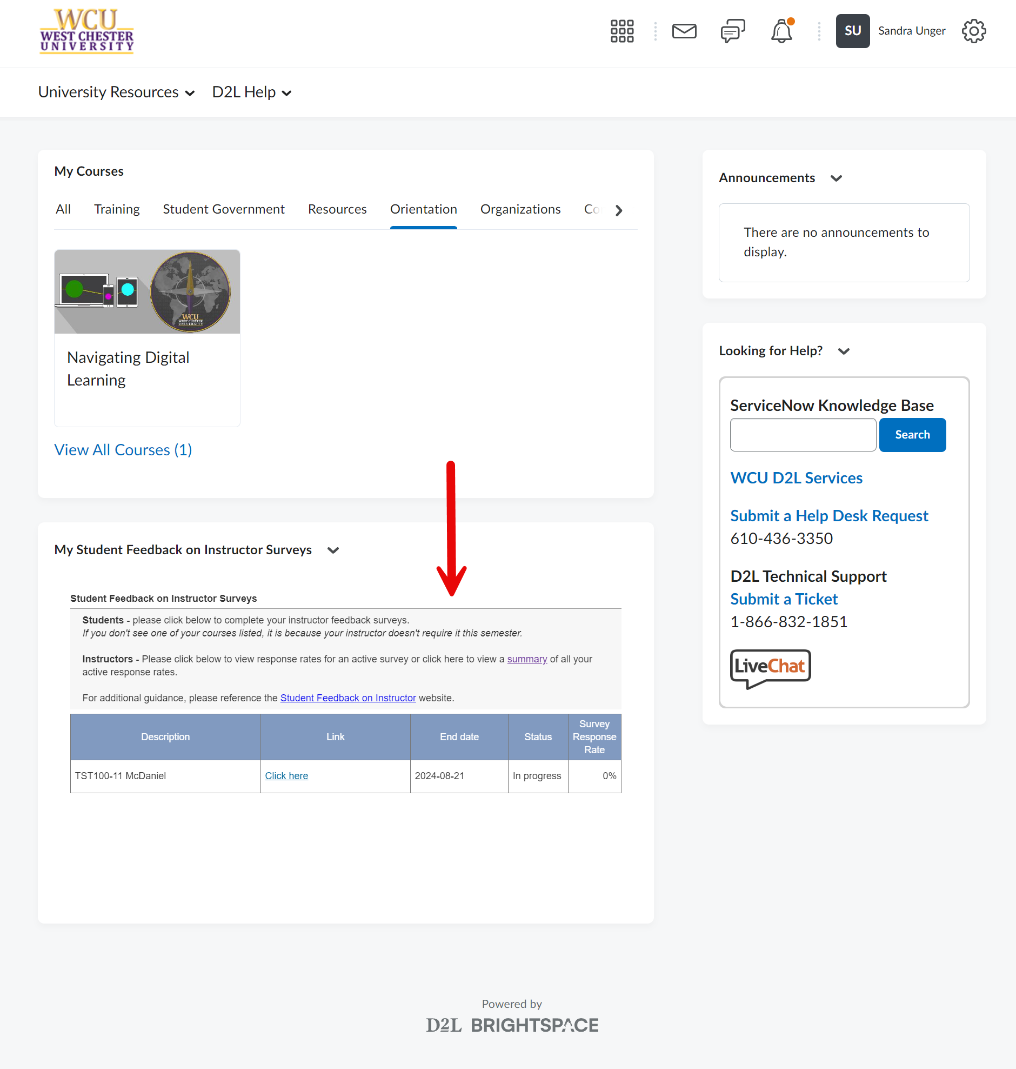
How
You can also access your surveys from the D2L home page

Slide 8
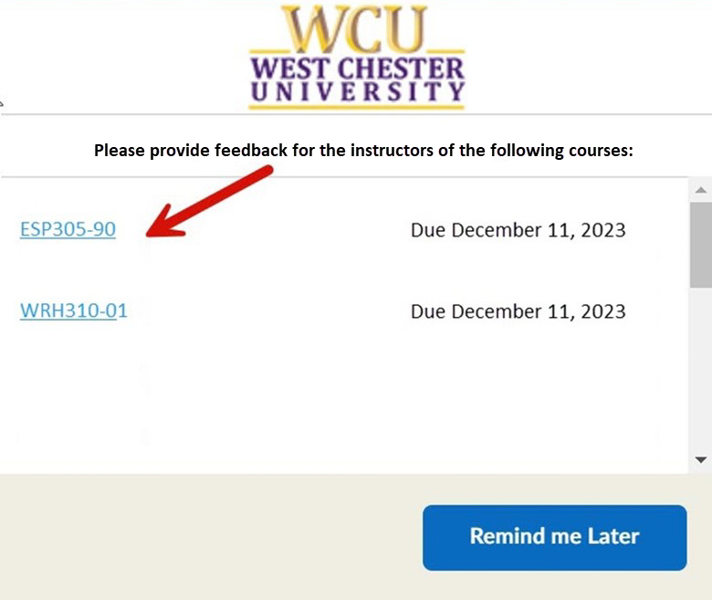
How
You will receive pop-up reminders in D2L with links to your surveys

Slide 9

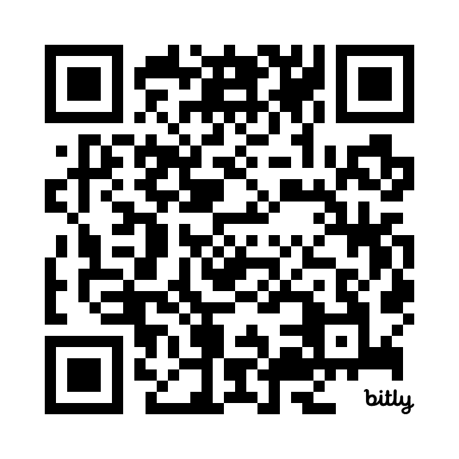
  Please complete the survey now
  https://SFI.wcupa.edu
Thank you for your participation!

