Slide 1
Approvals Timeline Review
CAPC Assembly
December 11, 2025

Slide 2
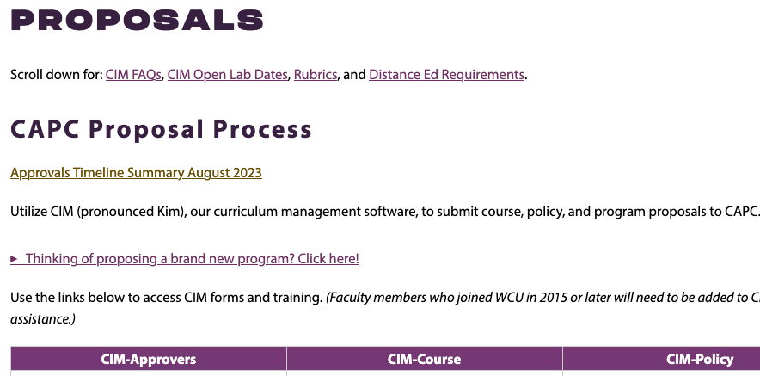
Approvals Timeline Summary

Slide 3
Approvals Timeline Summary
Summarizes criteria determining the effective date of course and program proposals (the earliest implementation semester)
Relevant factors:
  Nature of the proposed change (is it expansive or limiting/restrictive in its impact on students)
  Catalog cycle
  Registration cycle for subsequent semesters
  ‘Truth in advertising’

Slide 4
Program Changes
A. Program changes that limit curricular options, or change requirements, for students
Examples: elimination of a program/concentration; additional course requirement(s); degree change (e.g., BA to BS); additional prerequisite requirements that are not already reflected in the course list.
Such program changes should be approved in enough time to be advertised (e.g., via the catalog) to new students admitted to the program (typically one year in advance). For example, for the Fall 2026 implementation and admission cycle, changes would need to have been fully approved by May 2025.

Slide 5
Program Changes
B. Program changes that expand curricular options for students
Examples: addition of a new track; new course options to meet requirements; creation of a new non-degree program (e.g., a certificate)
Such program changes should be approved as soon as possible but not later than December of the year prior to implementation. For example, expansive program changes intended for Fall 2026 implementation would need to be fully approved by the December 2025 assembly (i.e., today).

Slide 6
Course Changes
A. Course changes that reduce or significantly impact student options
Examples: adding/removing general education attributes; additional/edits to prerequisites; substantial description changes; credit change; creation of a newly required course
Such changes need to be made prior to the start of course registration for a given semester. Given how early this process begins each semester, changes would need to be approved a year in advance, i.e., by the end of the same semester in the prior year. For example, changes for spring 2026 would need to be approved by May 2025 to be available to students at the start of the fall registration period for Spring 2026.

Slide 7
Course Changes
B. Course changes that expand accessibility or flexibility of courses, providing addition options to students
Examples: additional modality options, minor changes in course description
Such changes would not require an extended proposal timeline. However, course changes should be fully approved before the course registration period for the implementation semester. For example, changes for Spring 2026 should be approved by the end of September 2025 to be available for course registration beginning in October. It should be noted that in many cases such changes can go through Circulation.

Slide 8
CIM Proposal ‘Effective Dates’ Summary
Program changes that impose new requirements or limit student choices had to have been approved by May 2025 for Fall 2026 implementation
Program changes that are expansive in nature (e.g., add new options for students) had to have been approved by December 2025 (today) for Fall 2026
These timelines keep our proposal approval/implementation process aligned with the academic catalog
Reminder: Course changes generally need to be approved and built in time for the registration cycle for the desired implementation semester

Slide 9
Any questions?

