Slide 1
Capc kick-off meeting
Fall 2023

Slide 2
How CAPC Works

Slide 3
WHAT IS “CAPC”?
CAPC is the Curriculum and Academic Policies Council
  CAPC is a faculty legislative body, the only such body with authority to recommend changes to (or creation of) the curriculum and/or academic policies
  CAPC is a recommending body; the Provost has sole authority other the curriculum and academic policies

Slide 4
Why are we here?
…because CAPC is the curricular body mandated by the CBA (Article 31 section E):
  “There shall be a curriculum committee at each University, which shall be selected as determined by the FACULTY, but which may include at least one (1) administrator if designated by the President.”

Slide 5
Why are we here?
CAPC is governed by a set of bylaws that lay out the committee structure, duties, and processes that comprise the foundation of CAPC’s work
APSCUF runs elections for CAPC, which involve both at-large and department-specific members.
Members are elected to do the following:
  participate in CAPC’s decision-making processes around curriculum and academic policies, through the committee structure
  report back to their constituencies (department, college, etc.) about CAPC processes and actions
  department-specific members also provide support and guidance for colleagues developing curriculum proposals for submission to CAPC, e.g., about learning outcomes, CIM, etc.

Slide 6
How CAPC Works
Participation in decision-making processes happens through:
  work on committees and subcommittees
  monthly CAPC General Assembly meeting where decisions are made on the proposals sent up by the committees

Slide 7
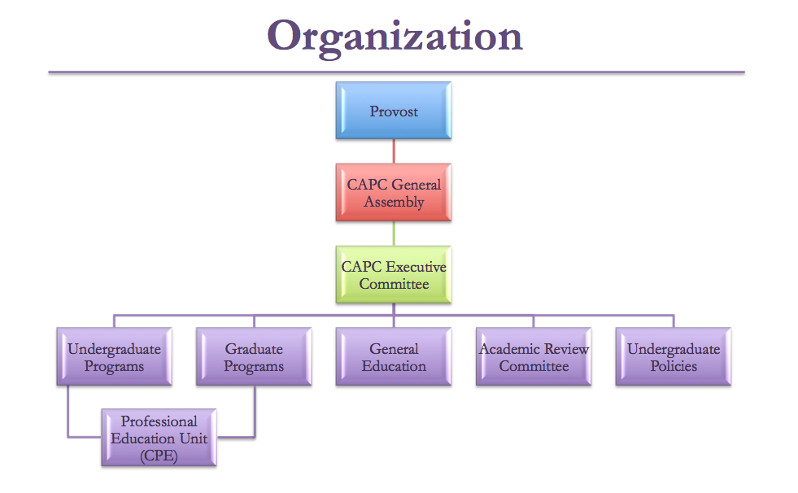
How CAPC Works

Slide 8
How CAPC Works
Several CAPC committees have subcommittees:
  General Education
    Distributives
    Diverse Communities
    Ethics
    Interdisciplinary
    Speaking Emphasis
    Writing Emphasis

Slide 9
How CAPC Works
Several CAPC Committees have subcommittees:
  Academic Review
    Course Review and Revalidation
    Low Enrollment Advisory
    Course Delivery
    Program Review
  Undergraduate Programs
    Culture Cluster

Slide 10
2023-24 CAPC Executive committee
  Chair: Susan Johnston, Anthropology & Sociology
  Vice Chair: Rodney Mader, English
  Secretary: Francis Atuahene, Public Policy & Administration
  Undergraduate Programs: Josh Auld, Associate Provost for Academic Affairs
  Undergraduate Policies: Elizabeth Pfaffle, Applied Music
  Graduate Programs & Policies: Lisa Calvano, Dean of the Graduate School
  General Education: Karen Mitchell, Psychology
  Academic Review: Jade Burris, Early & Middle Grades Education
  CAPC Support: Patrick Richard, Academic Affairs

Slide 11
How CAPC Works
You should know your assigned committee(s) by now. If not, they can be found at the CAPC website
Committees should meet on a regular schedule
Your service on CAPC includes attendance at both Assembly meetings and committee meetings
If you cannot attend, your proxy should attend on your behalf – applies to both Assembly and committee meetings
  The bylaws require all CAPC members to have a proxy identified and communicated to the CAPC Secretary in advance of meetings

Slide 12
How CAPC Works
Article 4.A.1.c.
“Each CAPC member will submit to the CAPC Secretary written notification of that member’s proxy. In the case of members elected by constituency, the proxy must be selected from the same constituency. Proxies should be identified no later than the first scheduled Assembly in the fall. Should the proxy require an alternate, the proxy or member should notify the Recording Secretary in writing prior to the Assembly in which the alternate is to serve.”

Slide 13
How CAPC Works
Your service on CAPC also includes the following:
  preparing for committee and sub-committee meetings by reading in advance and reflecting on all documents on the agenda
  preparing for CAPC Assembly by reviewing in advance those items on the agenda that did not come from your committee
  ensuring that you are fully acquainted with the current requirements for course and program proposals, including the relevant policies (syllabi, course evaluations, etc.)

Slide 14
How CAPC Works
Part of your duty as a CAPC member is to represent your constituency, and this means reporting back to them about CAPC Assembly and its procedures, debates, and recommendations.
  This includes CAPC decisions about courses, programs, or policies that may have impact on your department (or your other constituencies), whether or not they originated in your department or college
  You should also let your constituents know when an item of theirs appears on the Assembly agenda and remind them that they are invited to attend the relevant assembly meeting to respond to questions that might arise

Slide 15
How CAPC Works
Your duties as a CAPC member also include representing your constituency’s views:
  In assembly ‘floor’ discussions about motions under consideration
  In the ‘Updates from Departments’ portion of the agenda (under Continuing Business); this is a good place to let us know about items under discussion in your departments (or other constituencies)

Slide 16
How CAPC Works
  NOTE: When a committee has sent an item forward for the Assembly agenda, it is with that committee’s support (unless explicitly stated otherwise).
  Similarly, when a department chair, dean, or CAPC officer ‘signs off’ on a proposal in CIM, it indicates support (not simply acknowledgment)
    That said, deans may assume they are leaving curricular decisions to the departments and to CAPC, and are only approving the availability of resources and other non-curricular issues
  In point of fact, a decision at each step in the review process is to recommend (or not recommend), since final approval rests with the Provost

Slide 17
How CAPC Works
Motions passed by CAPC are submitted to the Provost for approval. The Provost makes the ultimate decisions regarding curriculum and academic policy.
  There is a procedure for dialogue in the event that the Provost does not approve CAPC recommendations. This is rare, however.
  The Provost’s approvals are circulated by Patrick Richard and are available on the CAPC website.

Slide 18
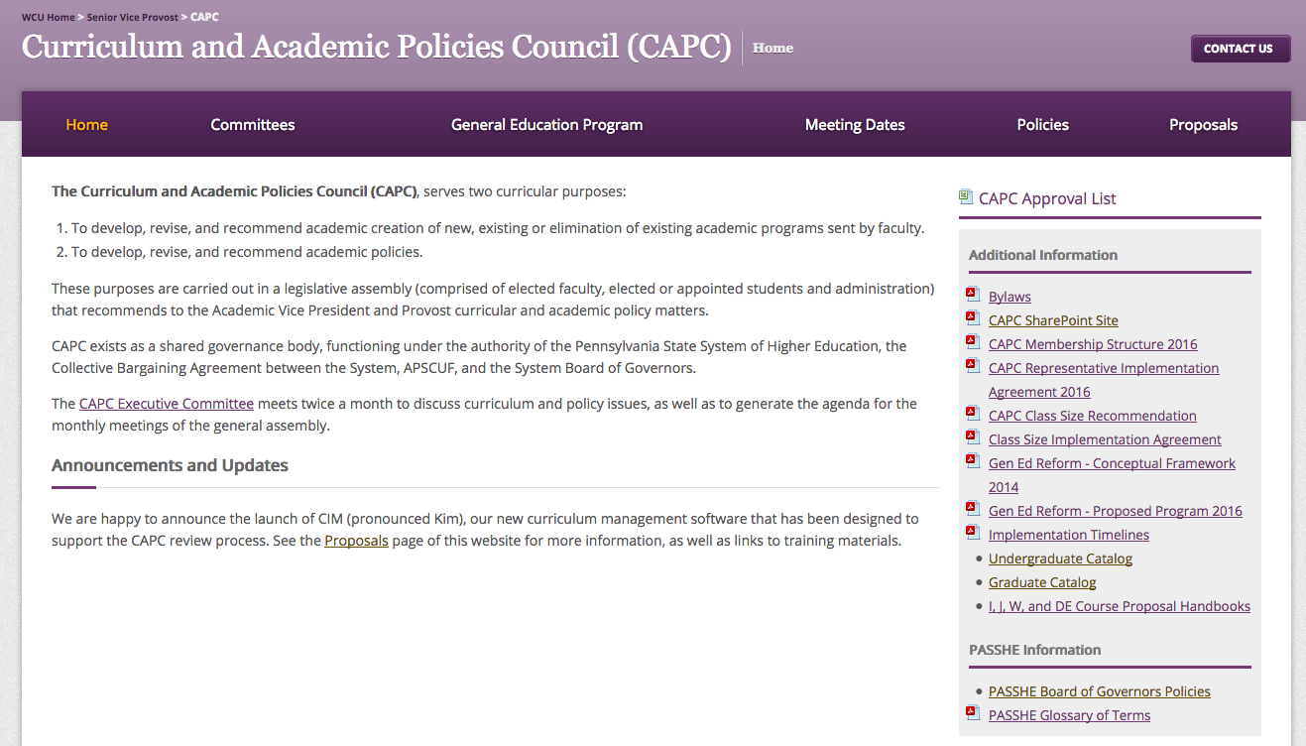
CAPC website
https://www.wcupa.edu/viceProvost/capc/

Slide 19
REMEMBER…
  In summary:
  CAPC is a contractually mandated representative body that gives faculty significant control over the curriculum.
  At WCU, we have it a lot better than many other places, including some in PASSHE
  As CAPC representatives, we have an obligation to responsibly carry out our mandate on behalf of the faculty and departments we represent

Slide 20
How cim Works

Slide 21
CIM: Course inventory management
https://www.wcupa.edu/viceProvost/capc/

Slide 22
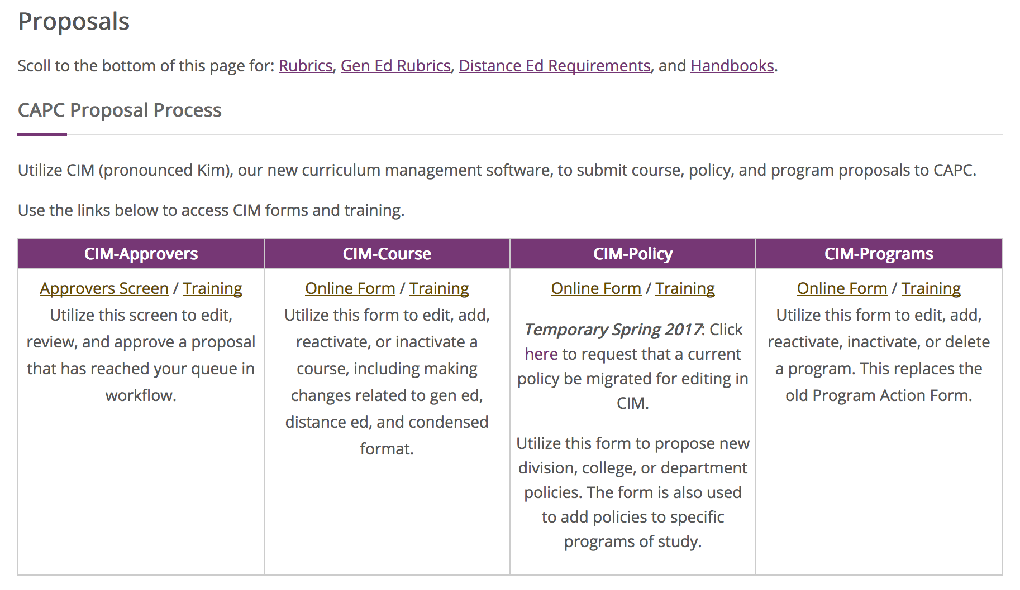
HOW CIM WORKS

Slide 23
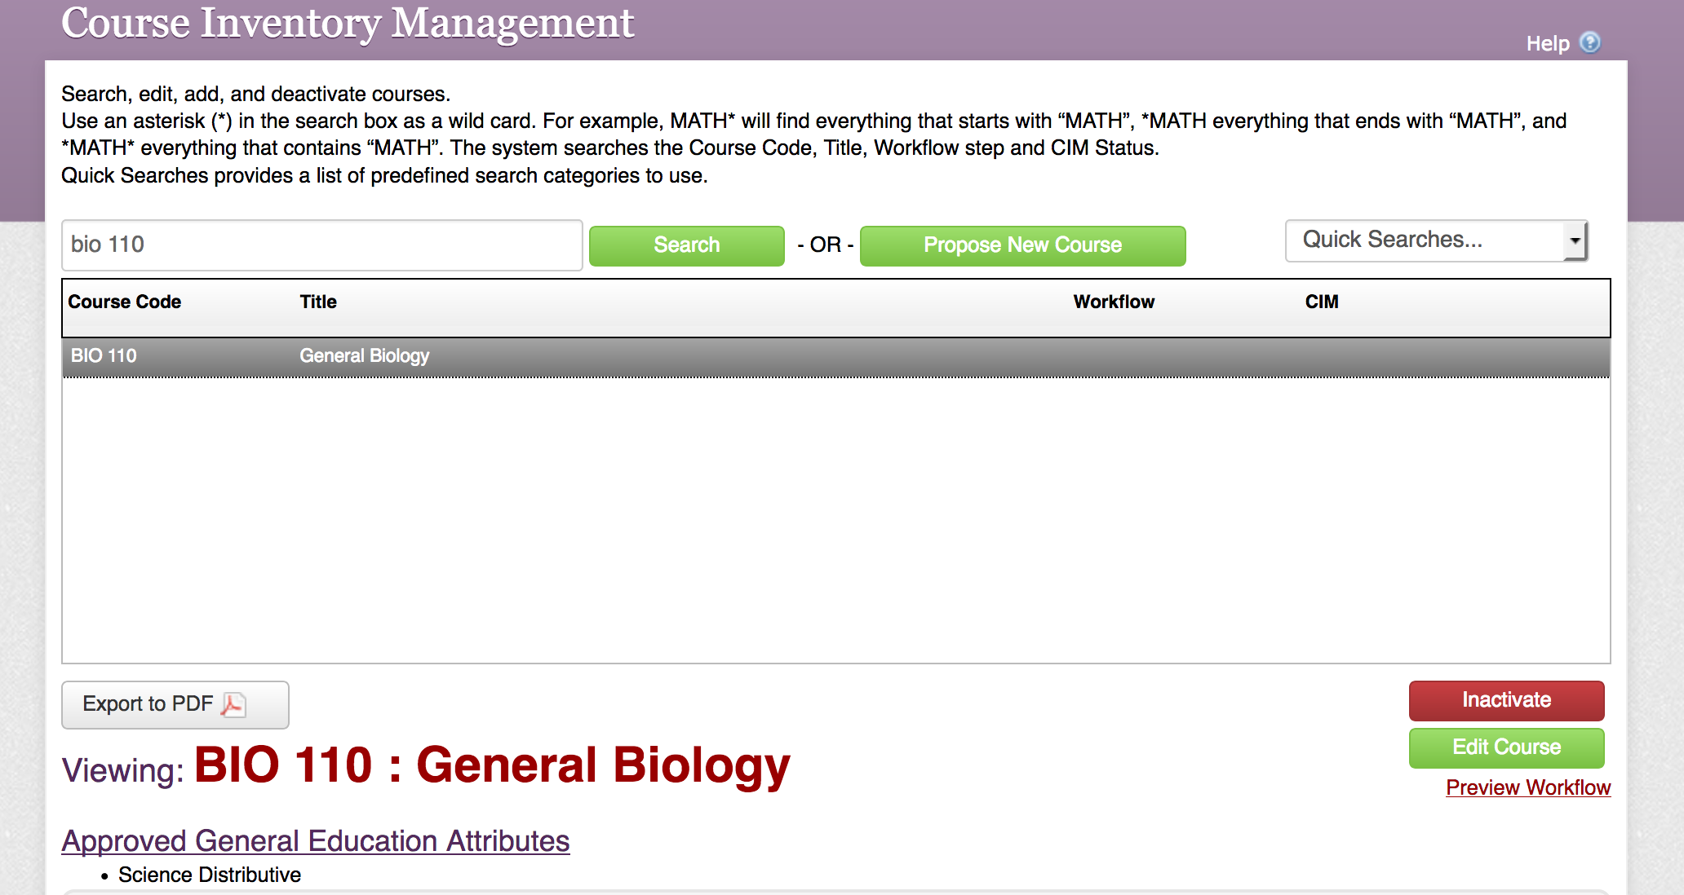
HOW CIM WORKS

Slide 24
HOW CIM WORKS

Slide 25
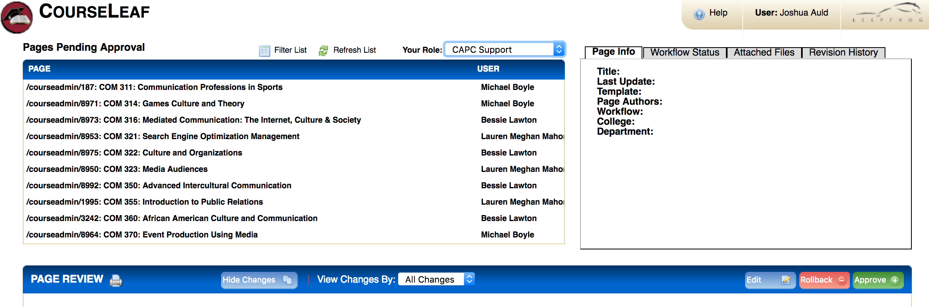
HOW CIM WORKS

Slide 26
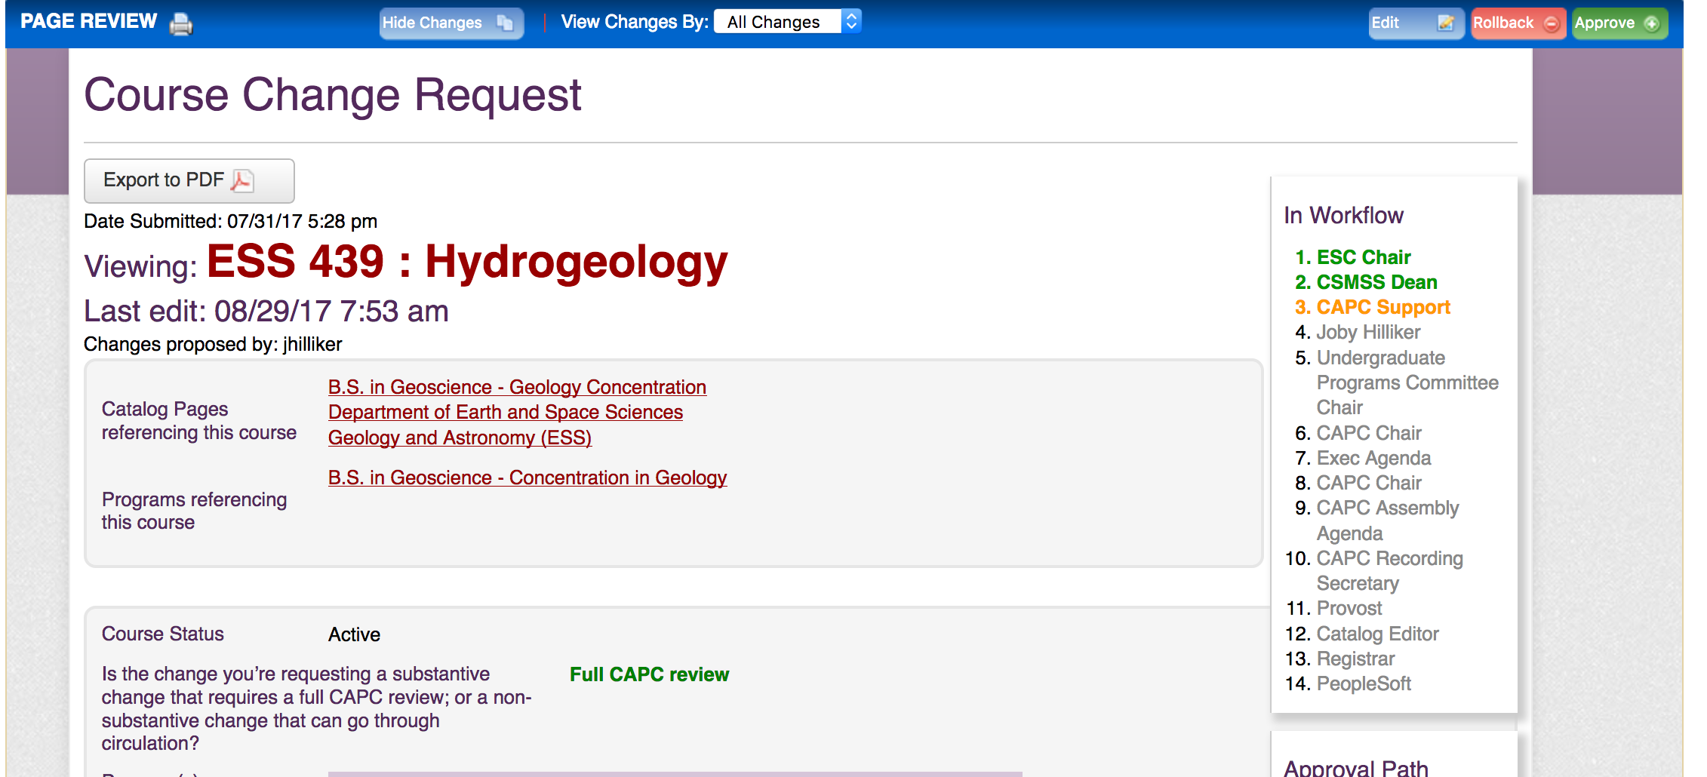
HOW CIM WORKS
Note: Email notifications (approval requests & notifications) come from “Patrick Richard”

Slide 27
HOW CIM WORKS

Slide 28
Cim reimplementation
Anticipated Timeframe
Form | Expected Availability
Program (edit existing or propose new program) | End of September 2023
Policy (edit existing or propose new policy) | End of September 2023
Course (edit existing or propose new course) | Middle of November 2023
Proposal approval timeline adopted last year will be followed
  See CAPC website (Proposals page)
For time-sensitive proposals, preparers are encouraged to work with relevant CAPC committee chairs to ensure proposal readiness for submission when forms are available

Slide 29
Proposal timelines 2023-24
Program changes that expand student options: must be approved by December 2023 assembly
Program changes that restrict student options: deadline was May 2023 for Fall 2024
Course proposals for Summer or Fall 2024 implementation must be recommended by February 23, 2024 in order to be available for registration
Course changes for Winter or Spring 2024 that can go through Circulation (e.g., additional modality) must complete that process by the start of October registration; see the email detailing the specific process to be used while the CIM forms are offline

Slide 30
CIM OPEN LABS
We typically provide two in-person opportunities early in the semester to help preparers with curriculum or CIM questions as they work to enter proposals in CIM. This semester we are doing them a bit later due to the gradual re-implementation of CIM.
Wednesday, Sept. 27, 1-3, Philips Lower-Level Conference Room
Friday, Oct. 27, 12-2, via Zoom (link will be sent out by Patrick Richard)

Slide 31
Recent updates & Efforts for this year

Slide 32
TRANSITION TO BANNER (RAMPORTAL) FROM MYWCU

Slide 33


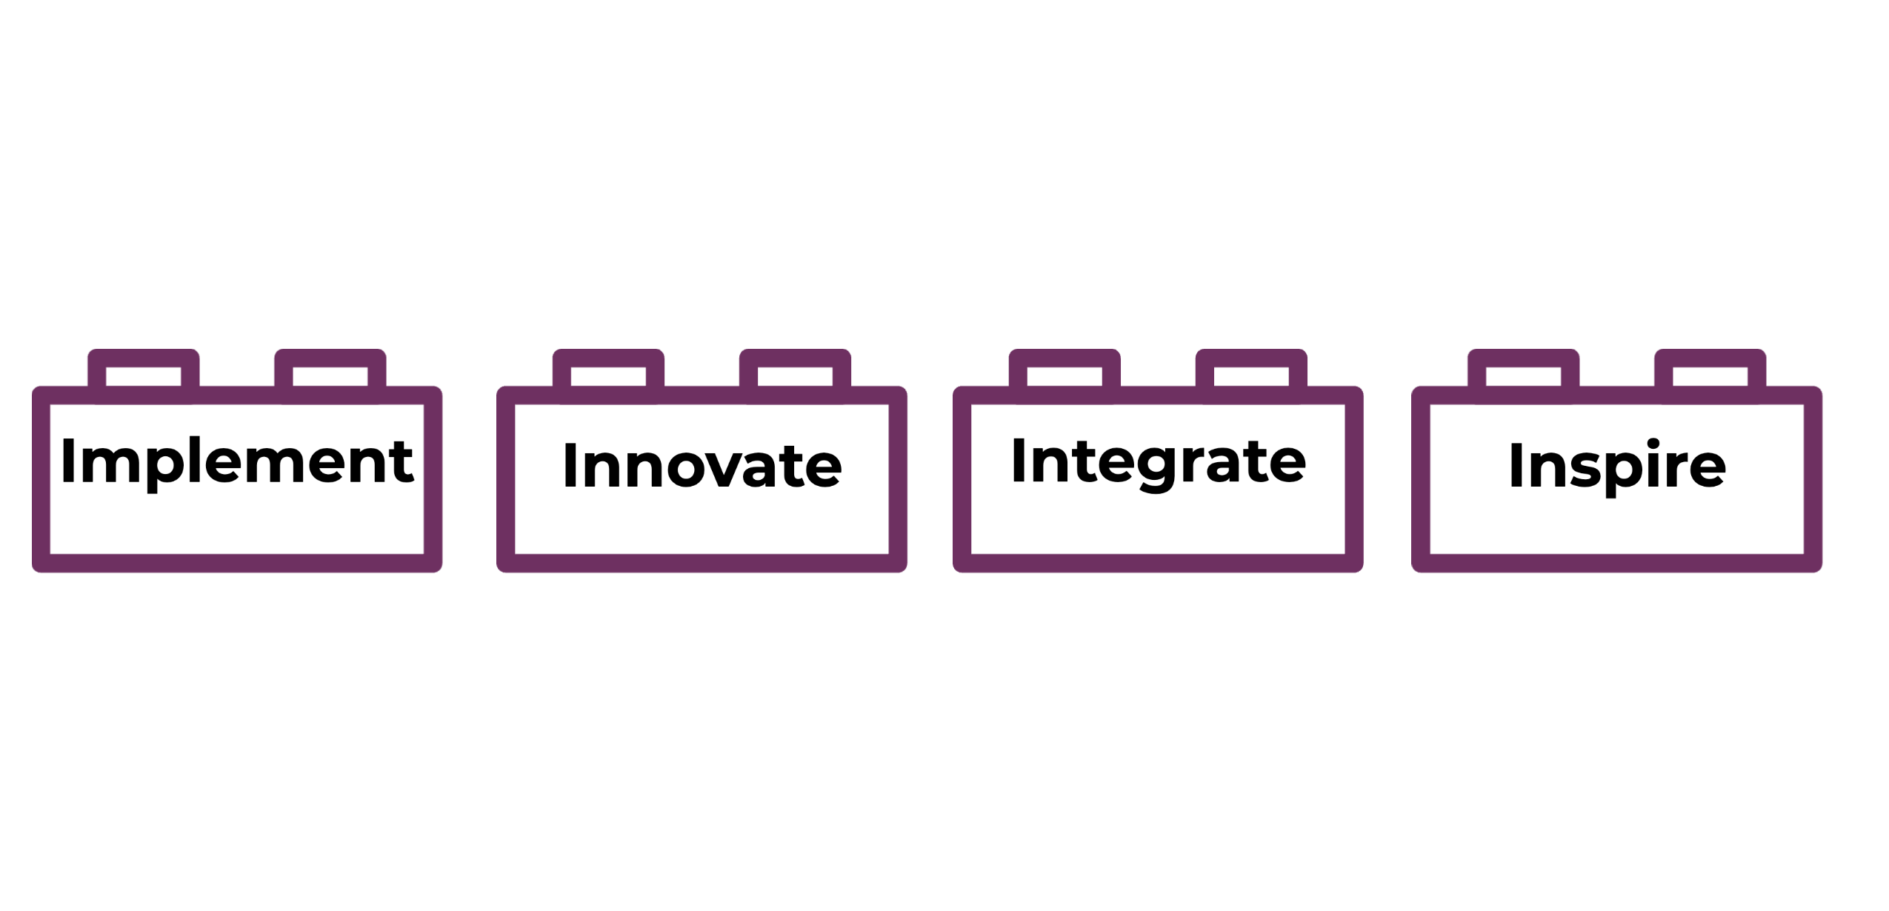

Banner Project
Why?
  PASSHE Move to a singular Student Information System (SIS)
  Facilitate “Academic Sharing”
  Two instances of Banner
    STP: Shared Technology Platform (all other PASSHE Schools)
    WCU Instance
How is WCU approaching this project
Implement
to maximize institutional flexibility to prioritize student success for the future.
Innovate
WCU business processes to transform the user experience.
Integrate
people, processes, information, and systems to create alignment, cohesion, and efficiency.
Inspire
collaboration and student-centered services across campus.

Slide 34
Instruction Mode Changes
Goal: Create greater clarity regarding how fully online courses are offered, particularly regarding whether the instruction is offered in real-time (synchronously) or more self-paced (asynchronously).
Instruction Mode | myWCU Code | RamPortal Code | Definition
In Person | P | IP | Face-to-face instruction Students attend in-person Distance learning is up to 15% of total course
Blended | BL & WE | BL | Combination of face-to-face and distance Distance may be synchronous or asynchronous Distance learning 15-79% of total course
Distance Majority | O8 | DM | Combination of face-to-face and distance Distance may be synchronous or asynchronous Distance learning 80-99% of total course
Distance Synchronous | OL | DS | Distance learning 100% of total course A portion of the course is synchronous
Distance Asynchronous | OL | DA | Distance learning 100% of total course The entire course is asynchronous
Multi-Modal* | Not in myWCU | MM | A mix of face-to-face and distance instruction Students have option to participate in class using either modality through semester
*CAPC is working on framework for Multi-Modal course review. Anticipated for Fall 2025.

Slide 35
Shifting Instruction Modes
This current instruction modes (P, BL, WE, O8, OL) will continue to be scheduled through summer 2024.
The new instruction modes (IP, BL, DM, DA, DS) will be scheduled starting fall 2024.
CIM, the system utilized by CAPC to manage curricular changes, will be updated to link to banner effective Fall 2023. Therefore, the new instruction modes will show in CIM this year.
  If a department is updating the instruction mode on a course in CIM, they will select from the new list of instruction modes.
Multi-Modal won’t be available for utilization until Fall 2025.

Slide 36
Single-Component Classes
WCU Currently utilizes multi-component courses (i.e., courses with two elements such as Lecture & Lab, or Lecture & Discussion).
  Example: BIO 110 has a lecture & lab component
In Banner we’ll move to having unique courses for each component
  Example: BIO 110 = Lecture, BIO 110L = Lab
  These courses are then setup as corequisites to ensure students enroll in both.

Slide 37
Shift to single-component
Worked with impacted departments to move multi-component courses to single-component in the catalog.
Effective for fall 2024
WCU Component Values
  Lecture: Remains the 3-digit catalog number (e.g., BIO 110)
  Laboratory: L will be placed at end of number (e.g., BIO 110L)
  Discussion: D will be placed at end of number (e.g., BIO 110D)
  Seminar: S will be placed at end of number (e.g., BIO 110S)

Slide 38
Grading
Each grade value has its own logic for 1) if grade is calculated in GPA; 2) if the grade counts toward earned credit.
Introducing characters to grades to distinguish between: standard grades, remedial grades, forgiven grades, academic renewal grade
  Example: Grade of "A"
    Calculate in GPA = Yes
    Earn Credit = Yes
  Example Grade of "A*" for remedial courses
    Calculate in GPA = Yes
    Earn Credit = No
Introduces a non-graded component (i.e., labs, discussions, etc.)

Slide 39
Examples of Grades
Level | Grade | Quality Points | Earned Credit | Count in GPA | Mode
DR | A | 4.000 | Yes | Yes | Standard
DR | E | 1.670 | Yes | No | Covid-19
GR | B+ | 3.330 | Yes | Yes | Standard
GR | P | 0.000 | Yes | No | Pass/Fail
GR | A-** | 3.670 | No | Yes | Accelerated TR Credit
UG | C | 2.000 | Yes | Yes | Standard
UG | C* | 2.000 | No | Yes | Remedial
UG | D^ | 1.000 | Yes | No | Academic Forgiveness
UG | D^^ | 1.00 | Yes | No | Academic Renewal
DR GR UG | NC | 0.000 | No | No | Non-Graded Component

Slide 40
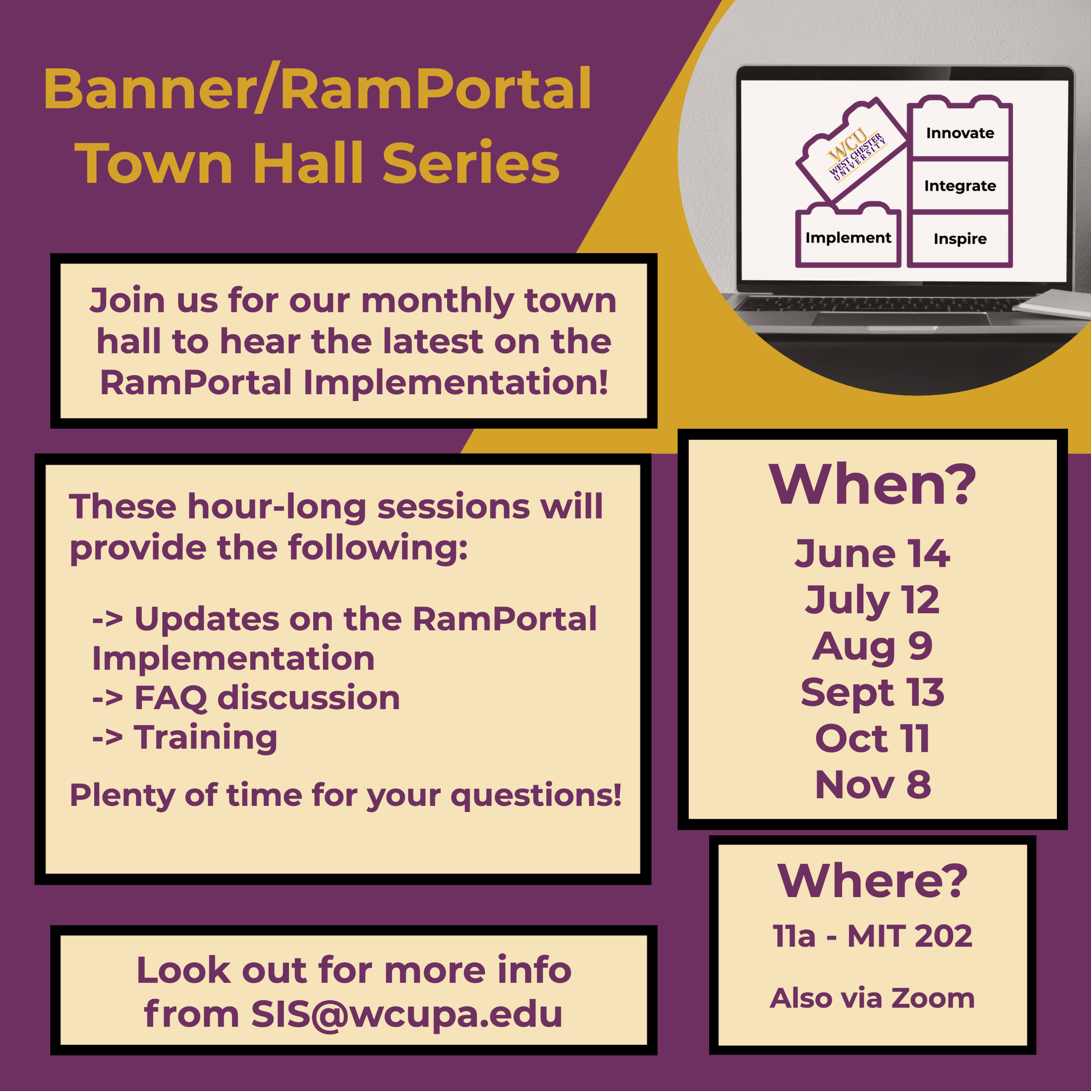
More to Come. Stay Informed.
Email:
SIS@wcupa.edu
Website: wcupa.edu/RamPortal

Slide 41
CAPC COMMITTEE UPDATES & PRIORITIES

Slide 42
Summer updates
DE Training Task Force Recommendations 2022
  New, modular OFD (Online Faculty Development) program developed by ODLI, implemented this summer
    4 required modules & 3 additional ‘elective’ modules
    Self-paced, asynchronous (on D2L)
Academic Policies Audit
  Provost’s office and CAPC reviewed the scope of existing policies (on CAPC website and/or in CIM)
  Eventual goal is to organize, update, and ensure academic policies are current and consistently available in a single location
Academic Review Committee re-envisioning (discussed below)

Slide 43
Priorities and efforts this year
Academic Programs & Policies
  Work toward a smooth process as CIM is reimplemented over the fall, supporting programs as they prepare proposals
  Complete process of ensuring undergraduate major and minor programs comply with existing PASSHE policy and local definitions
  Continue development and review of a comprehensive Graduate Academic Programs Policy
  Continue work to update and organize other Graduate and Undergraduate academic policies

Slide 44
Priorities & Efforts this year
General Education and General Requirements
  Complete the W revalidation process
  Complete Capstone assignment & ePortfolio implementations
  Recommend for approval new J Goal & SLOs resulting from the work of the Diverse Communities Task Force
  Continue work to create vibrant faculty learning communities around each of the components
Reminder: Gen Ed courses that come through the proposal review process, regardless of reason, will be reviewed under the current GE goal and SLO structure

Slide 45
UPDATES & EFFORTS THIS YEAR
Academic Review
  Committee’s structure and duties were reviewed this summer and refocused going forward in response to changing circumstances and needs
  Examples:
    using past reports to inform future work (e.g., Program Review subcommittee, Low Enrollment Advisory)
    utilizing a reactivated Course Delivery subcommittee to provide expertise on course modality questions
    refocusing the Course Review and Revalidation process on key elements of compliance with the catalog

