Slide 1
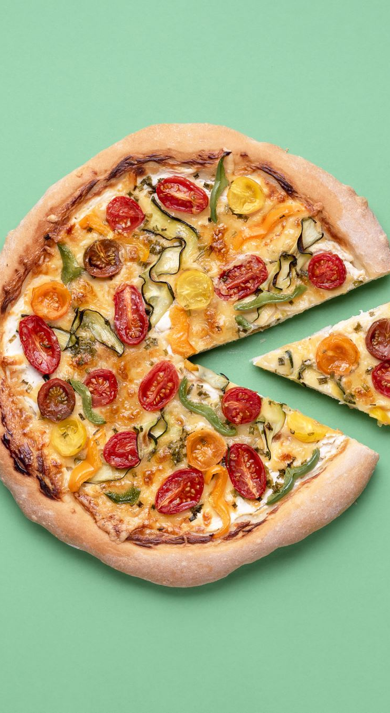
SAVE THE DATES!
Philosophy Events: Spring 2025
Monday, Feb 24 PHILM Night-Birdemic: Shock & Terror
4:30, AND 211, with snacks
Friday, April 4 Grad Student Conference
Monday, April 7 PHILM Night- Arrival
4:30, AND 211, with snacks
Thurs., April 24 Sustainability & Spirituality Conference
with Dr. Grace Ji-Sun Kim
6 PM, CHANGED to Mitchell 102
Wednesdays 3-4 ‘Phika’ Coffee & Sweets

