Slide 1
Cortisol Levels Relate to Executive Functioning in the classroom for children Attending Head Start Preschool
Brown, E.D (Faculty Member)., Weaver, Z., Garnett, M.L., Streich, M., and Shivde, G (Faculty Member).
Department of Psychology- West Chester University of PA

Slide 2
Introduction
Approximately 15 million children in the United States grow up in poverty (National Center for Children in Poverty, 2018)
The impact of poverty circumstances on learning and social-emotional development in children (Duncan & Brooks-Gunn, 1997)
Socioeconomic status disparities in Executive Functioning for explaining these outcomes.
Fitzpatrick and colleagues (2014)- academic success
Aspects of EF (e.g., working memory, cognitive flexibility, inhibitory control and attention shifting) predict variance in preacademic school readiness that is unique from that predicted by measures of general intelligence and processing speed.
O' Toole and colleagues (2017)- prosocial relationships
EF predicts prosocial behavior and positive peer relationships

Slide 3
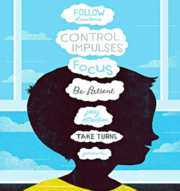
Executive Function
EF is a higher order cognitive system comprised of a variety of interrelated yet partially dissociable abilities (Miyake, 2000) such as strategic planning, cognitive flexibility, working memory, attention, regulation of emotions and inhibition of inappropriate or impulsive behavior (Fuster, 2002; Diamond, 2006)
EF skills in the classroom would serve to help children hold an instruction in mind during a classroom activity, while maintaining the ability to focus on novel stimuli relevant to problem-solving tasks and resisting external or internal distractions (Fitzpatrick et al., 2014)

Slide 4
The role of physiological stress in explaining Ses disparities in ef
Bronfenbrenner (1989)- Contextual risk factors of poverty disrupt the proximal processes in the child’s environment that are supportive of EF development (Fiese & Winter, 2010)
Physical and psychosocial family instability and home chaos-> poorer self-regulatory aspects of EF (Evans, 2003; Brown et al., 2010)
The link between childhood economic hardship and EF difficulties is also partially explained by dysregulation in the hypothalamic-pituitary-adrenal (HPA) axis and associated atypical neurodevelopment (Evans & Kim, 2013; Blair & Raver, 2016) In brain regions critical for EF (Miller & Cohen, 2001)

Slide 5
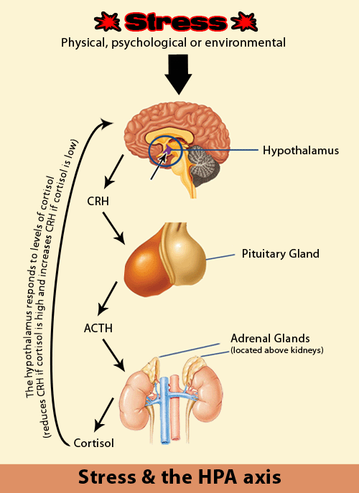
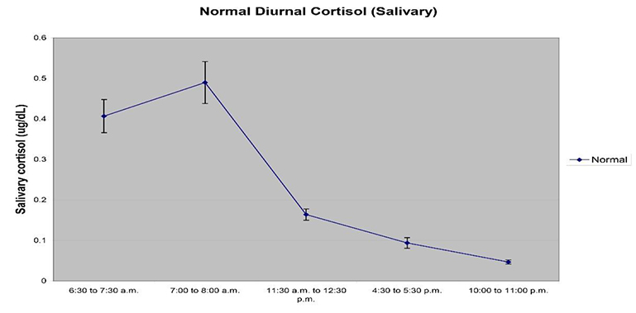
Poverty circumstance and Hpa activity
HPA Axis-primary physiological stress response system.
Activity during early childhood impacts life-long neurophysiological development (Gunnar & Quevedo, 2007)
Activity in the HPA axis - frequently measured via its end-product, cortisol, which is a primary glucocorticoid and can be obtained noninvasively through the sampling of hair or saliva (Kronenberg, 2007)
Adaptivity of cortisol production is context dependent (McEwen, 2013)
Research most consistently demonstrates that early childhood poverty is associated with excessive cortisol production in the HPA axis (Lupien et al., 2001; Evans et al., 2013)
Manifestations of HPA dysregulation (excessive or diminished production) in the individual are dependent upon developmental considerations, and the severity, nature and duration of stress exposure (Lupien et al., 2009).

Slide 6
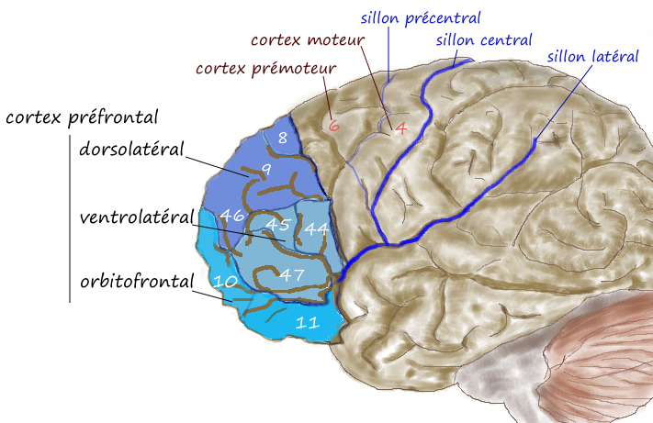
Hpa dysregulation and the developing prefrontal cortex
Dysregulated cortisol production is associated with synaptic suppression in PFC in animal models (Joels & Baram, 2009)
Risk for the development of this brain region as it is undergoing a period of rapid growth or synaptogenesis throughout early childhood (Coley et al., 2015).
Localization of EF to the PFC and related circuitry
Evidence From Neuroimaging Research
(Hanson, et al., 2013)- Observed reductions in grey matter volume in PFC of children in poverty.
(Noble et al., 2015)- SES disparities in PFC surface area

Slide 7
Cortisol and executive functioning
Blair and Raver (2013) examined the relationship between children from low-income households’ basal or morning cortisol levels and performance on measures of EF longitudinally (7 months to 4 years of age). Findings indicate that higher basal cortisol, a single time-point measurement predicted poorer performance on EF measures throughout early childhood.
Cortisol reactivity in Head Start Contexts (Blair & Razza, 2005)
Typical cortisol reactivity or slight increases in cortisol production followed by down-regulation in response to challenge predicted higher teacher-reported self-control and attention
A gap in our understanding of cortisol and EF is that most studies to date have focused on performance-based measures as opposed to assessing EF as manifested in children’s classroom behavior

Slide 8
Cortisol & Preschool Contexts
Full day childcare settings such as preschool alter the trajectory of cortisol across the day in middle-high SES children (Vermeer et al., 2006)
Unclear in the current literature as to whether similar alterations in typical cortisol trajectories occur in preschool contexts for children in poverty (Hatfield, 2019)
Particular poverty risk (home chaos, instability) associated with more typical decrease after midmorning (Eliassan et al., 2012)
Cumulative poverty risk- flattened cortisol trajectory (Zalewski et al., 2012)
Importance of childcare and relationship quality (Rappolt-Schlichmann, 2009)
Understanding more about how the context of preschool impacts cortisol across the day represents a critical need as preschool is a key context for early intervention, and atypical cortisol production holds significant implications for the development of EF.
We know of no studies to date that have examined the relationship between EF and cortisol production across the day in Head Start contexts.

Slide 9
Participants and Procedure
Participants
310 children who attended preschool in a large city in the Mid-Atlantic region
Mean age of children – 4 years, 9 months
53.5% female
51.3% African American, 16.l7% Latino or Hispanic American, 11.9% Asian American, 20.1% Caucasian or European
79.2% of children came from households with incomes below the federal poverty guideline; an additional 18.9% came from families classified as low-income
Students prescribed medications that have. been demonstrated to alter cortisol levels were excluded from the study
Procedure
Recruitment
Demographic interview with parents or caregivers
Assessments of child salivary cortisol
Completed at 9 am, 10:30 am, 12 pm, and 1:30 pm
Teacher ratings of child executive functioning

Slide 10
Materials and measures
Demographic Interview by Ackerman, Brown, & Izard (2003)
Provided information about standard indicators such as child age, sex, race and ethnicity, family size and household income
BRIEF (Gioia, Isquith, Guy & Kenworthy, 2000)
Obtain structured ratings of children's EF in academic context
Subdomains
Shifting
Imitation
Inhibition
Emotional Control and Working Memory
Planning/Organizing and Monitoring
Cortisol
510-k cleared high-sensitive enzyme immunoassay, a biochemical test for the concentration of cortisol in saliva (Salimetrics, LLC, State College, PA)
AUCg (Area Under the Curve with respect to ground)
AUC_{G}= (m₂+m₁) t₁2+(m₃+m₂) t₂2+(m₄+m₃) t₃2

Slide 11
Table 2
Correlations Among Study Variables This table shows the zero-order correlations between the independent variables and the teacher reports of executive functioning(BRIEF).
Variable 1 2 3 4 5 6 7 8 9 10 11 12 13 14 15 16
1. Age (Months) -
2. Sexª -.04 -
3. Race/Ethn. .01 .16** -
4. Care/Needs .07 -.07 .09 -
5. Cortisol .07 -.04 .11 .10 -
6. BT(inhibit) .18** .12**.02 .17** .19** -
7. BT(shift) .25** .06 .08 .11 .25** .89** -
8. BT(emotion) .21** .06 .03 .17** .20** .91** .94** -
9. BT(initiate) .23** .05 .07 .09 .26** .82** .88** .83** -
10. BT(mem.) .26**.11 .09 .08 .31** .83** .89** .82** .92** -
11. BT(plan) .28** .11* .08 .09 .29** .83** .92** .84** .93** .97** -
12. BT(org.) .21** .08 .04 .12* .30** .85** .88** .85** .85** .88** .89** -
13. BRIEF(BTM) .24**.11 .06 .14* .25** .92** .92** .88** .92** .93** .94** .91** -
14. BRIEF(BRI) .22** .08 .04 .15** .22** .97** .97** .98** .87** .87** .89** .89** .94** -
15. BRIEF(MI) .26** .10 .08 .11 .29** .88** .93** .87** .95** .98** .98** .93** .98** .93** -
16. BRIEF(GEC) .25** .09 .06 .13* .27** .93** .96** .93** .94** .95** .96** .93** .98** .97** .99** -
ª0=female, 1=male.
1=racial/ethnic minority
*p < .05. **p < .01.

Slide 12
Table 3
Multiple Regression Results for BRIEF(GEC) This table displays results of a regression analysis EXAMINING CHILD DINURAL CORTISOL AS A PREDICTOR OF THE brief GENERAL COMPOSITE SCORE, CONTROLLING FOR DEMOGRAPHIC COVARIATES.
BRIEF(GEC) B ` SE B β R² (Δ) R²
Model .15 .14***
Constant -.698. .44
Age .031*** .01 .24***
Sex .237* .11 .12*
Race/ethnicity .014 .13 .01
Family Income .119 . 07 .10
Cortisol .005*** .001 .25***
*p < .05. **p <.01. ***p < .001.

Slide 13
Discussion
Results support primary hypothesis- higher cortisol output across the day-> greater difficulties in teacher-reported EF.
Additional findings- consistent with previous literature
Limitations and Future Directions
Implications for policy and practice
Alleviating stress and supporting the development of self-regulatory skills.

Slide 14
References
Ackerman BP, Brown ED. Physical and psychological turmoil in the home and cognitive development. In: Evans GW, Wachs TD, editors. Chaos and its influence on children’s development: An ecological perspective. Washington, DC: American Psychological Association; 2010. pp. 35–47.
Blair, C., & Raver C. C. (2016). Poverty, Stress, and Brain Development: New Directions for Prevention and Intervention. Academic Pediatrics. 16, 530-536.
Blair, C., & Razza, R. P. (2007, March). Relating effortful control, executive function and false belief understanding to emerging math and literacy ability in kindergarten. Child Development,78(2), 647–663. doi:10.1111/cdev.2007.78.issue-2.
Bronfenbrenner U. Ecological systems theory. In: Vasta R, editor. Annals of child development, Vol. 6. Six theories of child development: Revised formulations and current issues. London: Jai; 1989. pp. 187–249.
Coley, R.L., Lynch, A.D., and Kull, M. (2015). Early exposure to environmental chaos and children's physical and mental health. Early Child Res Q. 2015; 32: 94–104
Diamond, A. (2006). The early development of executive functions. In E. Bialystok & F. I. Craik (Eds.), Lifespan cognition: Mechanisms of change (pp. 70–95). New York, NY: Oxford University press.
Duncan G, Brooks-Gunn J. 1997. Consequences of Growing Up Poor. New York: Russell Sage Found.
Evans, G.W., & Kim, P. (2013). Childhood poverty, chronic stress, self‐regulation, and coping. Child Development Perspectives, 7 (1), 43– 48.
Fiese, B, Winter, M. The dynamics of family chaos and its relation to children's socioemotional well-being. In: Evans GW, Wachs TD, editors. Chaos and its influence on children's development: An ecological perspective. American Psychological Association; Washington, DC: 2010. pp. 49–66.
Fitzpatrick C, McKinnon R, Blair C, Willoughby M (2014) Do preschool executive function skills explain the school readiness gap between advantaged and disadvantaged children? Learn Instr 30: 25–31.
Fuster, J. M. (2002). Frontal lobe and cognitive development. Journal of Neurocytology,31, 373–385.

Slide 15
references
Hanson, J., Hair, N., Shen, D. (2013) Family poverty affects the rate of human infant brain growth (2013), p. E80954.
Joëls, M., & Baram, T. Z. (2009). The neuro-symphony of stress. Nature Reviews Neuroscience, 10(6), 459–466. doi: 10.1038/nrn2632.
Kronenberg H, Melmed S, Polonsky KS, Larsen PR. Williams Textbook of Endocrinology. Saunders Elseviers: Amsterdam, the Netherlands, 2007.
Lupien, S. J., King, S., Meaney, M. J., & McEwen, B. S.(2001). Can poverty get under your skin? Basal cortisol levels and cognitive function in children from low and high socioeconomic status. Development and Psychopathology, 13, 653 – 676.
McEwen, B. S., Morrison, J. H. (2013). The brain on stress: Vulnerability and plasticity of the prefrontal cortex over the life course. Neuron, 79, 16–29.
Miller, E. K., & Cohen, J. D. (2001, March 1). An integrative theory of prefrontal cortex function. Annual Review of Neuroscience, 24(1), 167–202. doi:10.1146/annurev.neuro.24.1.167
Noble, K. Houston, S., Brito, E., et al. (2015). Family income, parental education and brain structure in children and adolescents.18. 773-778.
Sapolsky, R.M., Romero, L.M., Munck, A.U., 2000. How do glucocorticoids influence stress responses? Integrating permissive, suppressive, stimulatory, and preparative actions. Endocr. Rev. 211, 55—89.

