Slide 1

Spiritual Assessment in Palliative Care Clinical Practice: Nurse Practitioner Focused Educational Interventions and Outcomes
Caitlyn M. Moore, MS, MSN, CRNP, ACHPN

Slide 2
Conflicts of Interest
None

Slide 3
Problem/Purpose/objectives
Problem
Current curricula and continuing education efforts lack spiritual health information
Patient spiritual histories are often left out or inadequate in clinician assessment and documentation
Purpose
Improve spiritual care provision by nurse practitioners through an evidence-based training curriculum and standardized assessment tools.
Objectives
Increase rates of spiritual care professional referral
Increase rate of spiritual assessments
Increase NP spiritual care competence
Improve patient reported levels of anxiety and well-being

Slide 4
Background and significance
Holistic healthcare
The World Health Organization
The Joint Commission
Positive/Negative impacts on patient care

Slide 5
Terms and definitions
Palliative Care
Spirituality
Spiritual Care Professional

Slide 6
Review of the Literature
Databases: CINAHL, PubMed, Google Scholar, Ovid, and Web of Science
Key words: Spirituality, spiritual assessment, spiritual assessment tool, palliative care, existential assessment, spiritual distress, serious illness, and spiritual well-being
Published between 2014-2020*, peer reviewed

Slide 7
Review of the Literature
Spirituality as a domain of health
Spirituality and patient outcomes
Lack of definitive consensus regarding assessment tool
Faith/Belief, Importance, Community, Address in Care (FICA©) Spiritual History Tool
Gaps

Slide 8
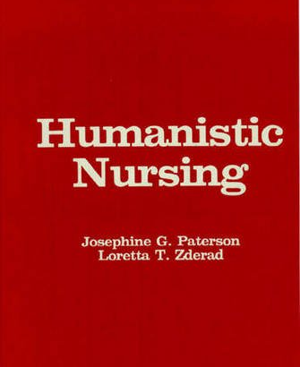
Conceptual framework
Phenomenologic Nursology
Broad guide for interactions in a call-and-response model
Health is finding meaning in existence and becoming
Nurse and patient change in relation to one another
    Spiritual Care Competence Scale for NP
    Anxiety and Well-being Scores for patients

Slide 9
Methods
Setting:
Not for profit community-based palliative care program
Sample:
Nurse Practitioners employed by the organization
Data Collection:
Chart review with spreadsheets
Data Analysis:
Descriptive and quantitative statistical analysis
Intervention:
SCCS, ISPEC©, FICA© documentation template, one-hour debrief session, repeat SCCS

Slide 10
Methods – outcome focused
Outcome One:
Rate of Spiritual Care Professional Referral
Outcome Two:
Rate of Spiritual Assessments by the Nurse Practitioner
Outcome Three:
Changes in Spiritual Care Competence Scale
Outcome Four: Changes in Patient reports levels of Anxiety and Well-being

Slide 11
Results Outcome two: rates of spiritual care assessment by the nurse practitioner
Patient were almost 3 times more
likely to be assessed at posttest
relative to pretest (OR=2.88, p<.01)

Slide 12
FICA® | Sample Questions | Documentation Examples
Faith / Belief: | Do you consider yourself spiritual or religious? Do you have spiritual beliefs that help you cope with stress? What gives you meaning? What gives you strength? | Associates strongly with religion, identifies as Catholic Spirituality is more personal, finds meaning in family/friends/work Defines spirituality as…
Importance | What importance does spirituality have in your life? Does your spirituality influence your healthcare decision making? | Very important, impacts how she deals with stress Pt wonders if he is “good enough in God’s eyes" Pt states “all of my decision-making is with God in mind”
Community | Are you part of spiritual community? Is this of support to you? Is there a group of people you really love or who are important to you? | Pt no longer able to attend mass, watches on TV, feels less connected Homebound, feel isolated from community/nature Expresses grief/loss due to not being able to practice yoga in studio Participates in a regular prayer ritual Enjoys company of family/like-minded friends – this has been restricted due to COVID
Address in Care | How would you like me to address your spirituality in your healthcare? *Newer models put this also in A/P with diagnosis of spiritual distress (if noted) | Referral to Chaplain Willing to see chaplain/spiritual provider/personal caregiver (i.e Priest, Imam, etc.) Continued presence and follow-up Referral to art therapist Discussed meditation apps and mindfulness approaches Coordinated with family regarding taking pt outside to be in nature *Can also include in A/P of documentation

Slide 13
Results outcome one: rate of spiritual care professional referral

Slide 14
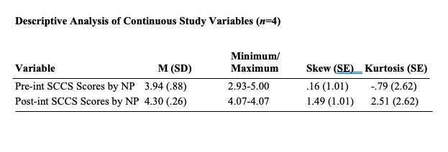
Results outcome three: Changes in Spiritual Care Competence Scale

Slide 15
Results outcome four: Changes in Patient reported levels of Anxiety and Well-being
Insufficient data available to analyze

Slide 16
Discussion
Consistent with previous studies
FICA© is a useful tool for spiritual assessments
Increase in assessment and referrals*
Increase in mean NP spiritual care competence⁻
More data needed to determine the impact on anxiety and well-being

Slide 17
Limitations
Small sample size of NPs
Missing Anxiety and Well-being score in clinical documentation
Diversity of sample

Slide 18
Conclusion
Education and training in spiritual health for nurse practitioners is beneficial
EBP Project demonstrates positive outcomes associated with standardized spiritual assessment tool

Slide 19
implications
Education
Clinical Practice
Policy

Slide 20
Recommendations for future inquiry
Larger sample size of nurse practitioners
Other settings
Associations with patient reported anxiety and well-being

Slide 21
Thank you!

