Slide 1

Does it hurt And heal? A qualitative study of the relationships among Sexual assault survivors in group therapy
Brittni Gettys M.S., Autumn Greene, Sydney Monaghan
WCU’s Virtual Research and Creativity Day
April 29th 2021

Slide 2



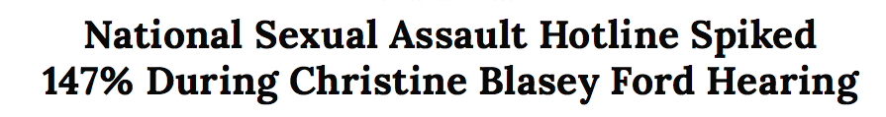
Notes:
Testified on September 27th 2018 in front of the US Supreme Court – one of the first and few times that a testimony of sexual assault was globally broadcasted.
Fun fact: sexual assault awareness month, teal is the color for SA Awareness – theme throughout presentation

Slide 3

Why study sexual assault survivors?
35% of women worldwide
1 in 3 women & 1 in 6 men will experience sexual assault in U.S.
Members of the LGBTQIA community at increased risk
Annually costs the U.S. $127 billion
30-50% of sexual assault survivors will be diagnosed with PTSD
Notes:
Sexual assault is a traumatic experience that can happen to any demographic or any individual.
Annually costs the United States $127 billion; more than any other crime including assault, murder, and drunk driving.
Treating sexual abuse is often costly and has long-term impacts on a person’s physical, emotional, mental and social well-being and has adverse affects on mental and physical health. For example….

Slide 4

Social Support
Serves as a protective factor for the development of PTSD.
Promotes self-worth, well-being and efficacy
Method for coping from the effects of traumatic experiences
Notes:
Sexual assault has been associated with an increased risk of developing post-traumatic stress disorder.
Social support is defined as the ongoing availability of one’s social network
Social support is important following exposure to sexual assault because of the interpersonal and often isolating nature of sexual assault. It is a powerful tool to help to combat the stigma one feels after being assaulted.

Slide 5
Group Therapy for Sexual Trauma
Provides context to study relationships among survivors
Understanding through shared experiences
Provide support that may not be available in survivors’ social networks
Notes:
Group psychotherapy for sexual assault survivors provides a powerful context in which survivors disclose to other survivors
Since the experience of trauma is often very isolating, survivor groups may hold an important part in the recovery process by offering a unique experience of support or understanding that may not otherwise exist in a survivor’s ordinary social environment
Despite numerous studies calling for further research in group therapy services for survivors of sexual assault, research on group therapy for the treatment of sexual assault survivors as well as trauma survivors more broadly is limited, so focusing on group therapy for sexual assault survivors will help to address this gap in the literature.

Slide 6
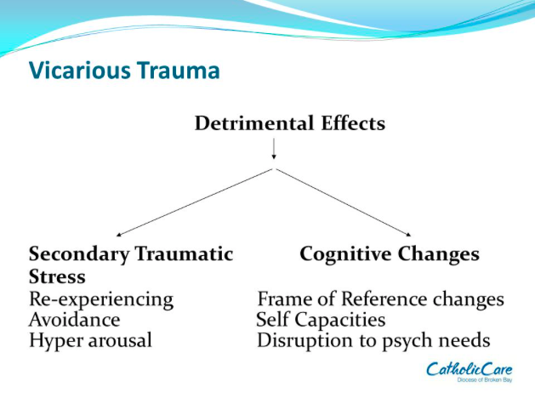
Vicarious Traumatization
Originally coined by McCann and Pearlman (1990)
The impact of traumatic stress derived from being exposed to a victim’s explicit account of a traumatic event.
Explored in the literature via therapist/client relational dyad, as well as first responders, emergency medical services, fire services, law enforcement, medical professionals, rape crisis and domestic violence counselors, social workers, and advocacy personnel.
Notes:
While support groups for sexual assault survivors can be healing, the group can also be a context where survivors end up activate traumatic stress in each other by disclosing their sexual assault experiences. There has been little research directed at understanding this phenomenon, however understanding this dynamic is necessary for the field to understand how or if group therapy is beneficial for survivors healing from sexual assault.
The construct of vicarious traumatization is similar to this phenomenon and has received attention from the literature in recent decades.
Increased exposure to clients’ traumatic experiences over time can increase a provider’s risk for developing vicarious traumatization, especially if the provider has a history of trauma exposure. It is curious if this may or may not be present amongst survivors of sexual assault with a shared trauma history.
Diagram on right shows that the symptoms of VT are very similar to the symptoms that present for PTSD

Slide 7

Shared Trauma
Occurs when a therapist AND client have experienced a similar traumatic event at some point in their lifetime.
Likely that this dynamic occurs between survivors as they help each other while healing from similar traumatic experiences
Notes:
different than vicarious traumatization because it involves a shared experience of trauma alone, or in addition to, the secondary traumatic effects from exposure to another’s account of a traumatic experience.
Despite the likelihood of the existence of this dynamic, there is a scarcity of literature exploring the presence of these two constructs within relationships between survivors of sexual assault. Currently, shared trauma is the closest concept, but it is studied exclusively through the relationship between therapist and client. The current literature has yet to explore the effects of shared and vicarious trauma among survivors of sexual abuse, beyond those who are clinicians providing psychological services to trauma-exposed populations.

Slide 8
Study Objectives
  What are the beneficial and protective factors?
  How do SA survivors utilize each other for social support within a group therapeutic context?
  What is the experience of survivors as they help peer survivors process and recover from similar traumatic experiences?
  How are survivors affected by exposure to shared trauma? How do they cope?
  Virtual therapy groups
Notes:
We seek to examine both the impact of the positive and negative effects of engaging in social support during post-trauma adjustment, so we are evaluating these aspects of social support simultaneously
We aim to explore a variety of effects within the relationship of peer-to-peer sexual assault survivor support groups, both positive and “negative” in nature.
So, overall, this study aims to examine the potential buffering and supportive effects of social support between sexual assault survivors, while also exploring the potential negative effects of vicarious traumatization and shared trauma
There is a lack of research on virtual therapy groups, therefore it is unknown how the virtual or remote modality may affect the sense of support experienced by members within these groups. While this was not an original objective of the study, the current study will contribute to this new area of research.

Slide 9
Participants
4-6 individuals
Selected from sexual assault support groups from college counseling centers and non-profit sexual assault victim services organizations.
  a) they are currently participating in a support group for sexual assault survivors and
  (b) they are eighteen years of age or older.
Individuals of all ages, races/ethnicity, sexual orientations, gender identities, and socioeconomic classes will be invited to participate in the research, given they meet the inclusion criteria
Notes:
Participants are being recruited from college counseling centers and non-profit crime victim services

Slide 10
Method – Interview Protocol
The potential healing effects of group therapy for sexual trauma
The extent with which relationships among sexual assault survivors facilitated healing and trauma recovery
Experiences of shared trauma or vicarious traumatization during participation in group therapy
How participants' coped with exposure to the sexual trauma of other group members
Notes:
Qualitative design using open-ended, semi-structured interviews lasting approximately one hour in duration
Interview Protocol assesses for the following domains:

Slide 11
Semi-Structured Interview Protocol
Questions designed by the primary researcher include the following:
Are there any helpful aspects of this group or some things you like about this group?
Are there any things about the group that you wish were different—anything you find unhelpful or that you don’t like?
When you hear others share their experiences in the group, does it make you think of your own experiences? If so, is that helpful--how? Is it uncomfortable--how?
Do you see group leaders help to manage the thoughts and feelings of all group members? In other words, do group leaders seem to know how to respond when members are sharing about traumatic experiences?
What do you think could be done to better support survivors in their healing process?
Notes:
A variety of questions will be asked of participants, some examples are:

Slide 12
Procedure
Fliers disseminated to agencies. Group leaders will disseminate fliers and provide information to the group members about the purpose of the study and will invite group members to participate in the semi-structured interview.
Group members sign the consent form and schedule an interview with the PI via a HIPPA compliant secure email service.
Interviews conducted remotely from an audio/visual recording lab in Wayne Hall
Recordings will be stored in a locked filing cabinet in the lab that only the PI, research team and dissertation supervisor have access to.
The PI and research team will de-identify and transcribe and the recordings for coding and data analysis.
Notes:
Contacting organizations and clinicians that lead each of the groups with fliers and information about the purpose of the study to invite the group members to participate in the research
Recording in the video lab allows the Zoom interviews to be downloaded and saved directly to password encrypted flash drives and will not be saved on Zoom.

Slide 13
Data Analysis
The analytic approach for this research will follow the coding steps of thematic analysis outlined by Braun & Clarke (2006).
Results will be analyzed through generating initial codes from the data set of participant interviews, analyzing codes to find and define themes, and lastly selecting the participants' statements to provide examples of themes across the data set.
This qualitative study will utilize multiple coders and inter-rater reliability will be calculated to increase reliability of the coding procedure and identified themes.

Slide 14
Implications
Expand the current literature on sexual assault
Increased understanding of buffering and supportive effects among sexual assault survivors and how these effects act as aids in the healing process
Further clarity on variables related to the effect of group therapy for sexual assault survivors and inform group treatment of sexual assault survivors
Ientify and discover potential risks of group treatment including re-traumatization and vicarious traumatization to sexual assault survivors when sharing experiences and how clinicians can help mitigate this risk
Add to the currently limited research on virtual modalities of mental health services
Notes:
Slide 2: This study will provide deeper understanding of buffering and supportive effects among sexual assault survivors and how these effects act as aids in the healing process.

